Slide 1
Figures – PAGES Magazine 23(1) 2015
Please cite the PAGES magazine article and, if available, the original reference when using a figure. See note section below the figures for details.

Slide 2
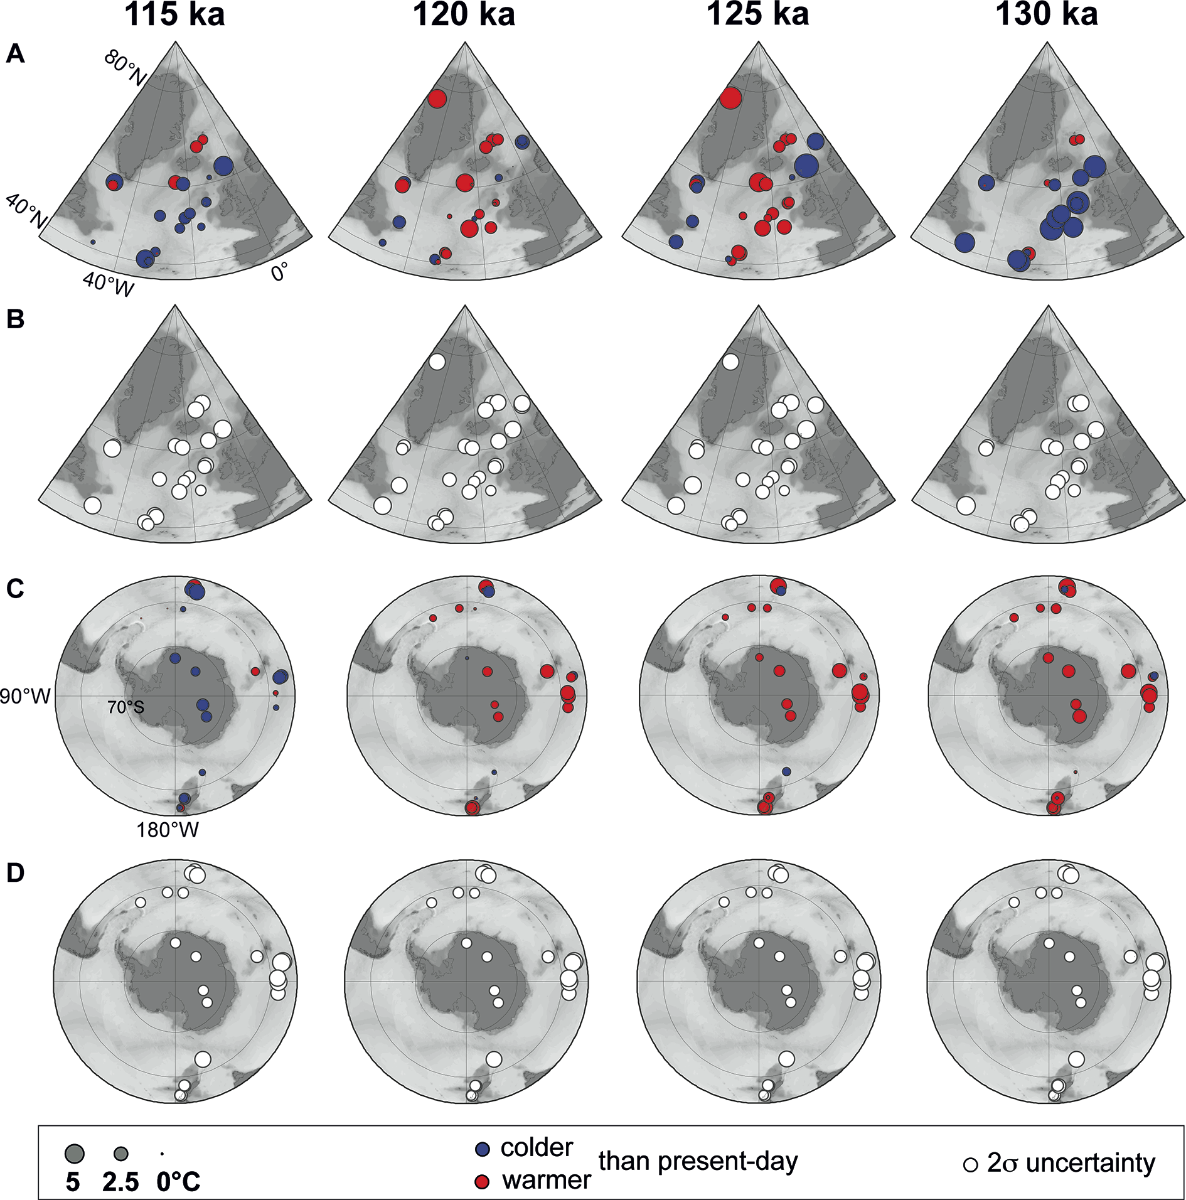
Notes:
Figure 1: Temperature time slices across the Last Interglacial. NH air and sea surface temperature anomalies (A) associated with 2σ uncertainties (B). (C) and (D) are the same as (A) and (B) for the SH. The size of the dots (both for temperature anomaly and associated 2σ uncertainty) follows the temperature scale given in the box. For all panels, warming (cooling) compared with modern temperature is represented in red (purple). The temperature anomalies are relative to the World Ocean Atlas (WOA) 1998, 10 m-depth data for marine records and relative to present-day instrumental surface air temperature measurements for ice records.
A new Last Interglacial temperature data synthesis as an improved benchmark for climate modeling
Emilie Capron1, A. Govin2 and E.J. Stone3
AFFILIATIONS
1British Antarctic Survey, Cambridge, UK
2MARUM/Center for Marine Environmental Sciences, University of Bremen, Germany
3School of Geographical Sciences, University of Bristol, UK
CONTACT
Emilie Capron: ecap@bas.ac.uk

Slide 3
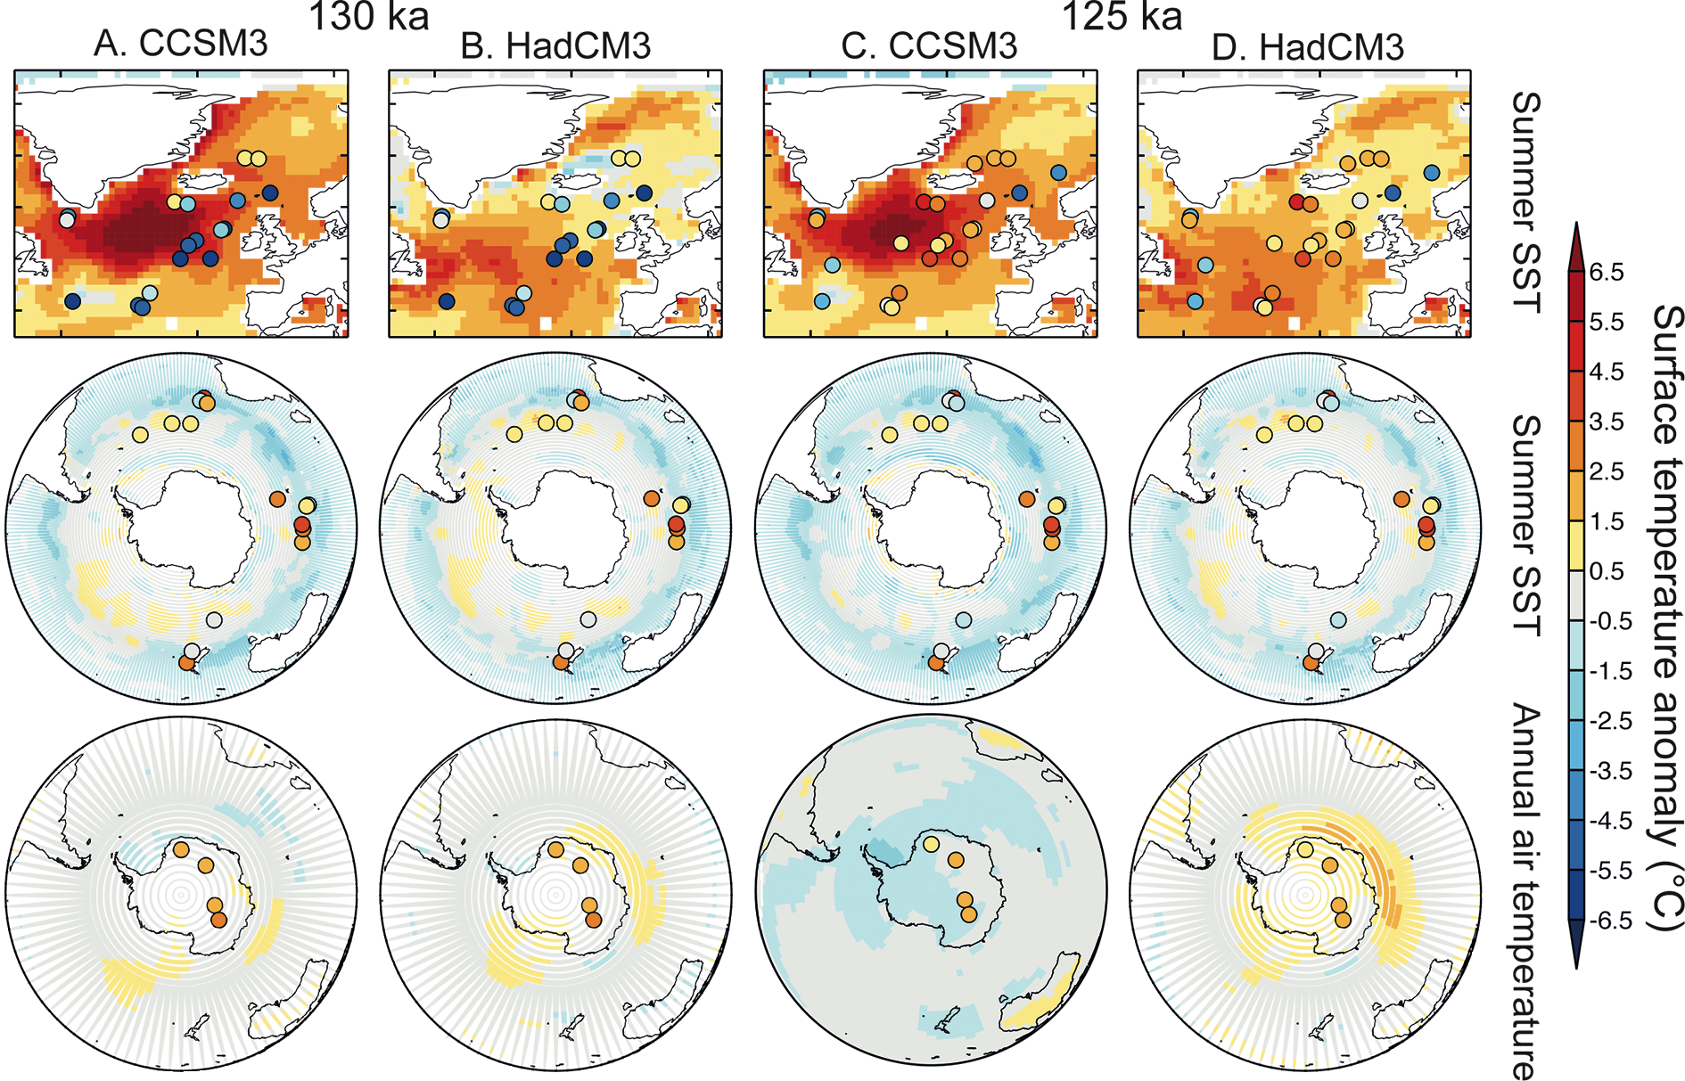
Notes:
Figure 2: Model-data comparison of time slice reconstructions for 130 ka (A and B) and 125 ka (C and D) with respective snapshot simulations using the CCSM3 and HadCM3 models. Summer SST temperature anomalies from the marine sediment data (dots) superimposed onto model July-August-September SSTs in the NH and model January-February-March SSTs in the Southern Ocean; Annual mean surface air temperature anomalies from ice core data (dots) superimposed onto the model annual surface air temperature.
A new Last Interglacial temperature data synthesis as an improved benchmark for climate modeling
Emilie Capron1, A. Govin2 and E.J. Stone3
AFFILIATIONS
1British Antarctic Survey, Cambridge, UK
2MARUM/Center for Marine Environmental Sciences, University of Bremen, Germany
3School of Geographical Sciences, University of Bristol, UK
CONTACT
Emilie Capron: ecap@bas.ac.uk

Slide 4
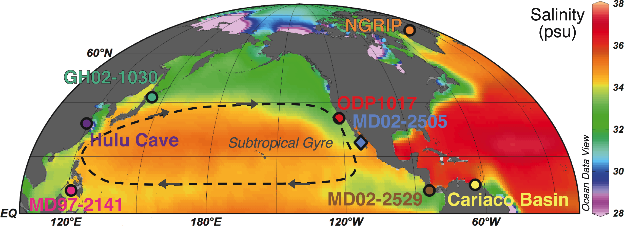
Notes:
Figure 1: Modern Northern Hemisphere Sea surface salinity and location of the studied paleoclimatic records. Salinity data are from Ocean Data View (http://odv.awi.de/en/data/ocean/world_ocean_atlas_2005/).
Widespread salinification of the North Pacific Ocean during the last glacial termination
Laura Rodríguez-Sanz1 and P. Graham Mortyn2,3
AFFILIATIONS
1Research School of Earth Science, The Australian National University, Canberra, Australia
2Institute of Environmental Science and Technology, Universitat Autònoma de Barcelona, Spain
3Department of Geography, Universitat Autònoma de Barcelona, Spain
CONTACT
Laura Rodríguez Sanz: laura.rodriguez@anu.edu.au

Slide 5
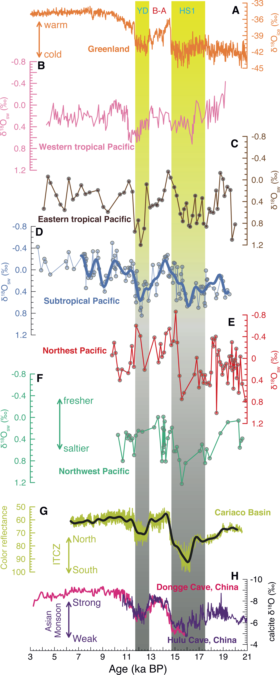
Notes:
Figure 2: Paleohydrologic records from across the North Pacific compared to key paleoclimatic records. (A) Climate variability recorded in the Greenland NGRIP ice core δ18O. Ice-volume corrected seawater δ18O from the (B) western (Rosenthal et al. 2003) and (C) eastern (Leduc et al. 2007) tropical Pacific, the (D) subtropical eastern Pacific (Rodríguez-Sanz et al. 2013), and the mid-latitude (E) northeastern (Pak et al. 2012) and (F) northwestern Pacific (Sagawa and Ikehara 2008). (G) Intertropical Convergence Zone (ITCZ) position, (Deplazes et al. 2013); (H) Asian Monsoon strength (Wang et al. 2001; Yuan et al. 2004). See Fig. 1 for the names and locations of sites. HS1, Heinrich Stadial 1; B-A, Bølling-Allerød; YD, Younger Dryas.
Widespread salinification of the North Pacific Ocean during the last glacial termination
Laura Rodríguez-Sanz1 and P. Graham Mortyn2,3
AFFILIATIONS
1Research School of Earth Science, The Australian National University, Canberra, Australia
2Institute of Environmental Science and Technology, Universitat Autònoma de Barcelona, Spain
3Department of Geography, Universitat Autònoma de Barcelona, Spain
CONTACT
Laura Rodríguez Sanz: laura.rodriguez@anu.edu.au

Slide 6
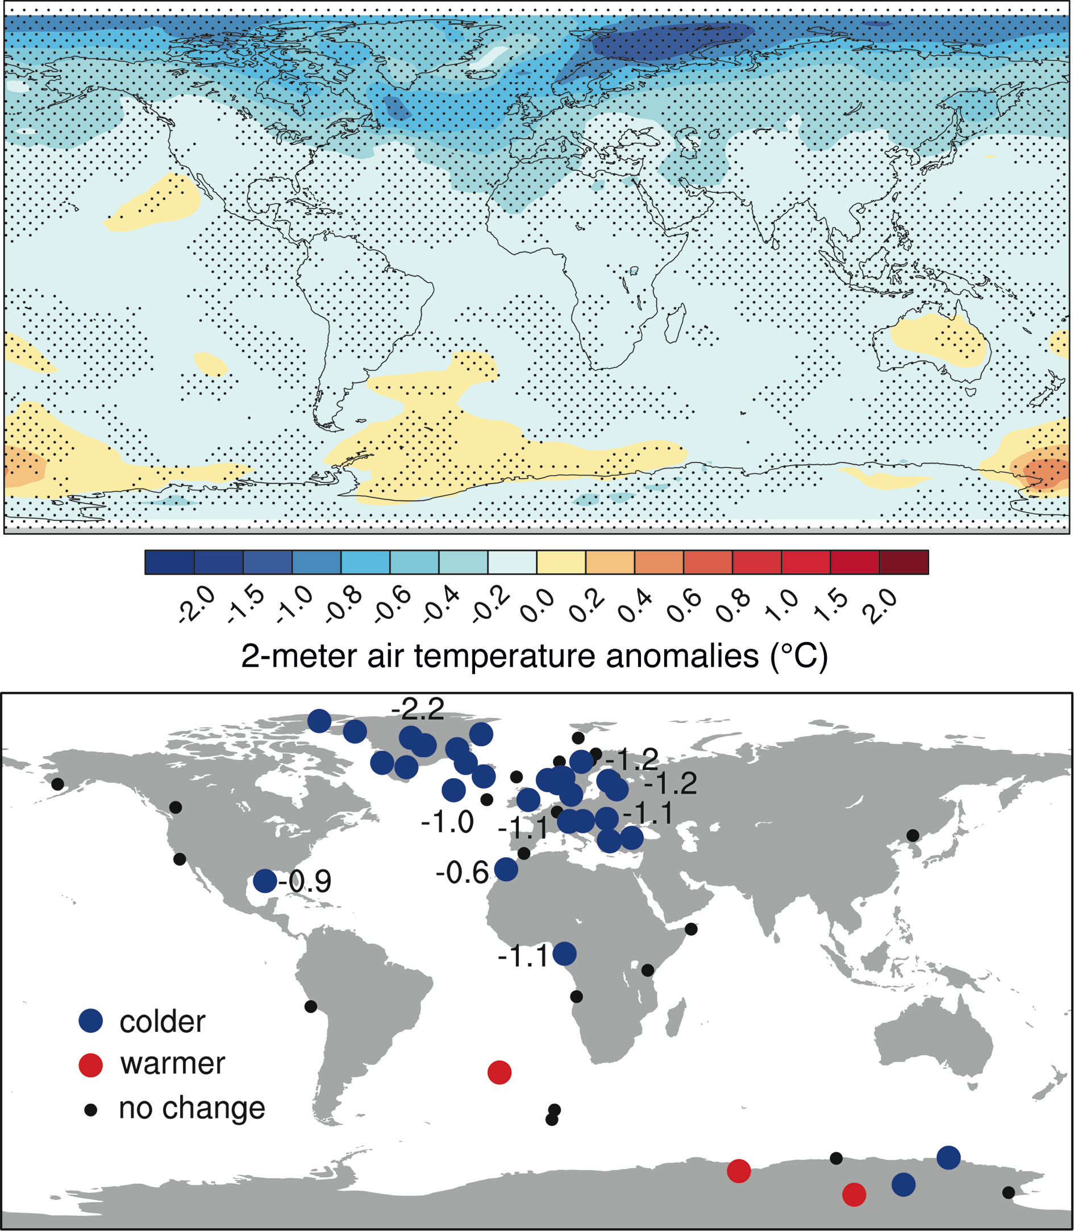
Notes:
Figure 1: Comparison of mean annual temperature anomalies for the 8.2 kyr event from a multi-model ensemble (top) and proxy evidence (bottom). Stippling shows grid cells where at least three of four simulations agree on the sign of the temperature anomaly. Quantitative estimates of temperature anomalies from proxies are shown in degrees Celsius.
Freshwater release and volcanic eruptions as drivers of abrupt changes during interglacial climate
D.M. Roche1,2, H. Renssen1, C. Morrill3,4, H. Goosse5 and A. Mairesse5
AFFILIATIONS
1Department of Earth Sciences, VU University of Amsterdam, The Netherlands
2Laboratoire des Sciences du Climat et de l’Environnement (LSCE), Gif-sur-Yvette Cedex, France
3Cooperative Institute for Research in Environmental Sciences, University of Colorado, Boulder, USA
4NOAA’s National Climatic Data Center, Boulder, USA
5Georges Lemaître Centre for Earth and Climate Research, Université catholique de Louvain, Louvain-la-Neuve, Belgium
CONTACT
Didier Roche: didier.roche@lsce.ipsl.fr

Slide 7
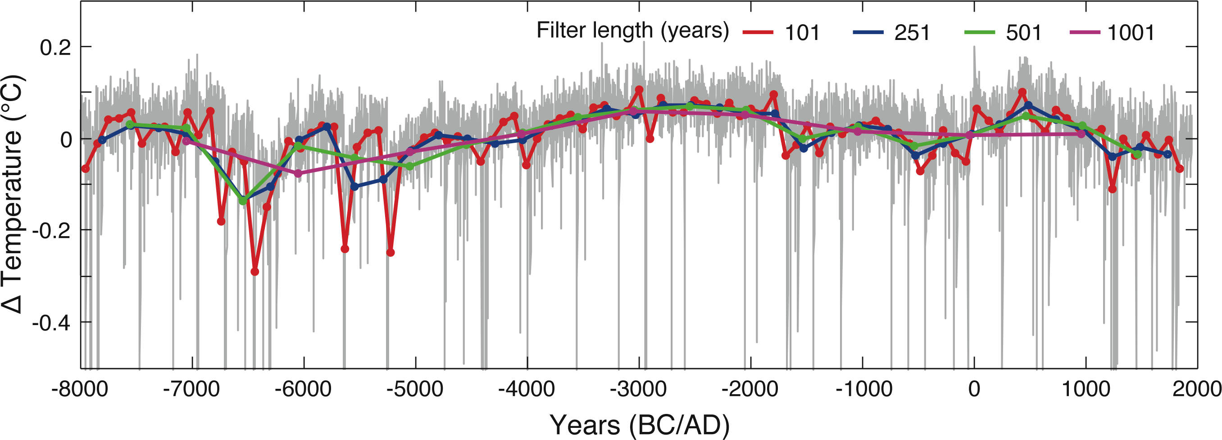
Notes:
Figure 2: Global annual mean temperature difference between the simulation with and without volcanism. Gray curve is the unfiltered simulation. Also shown are temperature filtered by a running mean of 101 (red), 251 (blue), 501 (green) and 1001 (pink) years. Note that the vertical scale does not show the whole range of extreme values. The strongest annual global cooling was 6 °C (in 6500 BC).
Freshwater release and volcanic eruptions as drivers of abrupt changes during interglacial climate
D.M. Roche1,2, H. Renssen1, C. Morrill3,4, H. Goosse5 and A. Mairesse5
AFFILIATIONS
1Department of Earth Sciences, VU University of Amsterdam, The Netherlands
2Laboratoire des Sciences du Climat et de l’Environnement (LSCE), Gif-sur-Yvette Cedex, France
3Cooperative Institute for Research in Environmental Sciences, University of Colorado, Boulder, USA
4NOAA’s National Climatic Data Center, Boulder, USA
5Georges Lemaître Centre for Earth and Climate Research, Université catholique de Louvain, Louvain-la-Neuve, Belgium
CONTACT
Didier Roche: didier.roche@lsce.ipsl.fr

Slide 8
Notes:
Figure 1: The penultimate (left) and last (right) deglaciations in Greenland, off Iberia, and Antarctica. From top to bottom: the precessional oscillation; climate variability traced by the Greenland NGRIP ice core (75ºN); alkenone-derived sea surface temperatures (SST) and total alkenone amount from marine sediment core ODP-976 (36ºN); and climate variability registered in the EPICADronning Maud Land ice core (75ºS). Two main structures relevant to inter-hemispherical connections stand out: the ‘‘Ws’’ and the ‘‘saddles”.
Multi-decadal temperature changes off Iberia over the last two deglaciations and interglacials and their connection with the polar climate
Belen Martrat1,2, P.C. Tzedakis3, V. Margari3, L.C. Skinner2, D.A. Hodell2 and J.O. Grimalt1
AFFILIATIONS
1Department of Environmental Chemistry, Institute of Environmental Assessment and Water Research (IDÆA-CSIC), Barcelona, Spain
2Department of Earth Sciences, University of Cambridge, UK
3Department of Geography, University College London, UK
CONTACT
Belen Martrat: belen.martrat@idaea.csic.es

Slide 9
Notes:
Figure 2: The last (left) and present (right) interglacials in Greenland, off Iberia and Antarctica. The descriptions of the individual curves are the same as for Figure 1. The distinctive feature is the “cooling trend”, calculated between perihelion passage in the NH autumn equino x and winter solstice – and the bipolar -seesaw variability that ensues.
Multi-decadal temperature changes off Iberia over the last two deglaciations and interglacials and their connection with the polar climate
Belen Martrat1,2, P.C. Tzedakis3, V. Margari3, L.C. Skinner2, D.A. Hodell2 and J.O. Grimalt1
AFFILIATIONS
1Department of Environmental Chemistry, Institute of Environmental Assessment and Water Research (IDÆA-CSIC), Barcelona, Spain
2Department of Earth Sciences, University of Cambridge, UK
3Department of Geography, University College London, UK
CONTACT
Belen Martrat: belen.martrat@idaea.csic.es

Slide 10
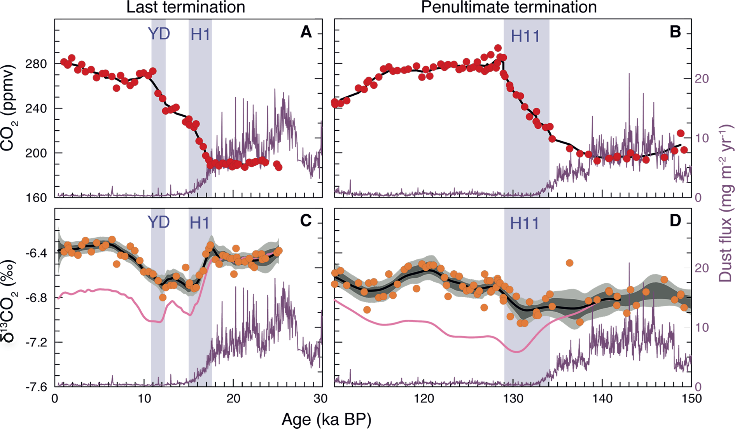
Notes:
Figure 1: Evolution of atmospheric CO2 (red dots), δ13CO2 (orange dots), and dust flux (purple line) over the last two glacial/interglacial transitions and the subsequent interglacial periods. All measurements were performed on the EPICADome C ice core. The dark and light grey shaded fields represent the 1σ and 2σ errors of a Monte Carlo spline average of the δ13CO2 (black line; Schmitt et al. 2012; Schneider et al. 2013). The pink line indicates the δ13Catm spline after a first order correction for global sea surface temperature changes. High-resolution eolian dust fluxes (purple line; Lambert et al. 2012) provide a measure for Southern Ocean Fe fertilization. YD =Younger Dryas, H = Heinrich events.
Ice core-based isotopic constraints on past carbon cycle changes
Hubertus Fischer1, J. Schmitt1, S. Eggleston1, R. Schneider1, J. Elsig1, F. Joos1, M. Leuenberger1, T.F. Stocker1, P. Köhler2, V. Brovkin3 and J. Chappellaz4
AFFILIATIONS
1Climate and Environmental Physics, Physics Institute and Oeschger Centre for Climate Change Research, University of Bern, Switzerland
2Alfred Wegener Institute, Helmholtz Centre for Polar and Marine Research, Bremerhaven, Germany
3Max Planck Institute for Meteorology, Hamburg, Germany
4UJF–Grenoble 1/CNRS, Laboratoire de Glaciologie et Géophysique de l’Environnement (LGGE), Grenoble, France
CONTACT
Hubertus Fischer: hubertus.fischer@climate.unibe.ch

Slide 11
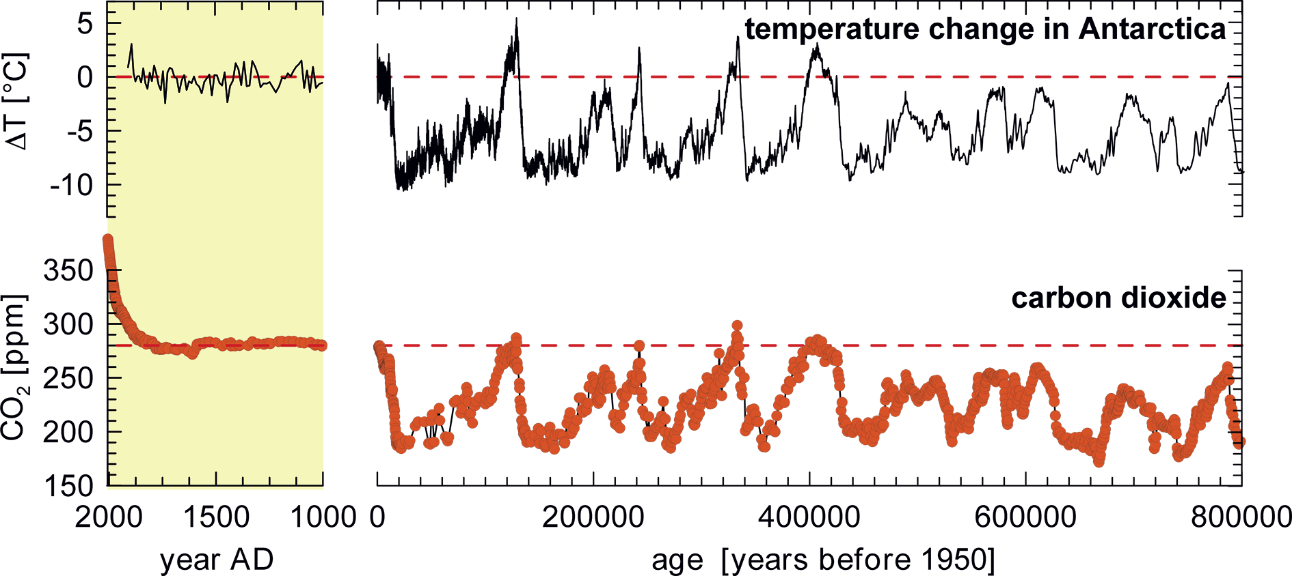
Notes:
Figure 2: Right: Antarctic temperature and CO2 variations over the last 800,000 years. Ice sheet surface temperature change was calculated from δD measured on the EPICAice core from Dome C (EPICAcommunity members 2004), CO2 concentrations were measured on the Antarctic Dome C and Vostok ice cores (Lüthi et al. 2008; Petit et al. 1999). Left: Blow up of Antarctic temperature (EPICAcommunity members 2004) and CO2 concentration changes (MacFarling Meure et al. 2006) over the last 1000 years.
Ice core-based isotopic constraints on past carbon cycle changes
Hubertus Fischer1, J. Schmitt1, S. Eggleston1, R. Schneider1, J. Elsig1, F. Joos1, M. Leuenberger1, T.F. Stocker1, P. Köhler2, V. Brovkin3 and J. Chappellaz4
AFFILIATIONS
1Climate and Environmental Physics, Physics Institute and Oeschger Centre for Climate Change Research, University of Bern, Switzerland
2Alfred Wegener Institute, Helmholtz Centre for Polar and Marine Research, Bremerhaven, Germany
3Max Planck Institute for Meteorology, Hamburg, Germany
4UJF–Grenoble 1/CNRS, Laboratoire de Glaciologie et Géophysique de l’Environnement (LGGE), Grenoble, France
CONTACT
Hubertus Fischer: hubertus.fischer@climate.unibe.ch

Slide 12
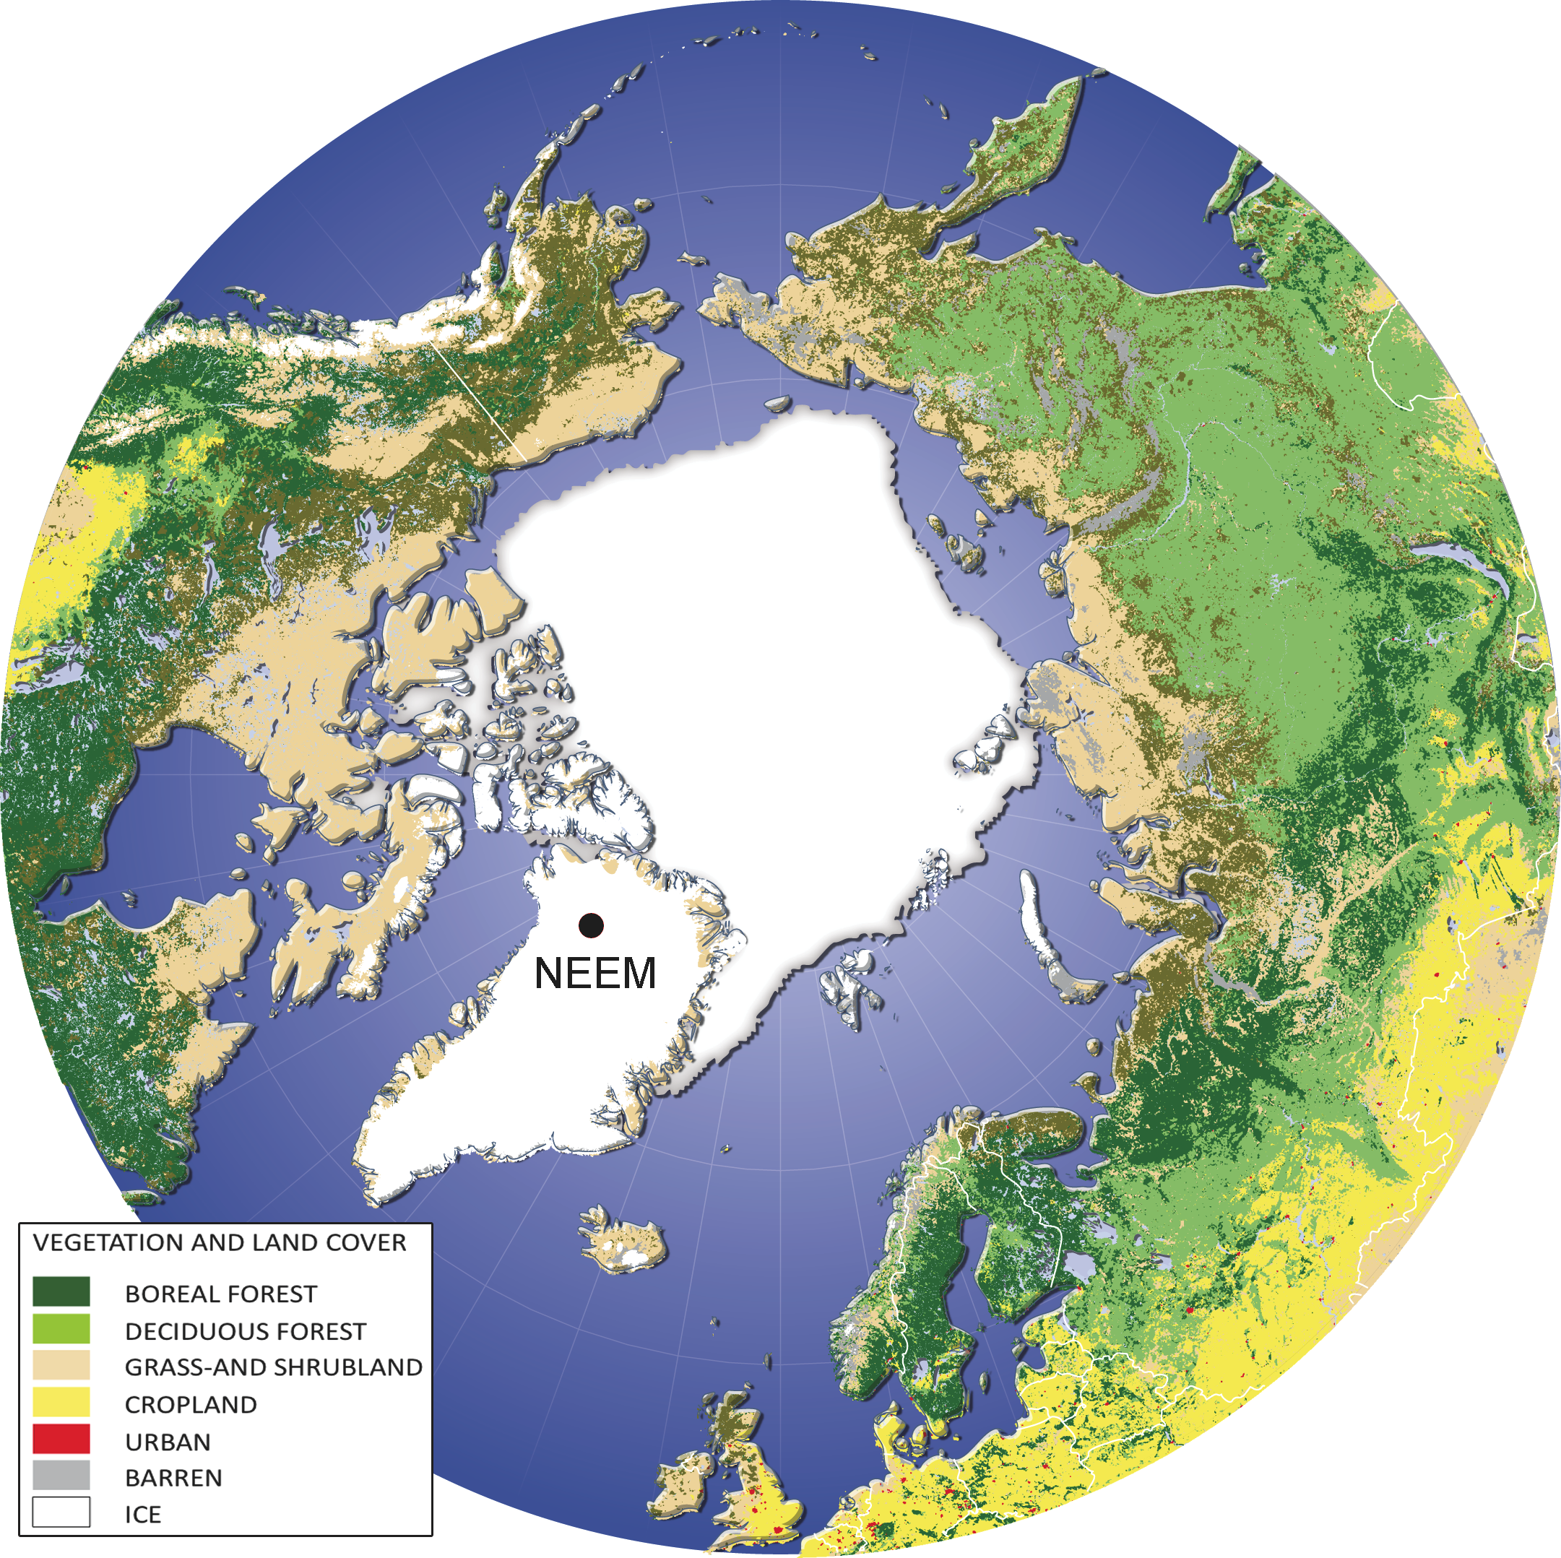
Notes:
Figure 1: Distribution of the high northern latitude land cover and location of the NEEM ice core drilling site at 77.49°N, 51.2°W, 2480 m above sea level. Modified from the European Commission Global Land Cover 2000 database and based on the work of cartographer Hugo Alhenius UNEP/GRIP-Arendal.
Two thousand years of boreal biomass burning recorded in the NEEMice cores
Natalie Kehrwald1, P. Zennaro1,2, S. Schüpbach3, T. Kirchgeorg1, J. R. McConnell4, R. Zangrando2, A. Gambaro1, and C. Barbante1,2,5
AFFILIATIONS
1Department of Environmental Science, Informatics and Statistics, Cà Foscari University of Venice, Italy
2IDPA-CNR, Venice, Italy
3Climate and Environmental Physics, Physics Institute and Oeschger Centre for Climate Change Research, University of Bern, Switzerland
4Desert Research Institute, Department of Hydrologic Sciences, Reno, USA
5Centro B. Segre, Accademia Nazionale dei Lincei, Rome, Italy
CONTACT
Natalie Kehrwald: Kehrwald@unive.it

Slide 13
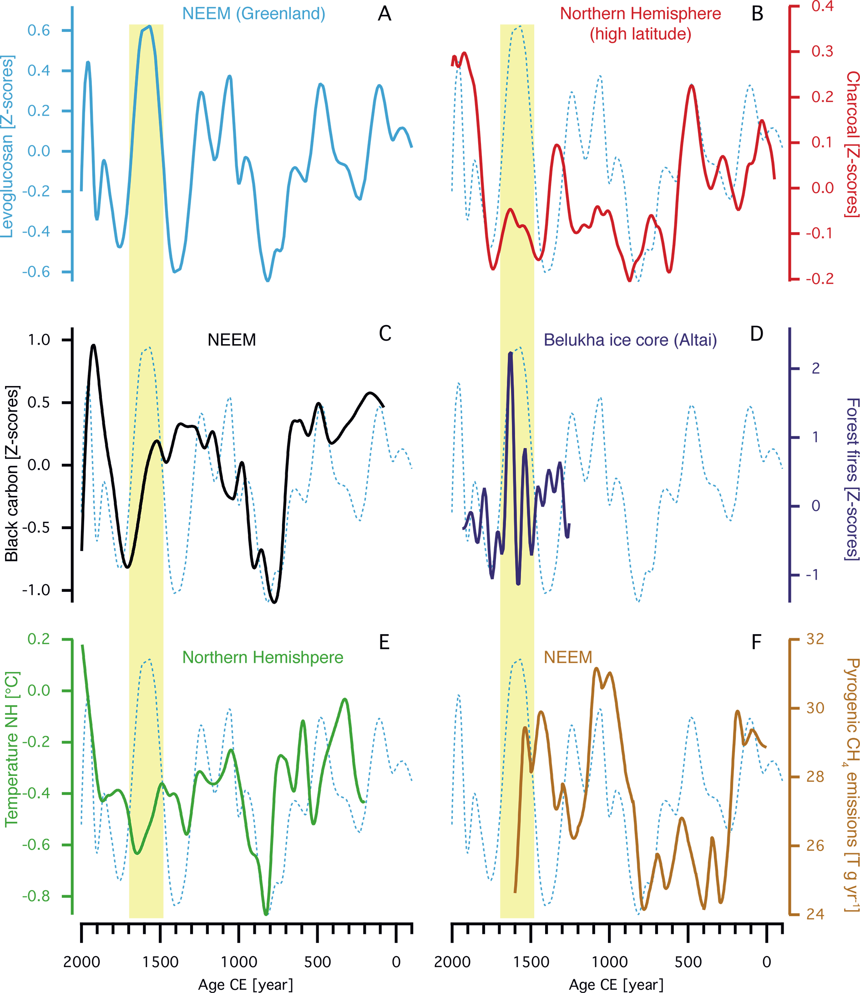
Notes:
Figure 2: Climatic and environmental records over the past 2000 years, presented as z-scores smoothed by incorporating the nearest 10% of data. (A) NEEM levoglucosan concentrations; (B) Boreal charcoal concentrations (Marlon et al. 2008); (C) NEEM black carbon versus levoglucosan concentrations; (D) Siberian forest fire reconstruction (Eichler et al. 2011); (E) Northern Hemisphere land temperature (Mann et al. 2008); (F) NEEM pyrogenic CH4 emissions (Sapart et al. 2012). Dashed blue lines in panels B-F are the levoglucosan record from Afor reference. The yellow vertical bar marks the levoglucosan-based 17th century fire activity maximum highlighted in the text.
Two thousand years of boreal biomass burning recorded in the NEEMice cores
Natalie Kehrwald1, P. Zennaro1,2, S. Schüpbach3, T. Kirchgeorg1, J. R. McConnell4, R. Zangrando2, A. Gambaro1, and C. Barbante1,2,5
AFFILIATIONS
1Department of Environmental Science, Informatics and Statistics, Cà Foscari University of Venice, Italy
2IDPA-CNR, Venice, Italy
3Climate and Environmental Physics, Physics Institute and Oeschger Centre for Climate Change Research, University of Bern, Switzerland
4Desert Research Institute, Department of Hydrologic Sciences, Reno, USA
5Centro B. Segre, Accademia Nazionale dei Lincei, Rome, Italy
CONTACT
Natalie Kehrwald: Kehrwald@unive.it

Slide 14
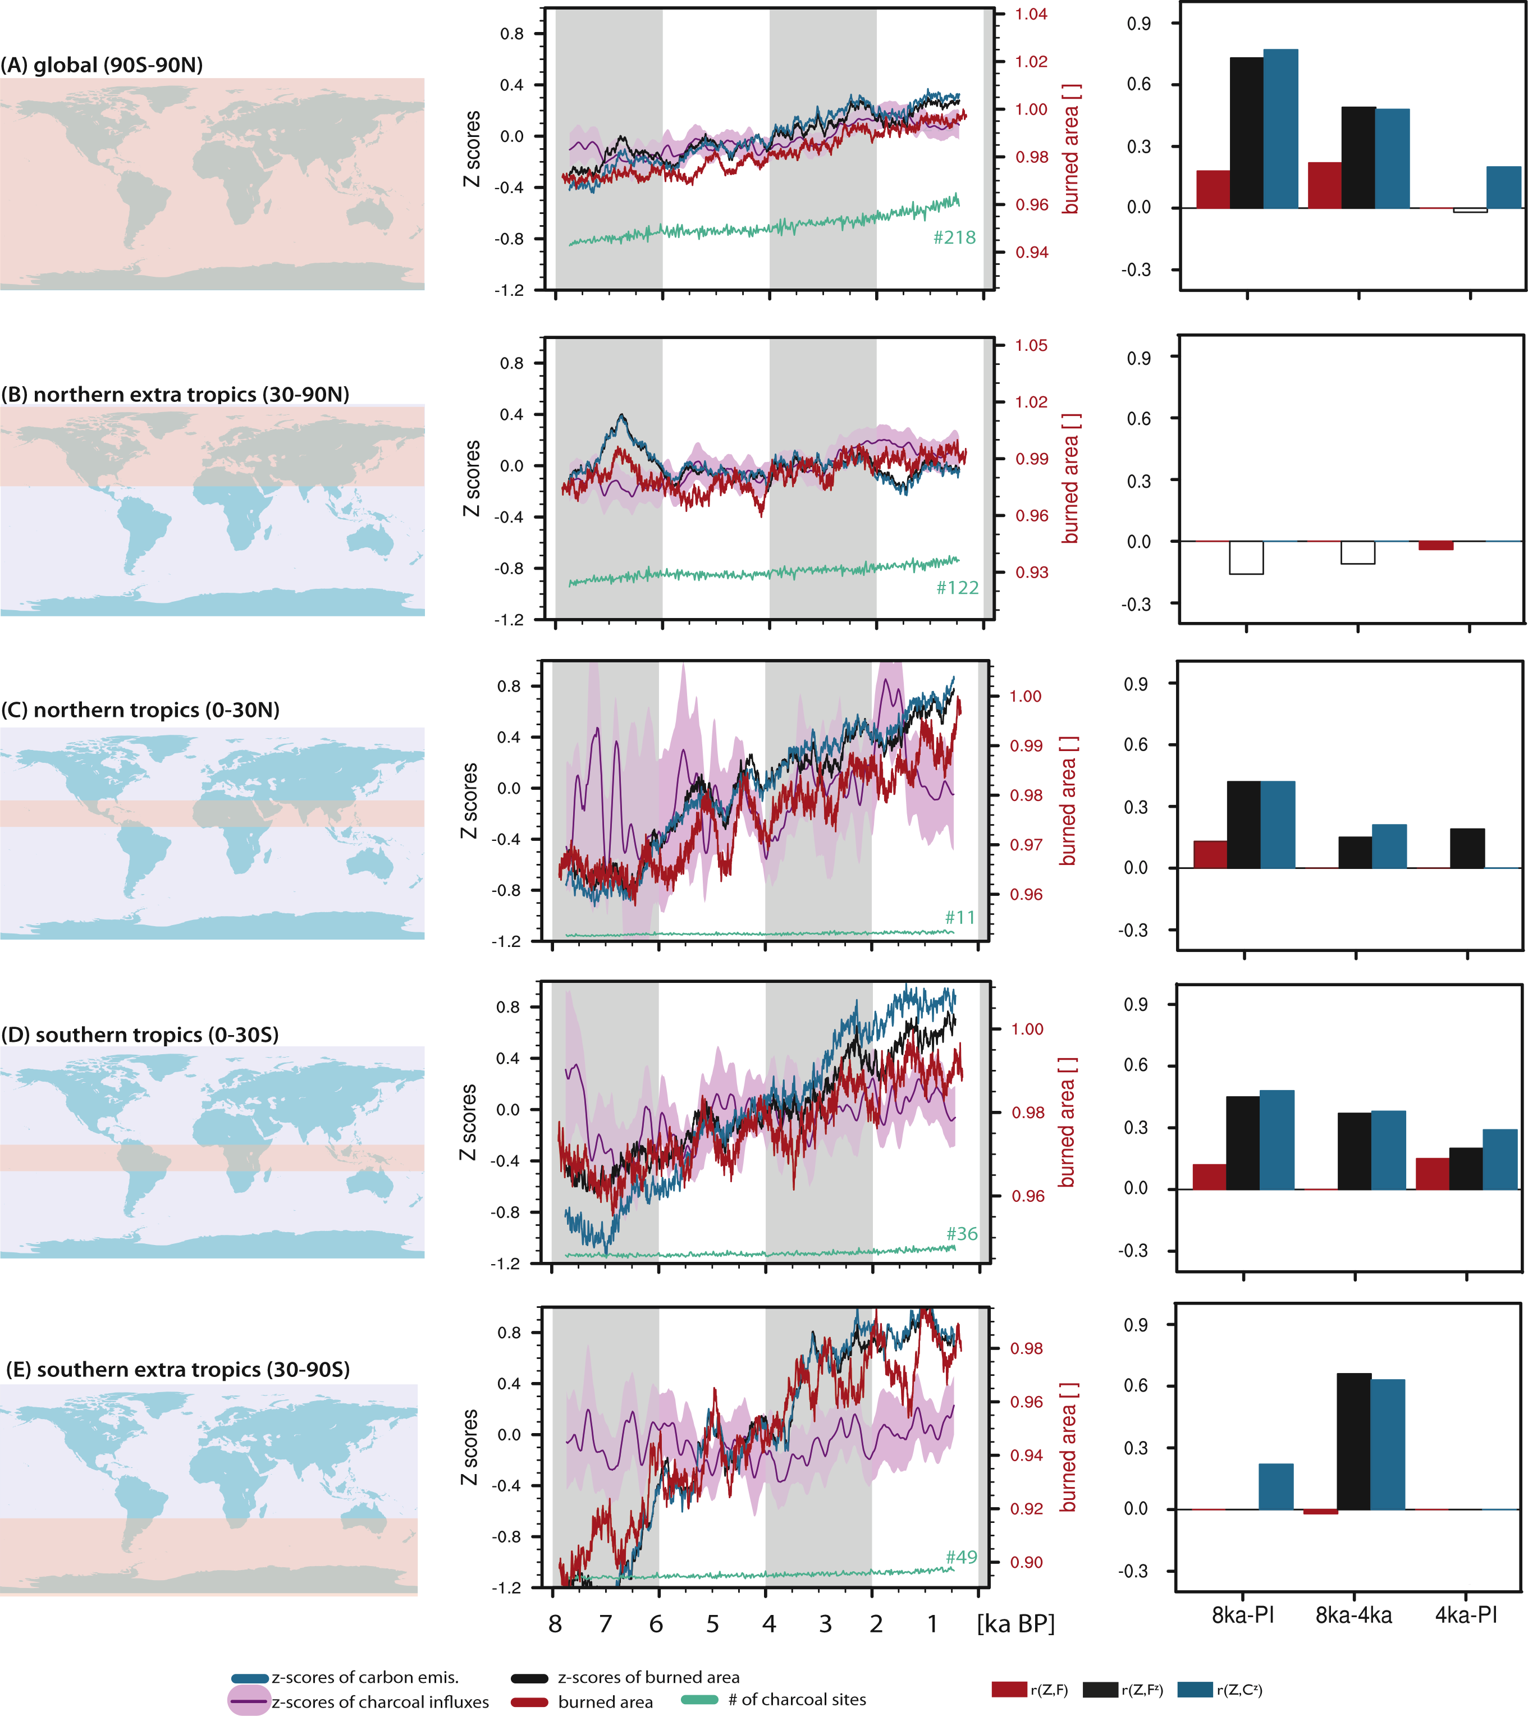
Notes:
Figure 1: Reconstructed and modeled biomass burning over the last 8 ka. Curves represent zonal averages smoothed with a 250-year running mean on global (A), extra tropical (B, E) and tropical (C, D) scales. reconstructions are shown by Z-scores of charcoal influxes (pink). Model output is given by untransformed burned area (red) and by the Z-score transformed values of modeled burned area (black) and fire-related carbon emissions (blue). The corresponding bar charts on the right hand side show the regional correlation between charcol records and model results (burned area, Z-score transformed values of burned area and fire-related carbon emissions seperately. Values are given for the full time series (8 ka-PI) and the first and last 4000 years, signicant and positive values are shown by filled bars.
How to compare modeled fire dynamics with charcoal records?
Tim Brücher1, V. Brovkin1, S. Kloster1, J.R. Marlon2 and M.J. Power3
AFFILIATIONS
1Max Planck Institute for Meteorology, Hamburg, Germany
2School of Forestry and Environmental Studies, Yale University, New Haven, USA
3Natural History Museum of Utah, Department of Geography, University of Utah, Salt Lake City, USA
CONTACT
Tim Brücher: tim.bruecher@mpimet.mpg.de

Slide 15
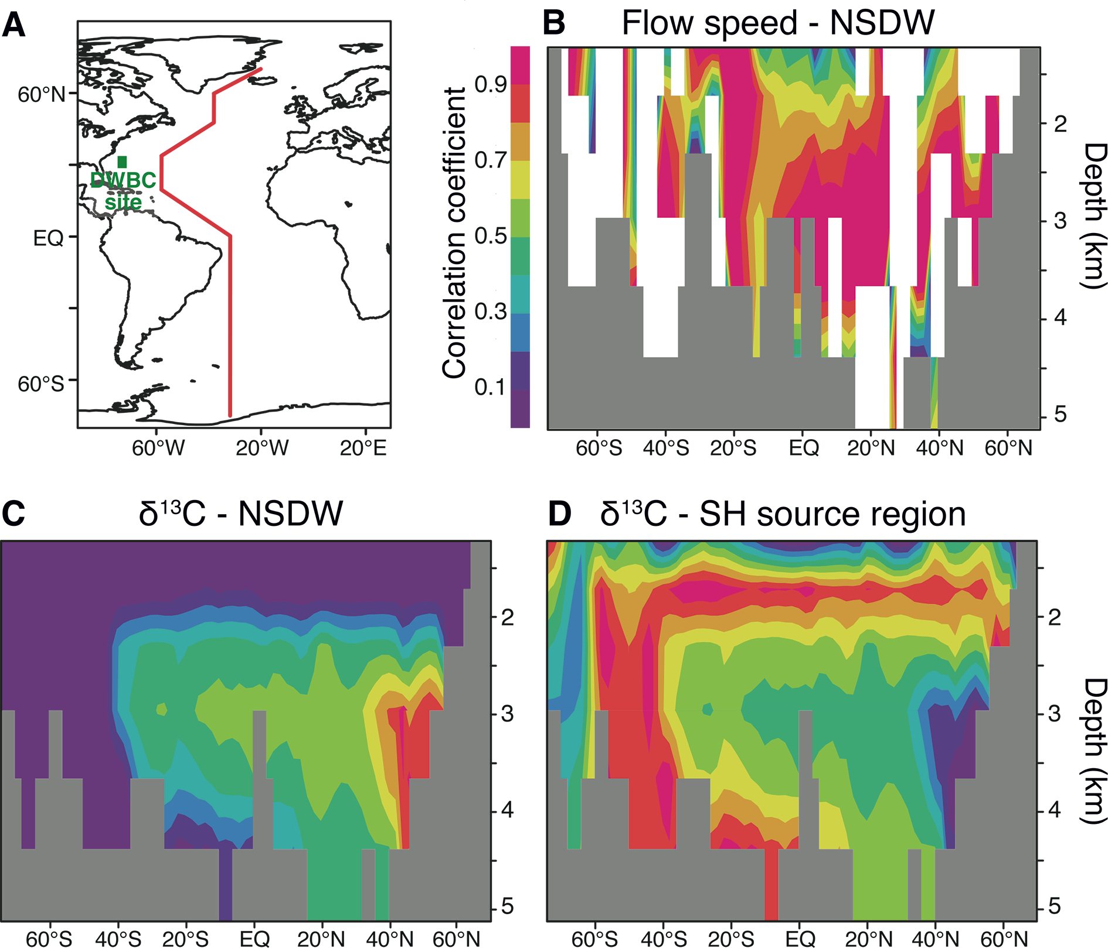
Notes:
Figure 1: Correlations between AMOC driving factors and simulated flow speeds or δ13C along a vertical transect through the Atlantic. (A) Map showing the transect path (red line) and the site used in Fig. 2 (green rectangle). (B) Correlations of the flow speed with NSDW. Correlation of δ13C with (C) NSDW, and (D) SH-source region δ13C changes. The cross-section roughly follows the western boundary of the Atlantic basin. Gray shading means bottom topography; white shading means that no linear combination of the drivers yielded a correlation with the flow speed changes above 0.5.
Modeling deep ocean flow speeds and δ¹³Cduring the Last Interglacial: Towards a more direct model-data comparison
Pepijn Bakker1,2, A. Govin3, D. Thornalley4, D. Roche1,5 and H. Renssen1
AFFILIATIONS
1Faculty of Earth and Life Sciences, VU University Amsterdam, The Netherlands
2College of Earth, Ocean, and Atmospheric Sciencees, Oregon State University, USA
3MARUM - Center for Marine Environmental Sciences, University of Bremen, Germany
4Department of Geography, University College London, UK
5Laboratoire des Sciences du Climat et de l’Environnement, Gif-sur-Yvette, France
CONTACT
Pepijn Bakker: pbakker@ceoas.oregonstate.edu

Slide 16
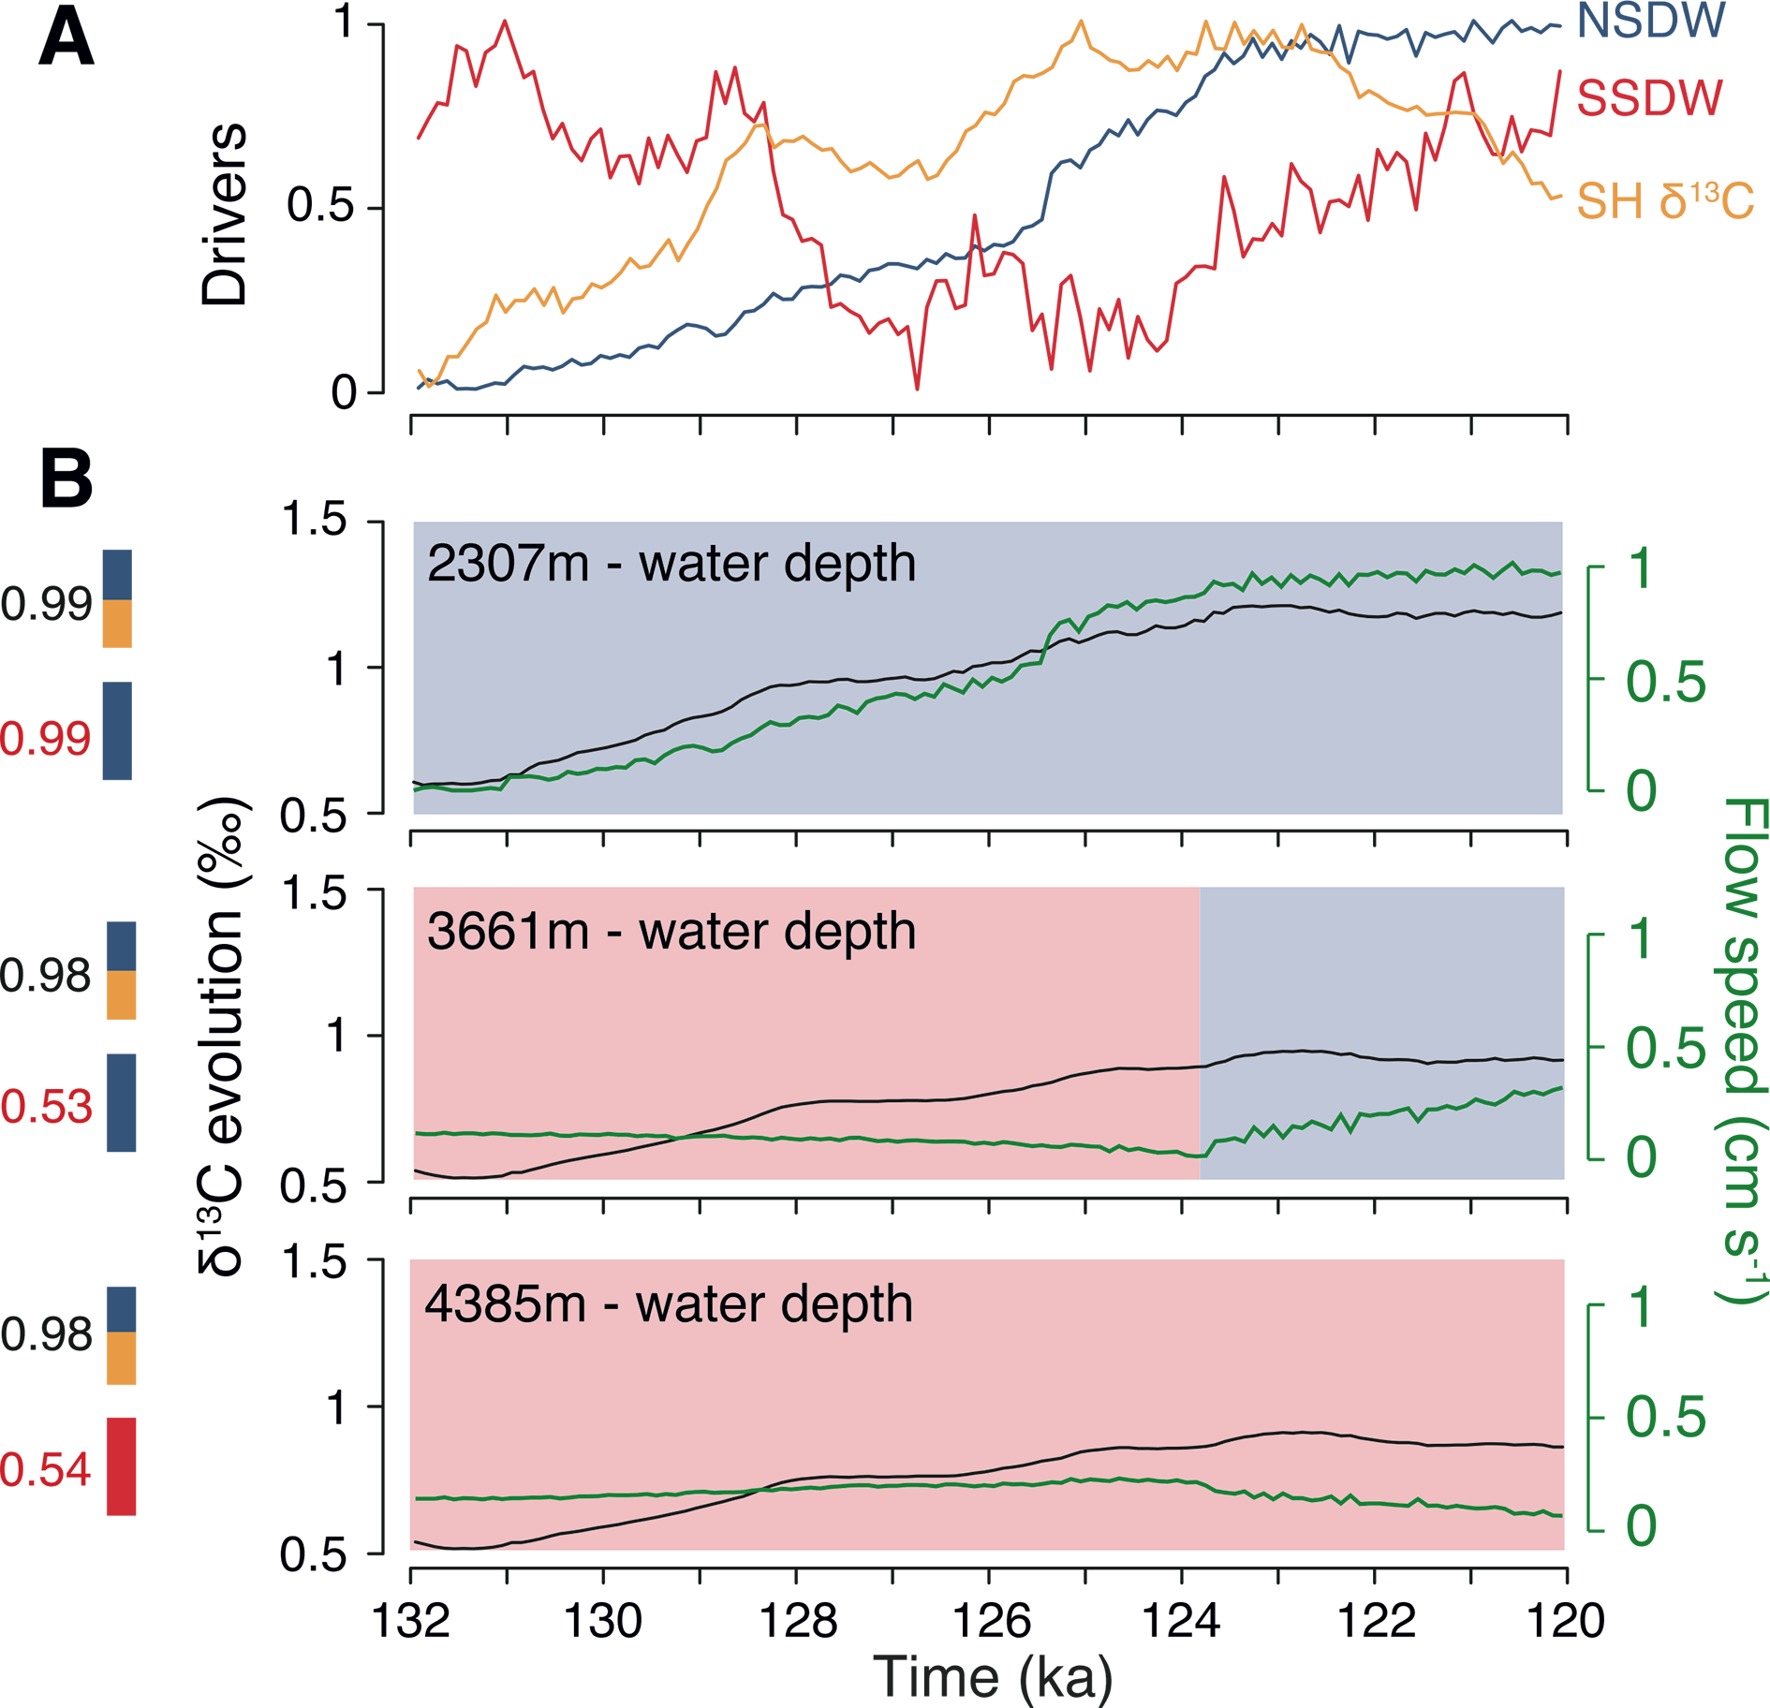
Notes:
Figure 2: Comparison of the simulated evolution of AMOC indicators during the LIG and their main large-scale drivers for three water depth levels at a site (grid-cell) located in the path of the DWBC in the subtropical northwestern Atlantic (green rectangle in Fig. 1A). (A) Simulated main drivers. (B) Evolution of δ13C (black) and flow speed (green). The vertical colored bars and associated R2 correlation values indicate the relative importance of the main (normalized) drivers shown in panel Ain reaching a best linear fit with the simulated records of δ13C (top bar) and flow speed (lower bar), respectively. For flow speed only NSDW and SSDW were taken into account. Red and blue shading of the panels indicate the water mass prevalent at each depth level, where southward flow was taken to be indicative of SSDW, northward flow of NSDW.
Modeling deep ocean flow speeds and δ¹³Cduring the Last Interglacial: Towards a more direct model-data comparison
Pepijn Bakker1,2, A. Govin3, D. Thornalley4, D. Roche1,5 and H. Renssen1
AFFILIATIONS
1Faculty of Earth and Life Sciences, VU University Amsterdam, The Netherlands
2College of Earth, Ocean, and Atmospheric Sciencees, Oregon State University, USA
3MARUM - Center for Marine Environmental Sciences, University of Bremen, Germany
4Department of Geography, University College London, UK
5Laboratoire des Sciences du Climat et de l’Environnement, Gif-sur-Yvette, France
CONTACT
Pepijn Bakker: pbakker@ceoas.oregonstate.edu

Slide 17
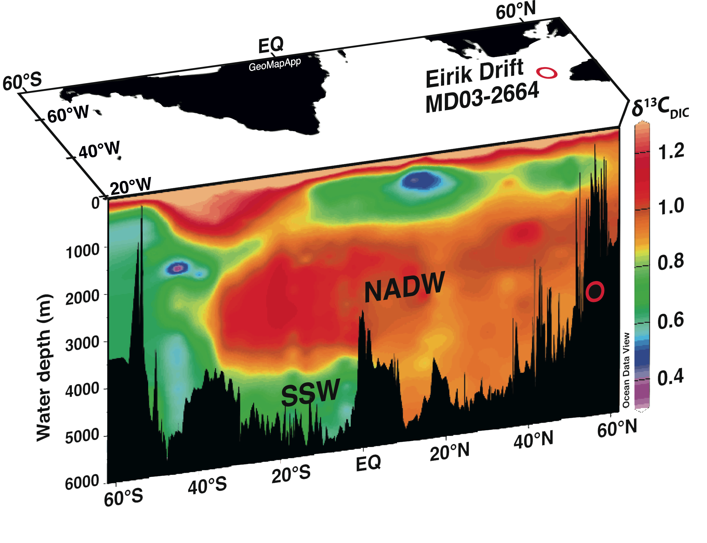
Notes:
Figure 1: The location of Eirik Drift core site MD03-2664 (red circle: 57°26’N, 48°36’W; 3442 m water depth) plotted geographically and projected onto the mid-Atlantic topographic profile. Colors show the modern carbon isotopic composition of dissolved inorganic carbon (δ13CDIC; Key et al. 2004). Note the strong influence of high- δ13C North Atlantic Deep Water (NADW) in the modern Atlantic, overlying low-δ13C Southern Source Waters (SSW). Figure modified from Galaasen et al. (2014)
Deep Atlantic variability during the last interglacial period
Eirik V. Galaasen1, U.S. Ninnemann1,2, N. Irvalı1, H.F. Kleiven1,2 and C. Kissel3
AFFILIATIONS
1Department of Earth Science and Bjerknes Centre for Climate Research, University of Bergen, Norway
2Uni Climate, Uni Research, Bergen, Norway
3Laboratoire des Sciences du Climat et de l’Environnement/IPSL, CEA/CNRS/UVSQ, Gif-sur-Yvette, France
CONTACT
Eirik V. Galaasen: eirik.galaasen@geo.uib.no

Slide 18
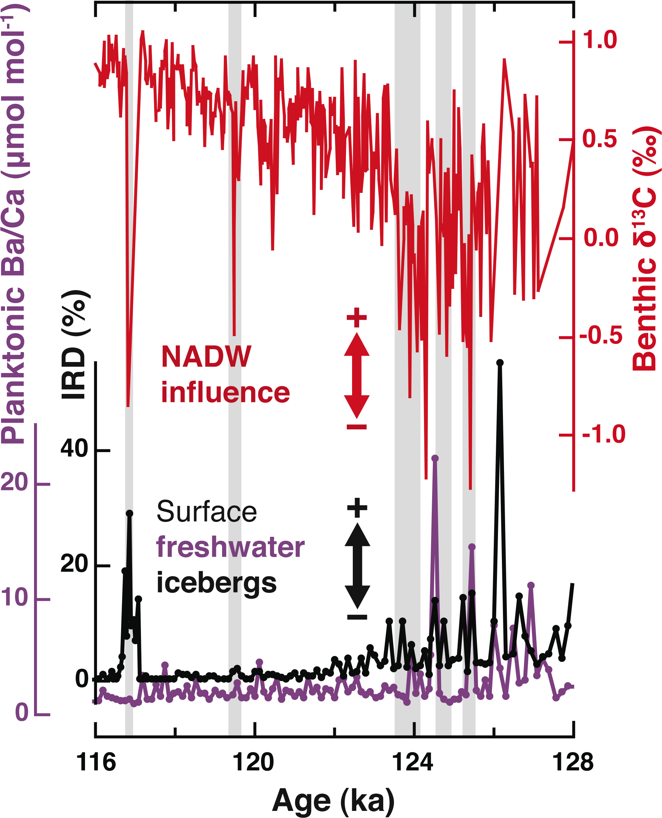
Notes:
Figure 2: Eirik Drift sediment core MD03-2664 records across the LIG, focused on the Marine Isotope Stage 5e benthic δ18O plateau, (116.1-128.0 ka; Shackleton et al. 2002; Shackleton et al. 2003): Red curve: δ13C measured on shells of the epibenthic foraminifera C. wuellerstorfi; Purple curve: Ba/Ca ratio in shells of the planktonic foraminifera N. pachyderma (s); Black curve: Ice-rafted debris (IRD) percentage in the coarse fraction. Gray shading highlights intervals of reduced bottom water δ13C and NADW influence. Figure modified from Galaasen et al. (2014).
Deep Atlantic variability during the last interglacial period
Eirik V. Galaasen1, U.S. Ninnemann1,2, N. Irvalı1, H.F. Kleiven1,2 and C. Kissel3
AFFILIATIONS
1Department of Earth Science and Bjerknes Centre for Climate Research, University of Bergen, Norway
2Uni Climate, Uni Research, Bergen, Norway
3Laboratoire des Sciences du Climat et de l’Environnement/IPSL, CEA/CNRS/UVSQ, Gif-sur-Yvette, France
CONTACT
Eirik V. Galaasen: eirik.galaasen@geo.uib.no

Slide 19
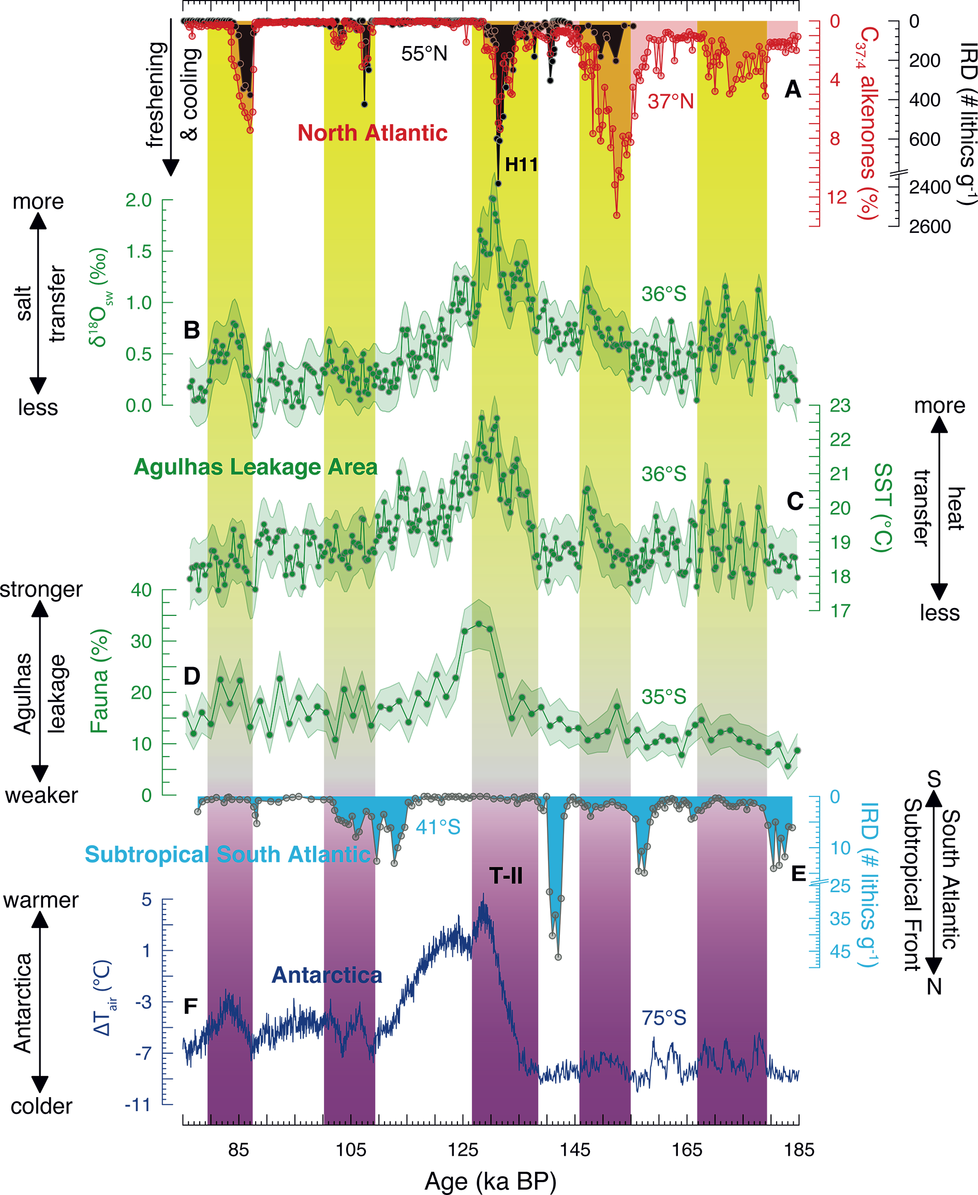
Notes:
Figure 1: Agulhas leakage variability and interhemispheric climate change across the penultimate glacial-interglacial cycle. (A) North Atlantic Ice Rafted Debris (IRD, black) from ODP site 980 (Oppo et al. 2006) and tetraunsaturated alkenones (C37:4, red) from MD01-2444 (Martrat et al. 2007). (B, C) Seawater stable oxygen isotopes (δ18OSW) and sea surface temperatures (SST) from MD96-2080 (Marino et al. 2013). (D) Agulhas Leakage Fauna from GeoB3603-2 (Peeters et al. 2004). Uncertainty envelopes (2σ) are shown in B-D. (E) IRD from MD02- 2588 (Marino et al. 2013). (F) Antarctic temperature anomaly from EPICADome C ice core (Jouzel et al. 2007). Vertical bands highlight intervals of North Atlantic cooling and Agulhas leakage strengthening. T-II=glacial Termination II; H11=Heinrich event 11. Figure modified from Marino et al. (2013).
The Agulhas Leakage: the missing link in the interhemispheric climate seesaw?
Gianluca Marino1 and Rainer Zahn2,3
AFFILIATIONS
1Research School of Earth Sciences, The Australian National University, Canberra, Australia
2Institució Catalana de Recerca i Estudis Avançats (ICREA), Barcelona, Spain
3Institut de Ciència i Tecnologia Ambientals (ICTA) and Departament de Física, Universitat Autònoma de Barcelona, Cerdanyola del Vallès, Spain
CONTACT
Gianluca Marino: gianluca.marino@anu.edu.au

Slide 20
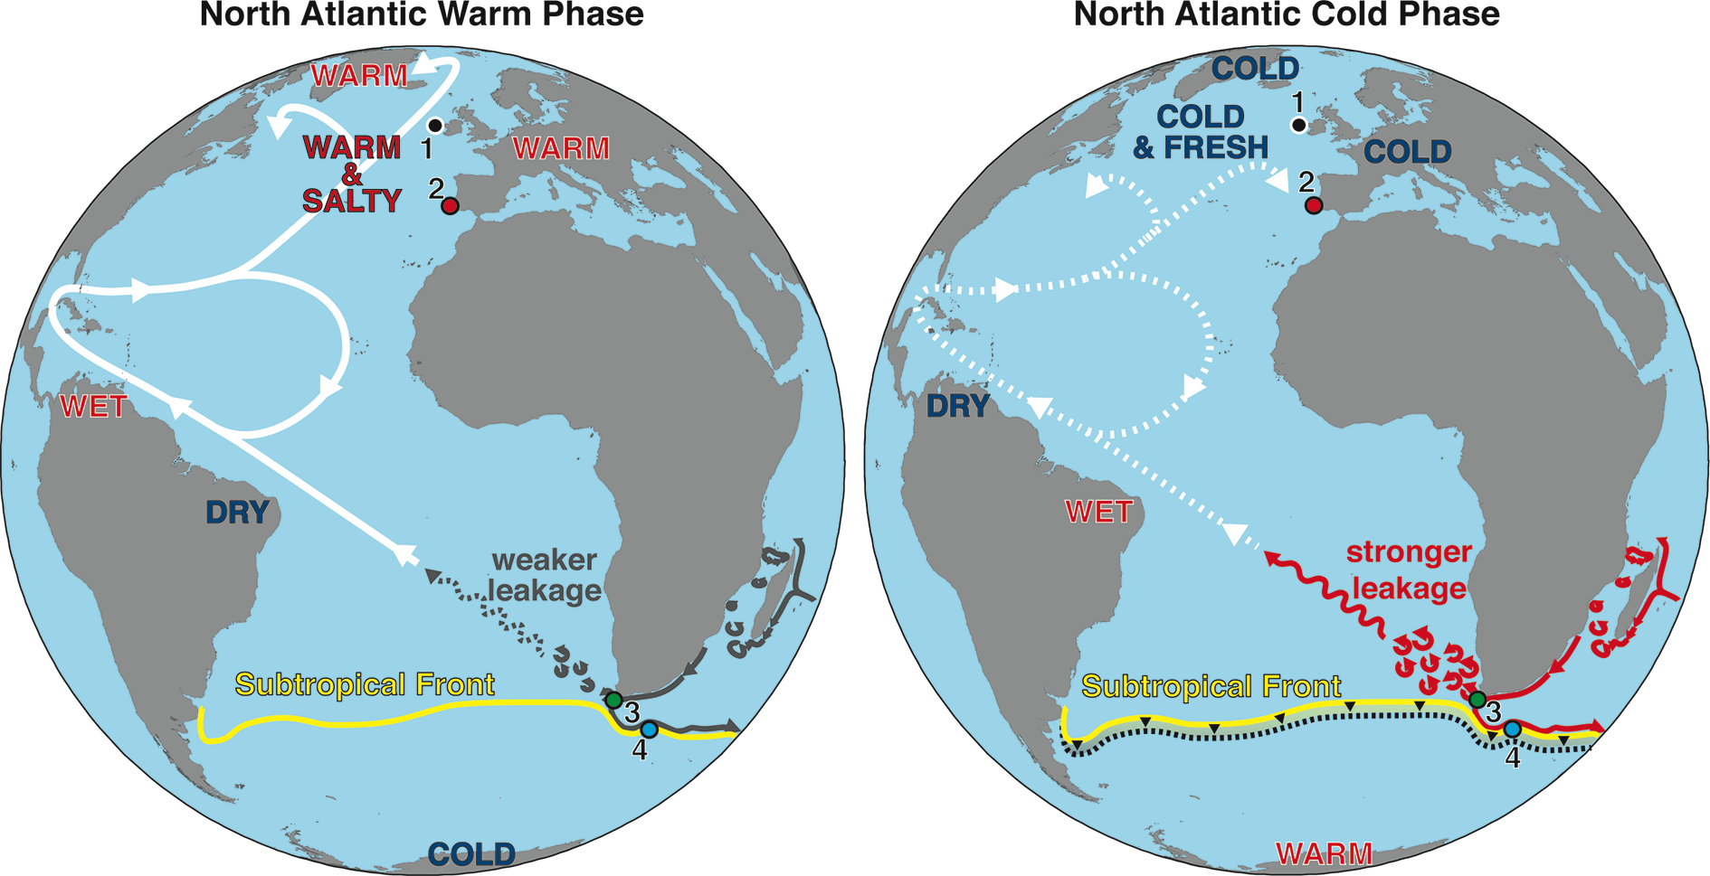
Notes:
Figure 2: Sketch illustrating the relationship between Agulhas Leakage (AL) and North Atlantic climate. North Atlantic warm phase; the Atlantic Meridional Overturning Circulation (AMOC) is strong, while the AL is weak. North Atlantic cold phase; the AMOC weakens, likely due to enhanced freshwater discharge into the North Atlantic. The attendant changes in the interhemispheric ocean and atmospheric circulation cause the southward shift and potential intensification of the mid-latitude westerlies in the Southern Hemisphere, accompanied by the southward migration of the Subtropical Front that strengthens the AL. Core locations are shown: ODP 980 (1), MD01-2444 (2), MD96-2080, GeoB3603-2 (3) and MD02-2588 (4).
The Agulhas Leakage: the missing link in the interhemispheric climate seesaw?
Gianluca Marino1 and Rainer Zahn2,3
AFFILIATIONS
1Research School of Earth Sciences, The Australian National University, Canberra, Australia
2Institució Catalana de Recerca i Estudis Avançats (ICREA), Barcelona, Spain
3Institut de Ciència i Tecnologia Ambientals (ICTA) and Departament de Física, Universitat Autònoma de Barcelona, Cerdanyola del Vallès, Spain
CONTACT
Gianluca Marino: gianluca.marino@anu.edu.au

Slide 21
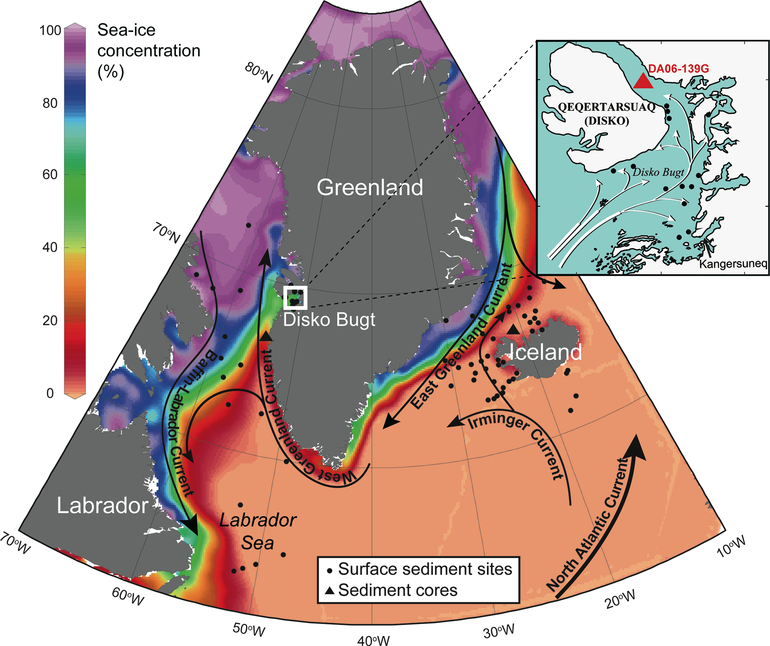
Notes:
Figure 1: Maps of the NW Atlantic, indicating the prevailing surface currents, the distribution of surface sediment samples for the regional diatom-based sea-ice transfer function, and the locations of the sediment cores mentioned in the text. The satellite April sea-ice concentration for 1979-2010 is indicated as a background.
Sea-ice variability off West Greenland over the last five millennia derived from diatom assemblages
Longbin Sha1, H. Jiang1, M-S. Seidenkrantz2, K.L. Knudsen2, J. Olsen3 and A. Kuijpers4
AFFILIATIONS
1Key Laboratory of Geographic Information Science, East China Normal University, Shanghai, China
2Centre for Past Climate Studies and Arctic Research Centre, Aarhus University, Denmark
3Department of Physics and Astronomy, Aarhus University, Denmark
4Geological Survey of Denmark and Greenland (GEUS), Copenhagen, Denmark
CONTACT
Longbin Sha: shalongbin@hotmail.com

Slide 22
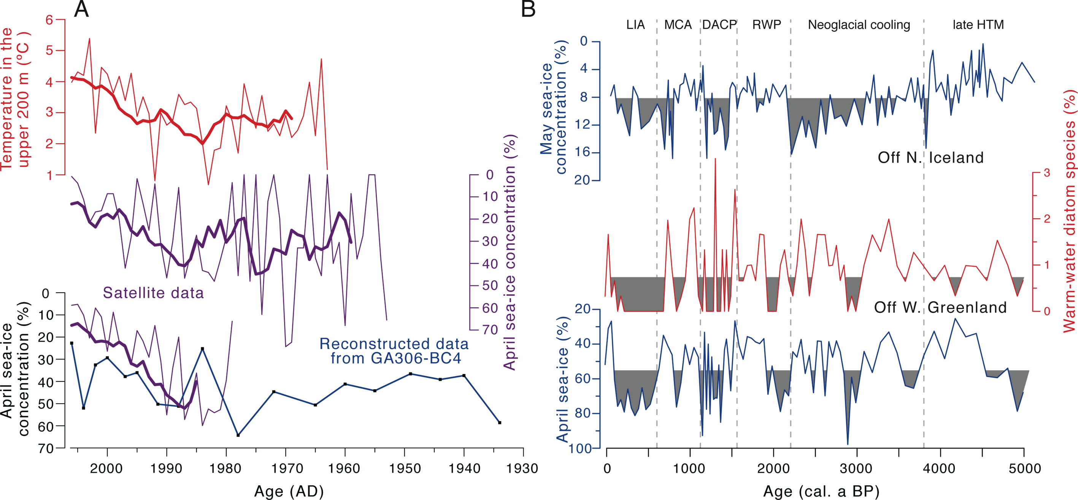
Notes:
Figure 2: Sea-ice records over the last century and the last 5000 years, respectively. (A) From bottom to top: Reconstructed SIC (blue) from core GA306-BC4 compared with the SIC from satellite observation (red) and model output (purple), and annual mean instrumental temperatures (orange). Original data are shown as thin lines; thick lines are 7-point weighted moving averages. (B) From bottom to top: Reconstructed SIC (blue) and warm-water diatom taxa (green) from core DA06-139G, reconstructed May SIC from core MD99-2269 (purple; Justwan and Koç Karpuz 2008). The gray shading indicates value below each record’s mean. Approximate time intervals for historical NE Atlantic climate events are given (LIA: Little Ice Age; MCA: Medieval Climate Anomaly; DACP: Dark Ages Cold Period; RWP: Roman Warm Period; HTM: Holocene Thermal Maximum). Figure modified from Sha et al. (2014).
Sea-ice variability off West Greenland over the last five millennia derived from diatom assemblages
Longbin Sha1, H. Jiang1, M-S. Seidenkrantz2, K.L. Knudsen2, J. Olsen3 and A. Kuijpers4
AFFILIATIONS
1Key Laboratory of Geographic Information Science, East China Normal University, Shanghai, China
2Centre for Past Climate Studies and Arctic Research Centre, Aarhus University, Denmark
3Department of Physics and Astronomy, Aarhus University, Denmark
4Geological Survey of Denmark and Greenland (GEUS), Copenhagen, Denmark
CONTACT
Longbin Sha: shalongbin@hotmail.com

Slide 23
Notes:
Figure 1: Statistics related to the structure of the Past4Future project, including (A) the project partners and their national affiliations and (B) the functions and gender of people involved.
The Past4Future project: outreach and dissemination of results
Dorthe Dahl-Jensen
AFFILIATIONS
Centre for Ice and Climate, Niels Bohr Institute, University of Copenhagen, Denmark Coordinator of Past4Future.
CONTACT
Dorthe Dahl-Jensen: ddj@nbi.ku.dk

Slide 24
Notes:
Figure 2: Statistics related to the products of the Past4Future project, including (A) its target audiences, (B) scientific publications and (C) presentations (as of mid-November 2014).
The Past4Future project: outreach and dissemination of results
Dorthe Dahl-Jensen
AFFILIATIONS
Centre for Ice and Climate, Niels Bohr Institute, University of Copenhagen, Denmark Coordinator of Past4Future.
CONTACT
Dorthe Dahl-Jensen: ddj@nbi.ku.dk

Slide 25
Notes:
Figure 1: (A) Global mean temperature from proxies (Marcott et al. 2013; Shakun et al. 2012) and models (Liu et al. 2014). (B) Histograms of the Holocene time series in (A) showing how the distribution of Holocene temperatures compare to the 20th century instrumental range and IPCC projections for 2100 (Collins et al. 2014). (C) Power Spectral Density (PSD) of sea surface temperature for Holocene time series (Laepple and Huybers 2014). RCP = Representative Concentration Pathway.
Holocene climate change and its context for the future
Shaun A. Marcott1 and Jeremy D. Shakun2
Mount Hood, USA, 13-16 October 2014
AFFILIATIONS
1Department of Geoscience, University of Wisconsin- Madison, USA
2Department of Earth and Environmental Sciences, Boston College, USA
CONTACT
Shaun A. Marcott: smarcott@wisc.edu

Slide 26
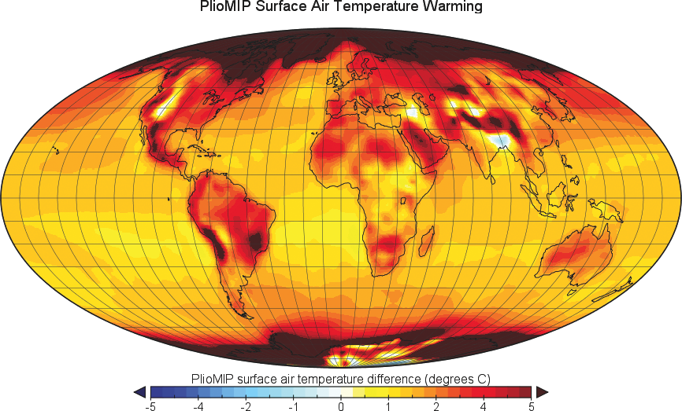
Notes:
Figure 1: Mean annual surface air temperature anomaly (mid-Pliocene minus pre-industrial simulations) based on a multi-model means ensemble obtained by the Pliocene Model Intercomparison Project. Adapted from Haywood et al. (2013).
Multiproxy approach to reconstruct the Pliocene climate
Antoni Rosell-Melé1, E.L. McClymont2, P.S. Dekens3, H. Dowsett4, A.M. Haywood5 and C. Pelejero6
Barcelona, Catalonia, Spain, 17-19 September 2014
AFFILIATIONS
1ICREAand Institute of Environmental Science and Technology, Universitat Autònoma de Barcelona, Catalonia, Spain
2Department of Geography, Durham University, UK
3Department of Earth & Climate Sciences, San Francisco State University, USA
4Eastern Geology & Paleoclimate Science Center, US Geological Service, Reston, USA
5School of Earth and Environment, University of Leeds, UK
6ICREAand Institut de Ciències del Mar, CSIC, Barcelona, Catalonia, Spain
CONTACT
Antoni Rosell-Melé: antoni.rosell@uab.cat

Slide 27
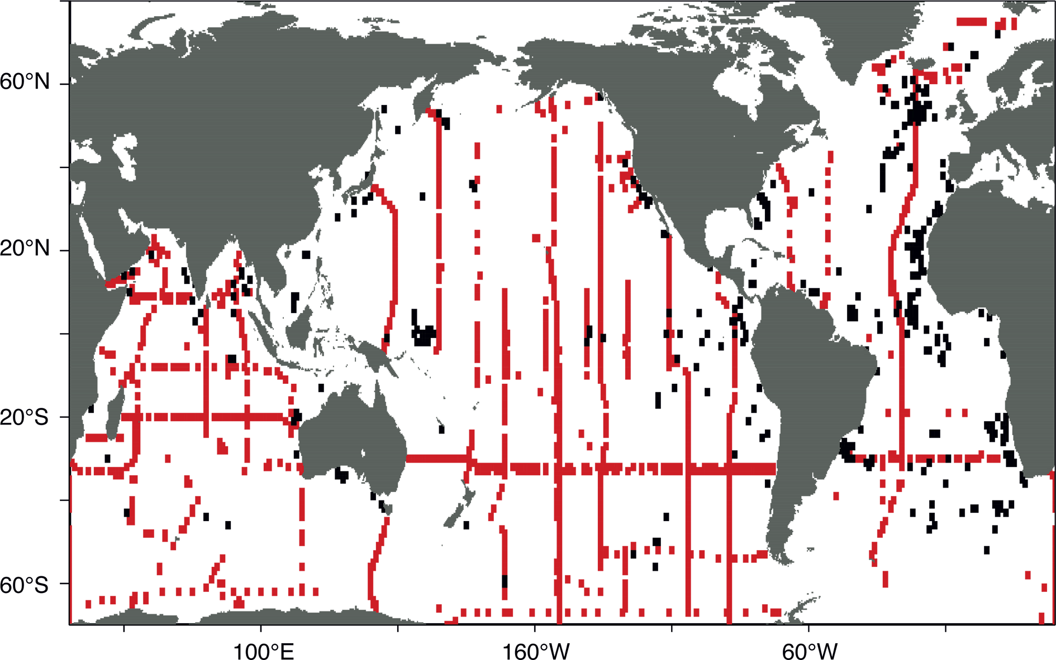
Notes:
Figure 1: Map of available δ13Cforam data (on a 1° grid) from core-top sediment foraminifera (black; Pederson et al. 2014 plus unpublished data from A. Mix) and water column δ13CDIC (red) measurements. These two datasets will be used for calibrations.
Deglacial Ocean Circulation and Carbon Cycling
Andreas Schmittner1, S.L. Jaccard2, A.C. Mix1 and E.L. Sikes3
Inaugural OC3 Workshop, Bern, Switzerland, 1-3 October 2014
AFFILIATIONS
1College of Earth, Ocean, and Atmospheric Sciences, Oregon State University, Corvallis, USA
2Institute of Geological Sciences, University of Bern, Switzerland
3Institute of Marine and Coastal Sciences, Rutgers University, New Brunswick, USA
CONTACT
Andreas Schmittner: aschmitt@coas.oregonstate.edu

Slide 28
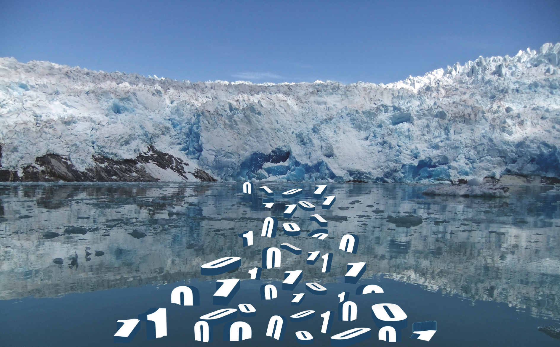
Notes:
Figure 1: The systematic conversion of observation into data is a cornerstone of scientific method as suggested by the marine-terminating ice margin of Nigerdlikasik Bræ in southern Greenland. Image credit: A Carlson and F Williams.
Developing databases of past sea-level and ice-sheet indicators
Felicity Williams1, N. Hallmann2, A. Carlson3, A.J. Long4 and N.L.M. Barlow4
PALSEA2 Workshop, Lochinver, Scotland, UK, 16-22 September 2014
AFFILIATIONS
1Ocean and Earth Science, University of
Southampton, UK
2Aix-Marseille Université, CNRS, IRD, CEREGE UMR, Aix-en-Provence, France
3College of Earth, Ocean, and Atmospheric Sciences, Oregon State University, Corvallis, USA
4Department of Geography, Durham University, UK
CONTACT
Anders Carlson: acarlson@coas.oregonstate.edu

Slide 29
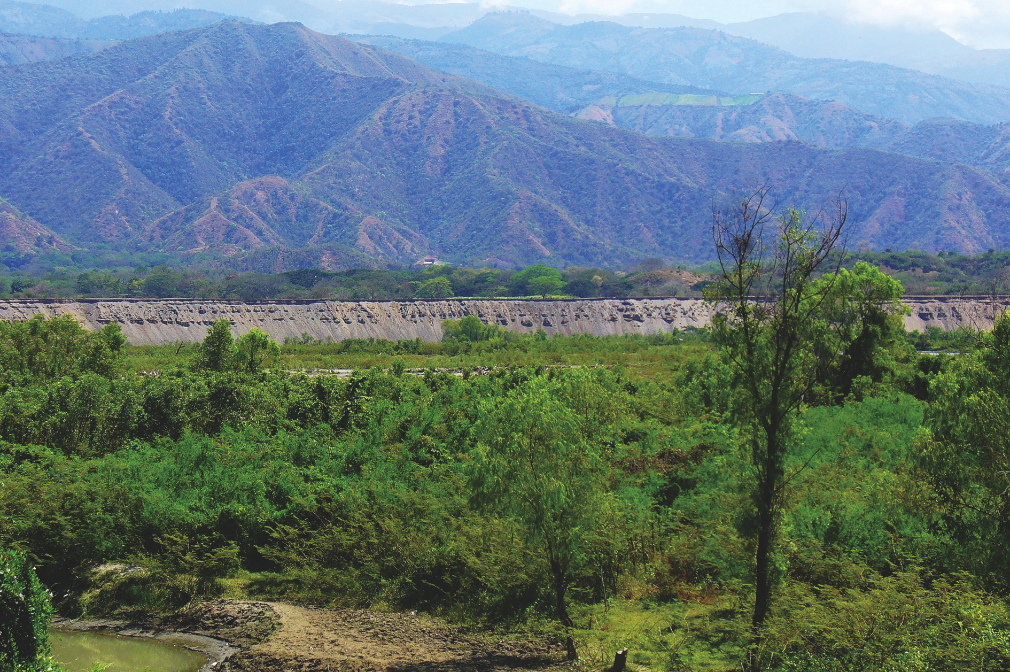
Notes:
Figure 1: Panoramic view of the San Nicolás terrace in the Santa Fé–Sopetran Basin, northern Colombia.
Climate Change and human impact in Central and South America over the last 2000 years
J. Ignacio Martínez1, C. González2, M. Grosjean3 and R. Villalba4
LOTRED-SA 3rd Symposium and Training Course, Medellín, Colombia, 7-12 July 2014
AFFILIATIONS
1Dept. Geología, Universidad EAFIT, Medellín, Colombia
2Dept. Ciencias Biológicas, Universidad de los Andes, Bogotá, Colombia
3Oeschger Centre for Climate Change Research, University, Bern, Switzerland
4Instituto Argentino de Nivología, Glaciología y Ciencias Ambientales IANIGLA, Mendoza, Argentina
CONTACT
Martin Grosjean: martin.grosjean@oeschger.unibe.ch

Slide 30
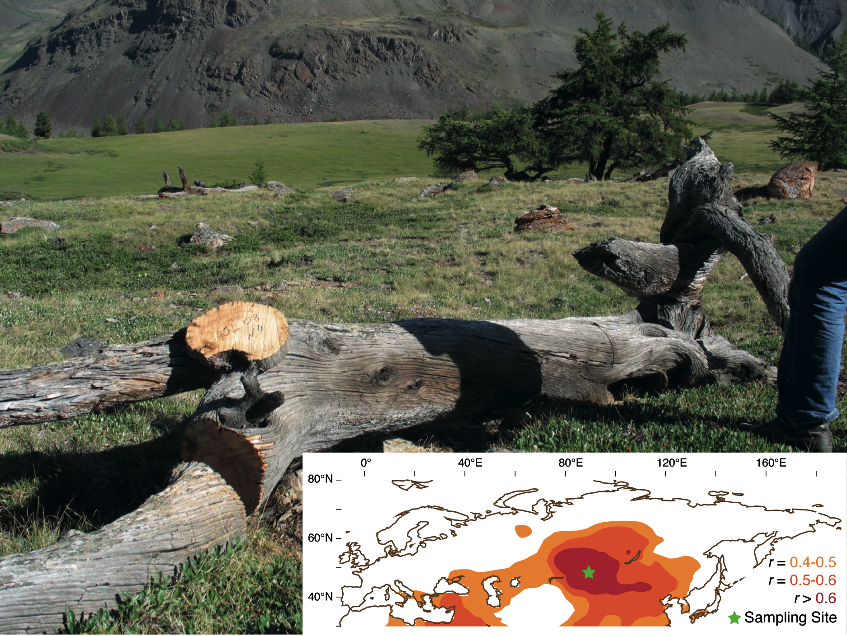
Notes:
Figure 1: Adry-dead Siberian larch (Larix sibirica Ledeb.) in the Russian Altai Mountains (~88°E, 50°N). The trunk, located well above the current tree line (~2,450m asl), contains several hundred rings and dates back into medieval times (Myglan et al. 2012). Such samples allow to develop an annually resolved and absolutely dated summer temperature reconstruction. The inset shows spatial field correlations of a new Altai tree-ring width record against gridded JJAtemperatures from AD 1821-2011. Partners include V.S. Myglan, D.V. Ovtchinnikov and A.V. Kirdyanov (all Krasnoyarsk, Russia). Photo: Myglan VS, Inset: Büngten U, unpublished.
Towards a spatiotemporal expansion of temperature and hydroclimatic proxy archives
Ulf Büntgen1,2, J. Luterbacher3, F. Charpentier Ljungqvist4, J. Esper5, D. Fleitmann6, M. Gagen7, F. González-Rouco8, S. Wagner9, J. Werner10, E. Zorita9 and F. Martínez-Peña11
Soria, Spain, 14-17 September 2014
AFFILIATIONS
1WSL, Birmensdorf and OCCRBern, Switzerland
2Global Change Research Centre, Brno, Czech Republic
3Department of Geography, Justus Liebig University of Giessen, Germany
4Bolin Centre for Climate Research, Stockholm University, Sweden
5Department of Geography, Johannes Gutenberg University, Mainz, Germany
6Department of Archaeology and Centre of Past Climate Change, University of Reading, UK
7Department of Geography, University of Swansea, UK
8Institute of Geoscience, Faculty of Physics, University Complutense Madrid, Spain
9Institute for Coastal Research, Helmholtz Centrum, Geesthacht, Germany
10Department of Earth Science, University of Bergen, Norway
11Research Unit of Forestry Mycology and Trufficulture, Cesefor Foundation, Soria, Spain
CONTACT
Ulf Büntgen: buentgen@wsl.ch

Slide 31
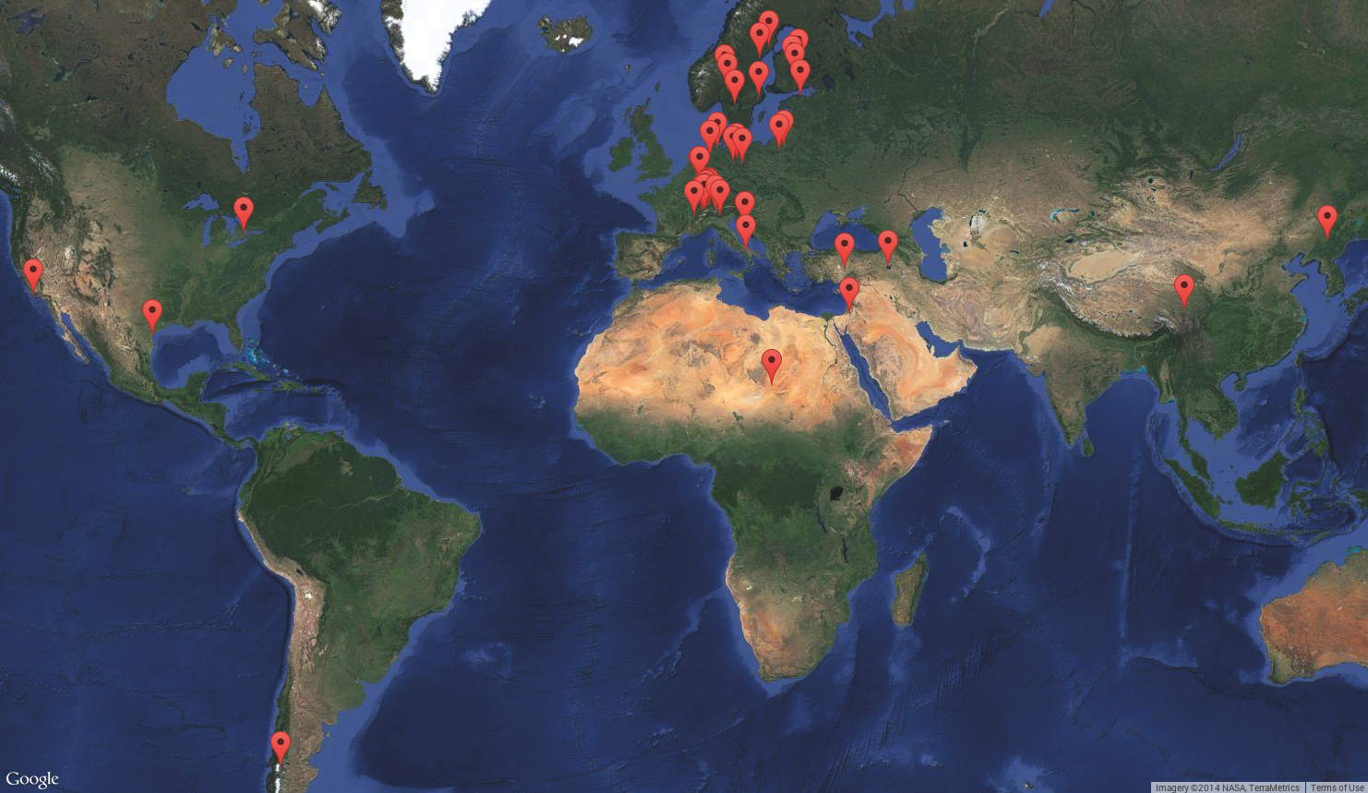
Notes:
Figure 1: Screenshot from the Varve Image Portal documenting the current global coverage of varve images.
The online Varve Image Portal: Anew tool for studying annually laminated sediments
Bernd Zolitschka1, P. Francus2,3, A.E.K. Ojala4, A. Schimmelmann5 and C. Telepski6
AFFILIATIONS
1Institute of Geography, University of Bremen, Germany
2Institut National de la Recherche Scientifique, Québec, Canada
3GEOTOP-UQAM-McGill, Montréal, Canada
4Geological Survey of Finland, Espoo, Finland
5Department of Geological Sciences, Indiana University, Bloomington, USA
6PAGES International Project Office, Bern, Switzerland
CONTACT
Bernd Zolitschka: zoli@uni-bremen.de

Slide 32
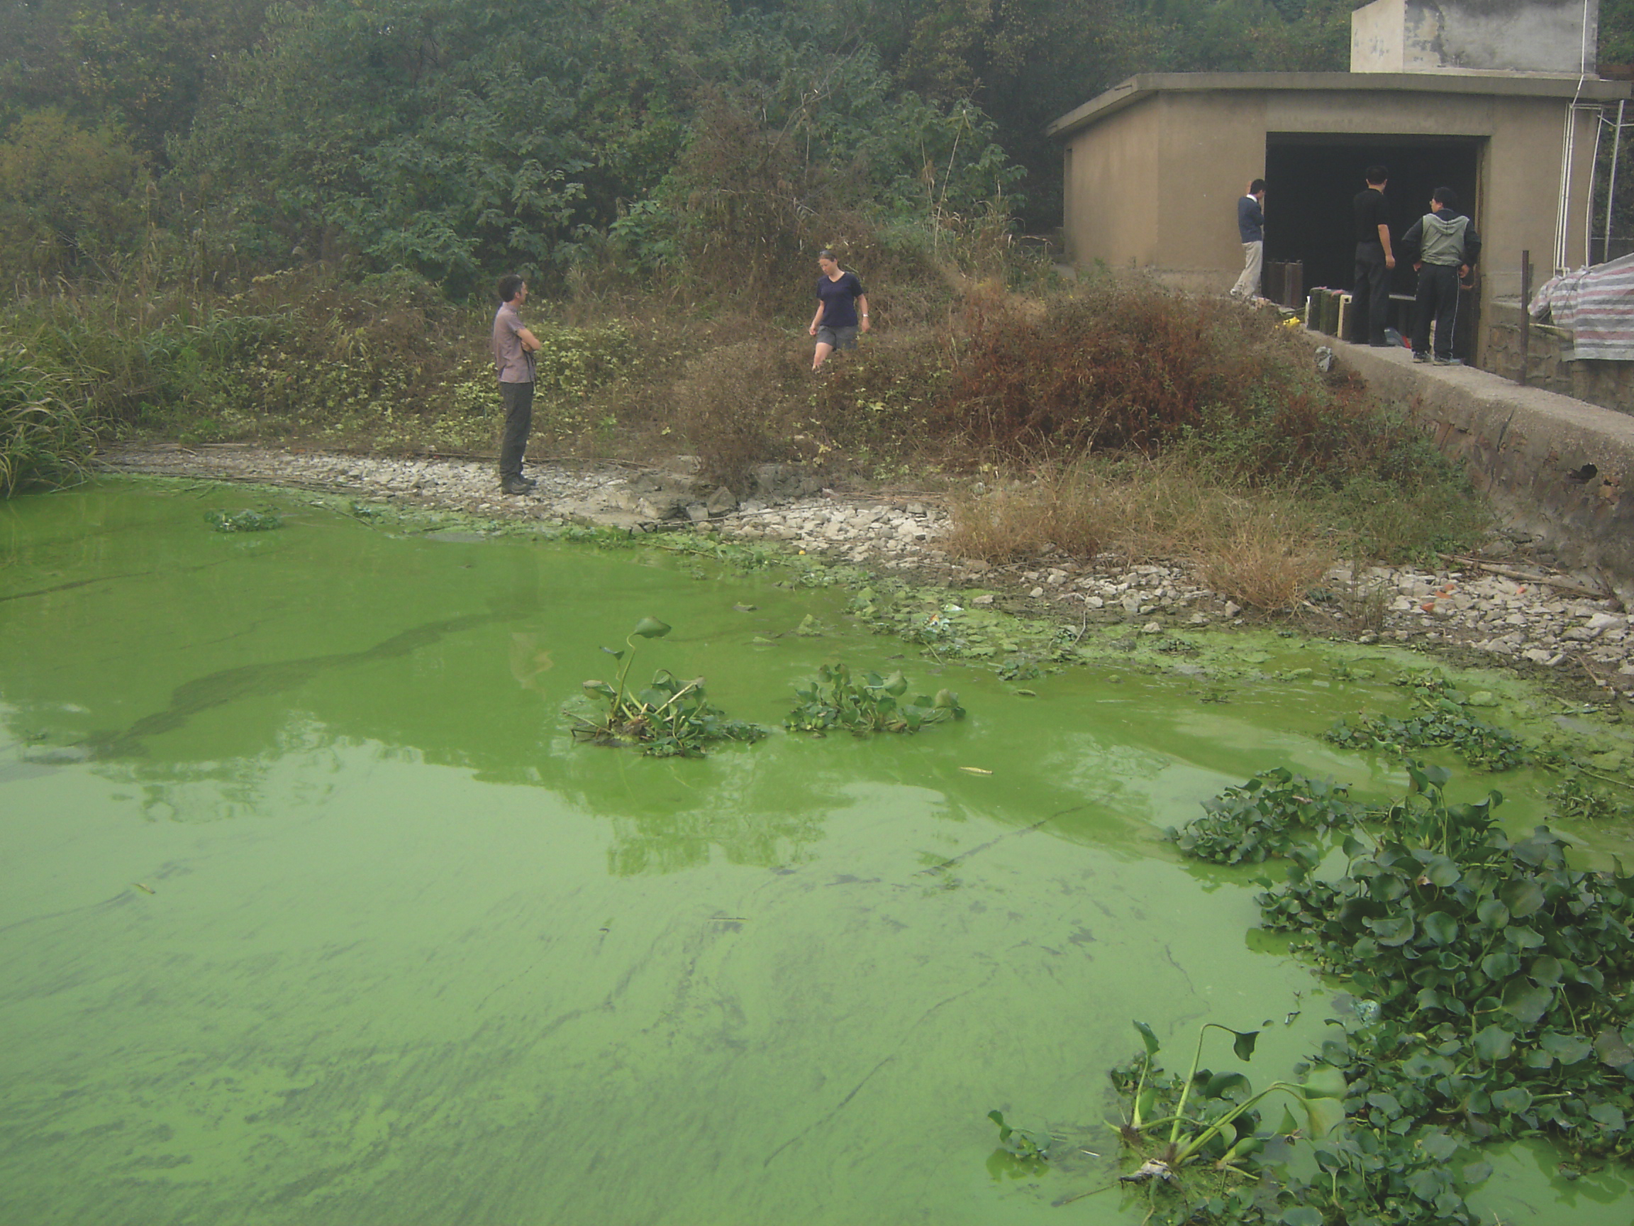
Notes:
Figure 1: Taihu Lake, on the southern part of the Yangtze River delta, is the third largest freshwater lake in China. Taihu became eutrophic following intensive development from the 1980s and has been covered by an extensive Microcystis bloom since the late 1990s. Understanding the nature of aquatic transitions provides insights for the challenge of wetland restoration.
Aquatic Transitions Working Group
Peter Gell1, J.A. Dearing2, S. Juggins3, M.-E. Perga4, J. Saros5 and C. Sayer6
AFFILIATIONS
1Water Research Network, Federation University Australia, Ballarat, Australia
2Geography and Environment, Southampton University, UK
3Geography, Newcastle University, UK
4Institute national de la recherche agronomique, Paris, France
5Climate Change Institute, University of Maine, USA
6Environmental Change Research Centre, University College London, UK
CONTACT
Peter Gell: p.gell@federation.edu.au

Slide 33
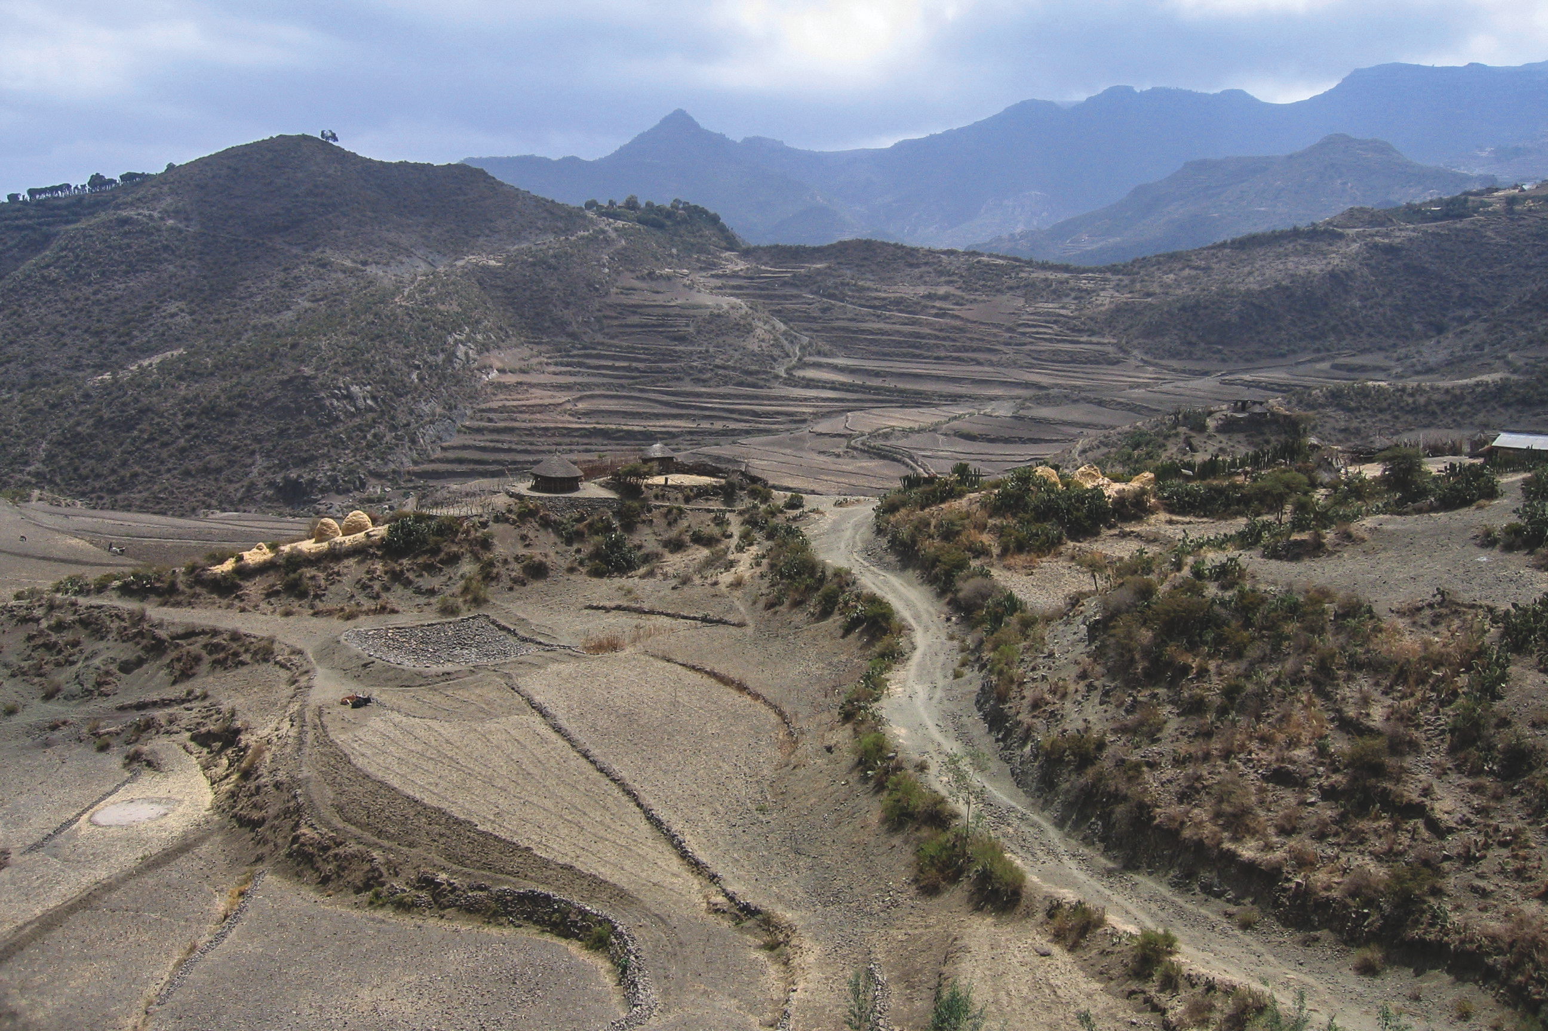
Notes:
Figure 1: Smallholder rain-fed agriculture in the Ethiopian Highlands, Amhara Region, Ethiopia. Photo by Veerle Vanacker.
Global Soil and Sediment transfers in the Anthropocene
Thomas Hoffmann1, D. Penny2, G. Stinchcomb3, V. Vanacker4 and X.X. Lu5
AFFILIATIONS
1Department of Geography, University of Bonn, Germany
2School of Geosciences, University of Sydney, Australia
3Watershed Studies Institute, Murray State University, USA
4Department of Geography, Louvain, Belgium
5Department of Geography, National University of Singapore
CONTACT
Thomas Hoffmann: thomas.hoffmann@uni-bonn.de

Slide 34
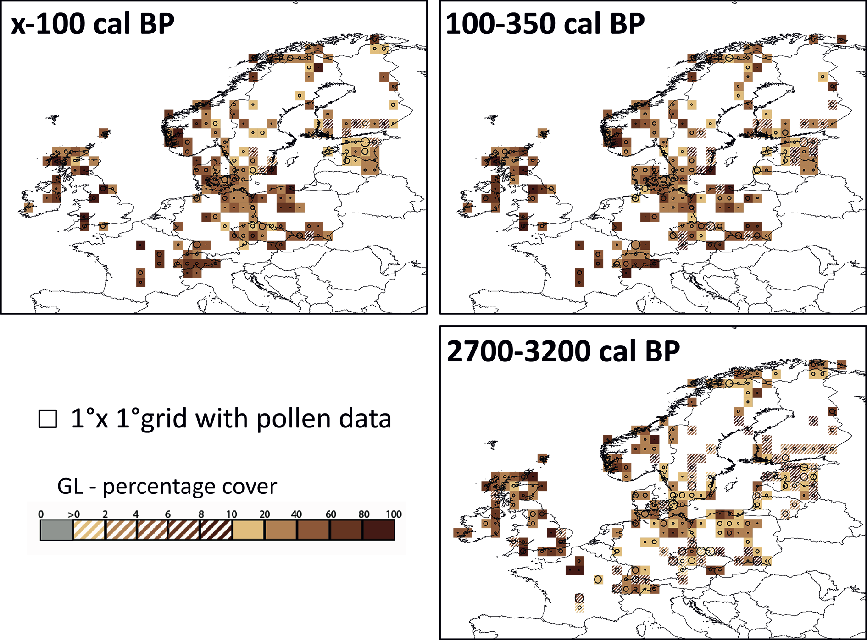
Notes:
Figure 1: Grid-based REVEALS estimates for the plant functional type (PFT) grassland (GL) for three Holocene time-windows. The scale is percentage cover, with the different colors indicating different percentage intervals: >0–10% in 2% intervals, 10–20% in a 10% interval, and 20–100% in 20% intervals. The category 0 (grey) corresponds to the grid cells with pollen records but no pollen data for the actual PFT and, therefore, no REVEALS estimates. The category >0–2 corresponds to REVEALS estimates different from zero (can be less than 1%) up to 2%. The uncertainties of PFT REVEALS estimates are shown by circles of various sizes in each grid cell with an estimate. The circles represent the coefficient of variation (CV; the standard error divided by the REVEALS estimate). When SE ≥ REVEALS estimate, the circle fills the entire grid cell and the REVEALS estimate is considered unreliable. This occurs mainly where REVEALS estimates are low. GL (all most common herbs): Artemisia species, Cyperaceae, Filipendula species, Poaceae (Gramineae), Plantago lanceolata, Plantago media, Plantago montana, Rumex acetosa-type (several species). Modified from Trondman et al. (in press).
LandCover6k: Global anthropogenic land-cover change and its role in past climate
Marie-José Gaillard1 and LandCover6k Interim Steering Group members2
AFFILIATIONS
1Department of Biology and Environmental Science, Linnaeus University, Kalmar, Sweden
2See list of Interim Steering Group members at: www.pages-igbp.org/workinggroups/landcover6k/people
CONTACT
Marie-José Gaillard: marie-jose.gaillard@lnu.se

Slide 35
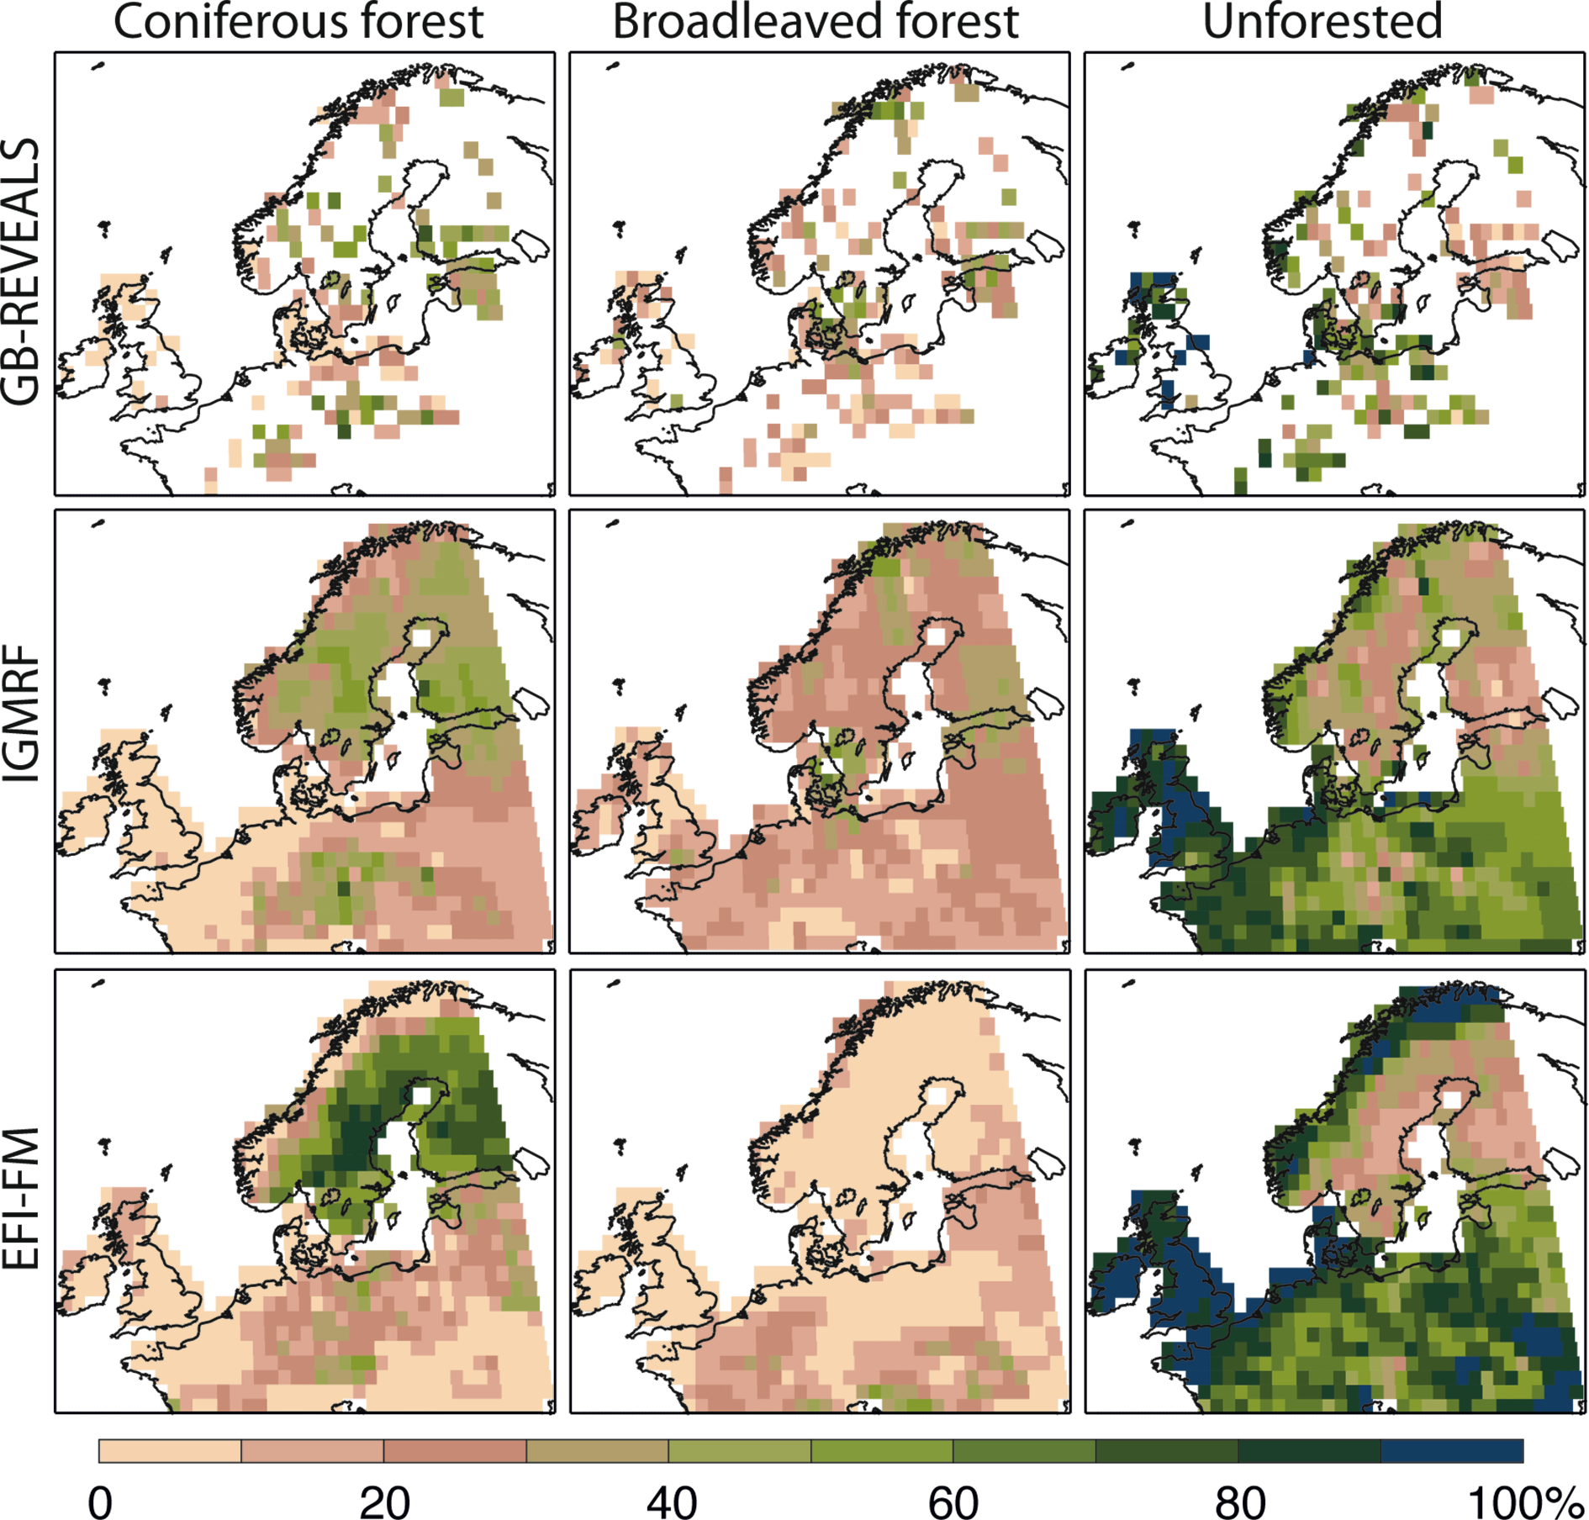
Notes:
Figure 2: Reconstructions of proportion (% cover) of the three land-cover types coniferous forest, broadleaved forest and unforested for the 0.05 ka time window (modified from Pirzamanbein et al. 2014). From top to bottom, the pollen-based REVEALS estimates, the reconstruction from the intrinsic Gaussian Markov Random Field model (IGMRF), and the present day land-cover data extracted from the forest map of Europe compiled by the European Forest Institute (EFI-FM). For details, see text and Pirzamanbein et al. (2014).
LandCover6k: Global anthropogenic land-cover change and its role in past climate
Marie-José Gaillard1 and LandCover6k Interim Steering Group members2
AFFILIATIONS
1Department of Biology and Environmental Science, Linnaeus University, Kalmar, Sweden
2See list of Interim Steering Group members at: www.pages-igbp.org/workinggroups/landcover6k/people
CONTACT
Marie-José Gaillard: marie-jose.gaillard@lnu.se

