Slide 1
Figures – PAGES news 21(2) 2013
Please cite the PAGES news article and, if available, the original figure reference when using a figure. See note section below the figures for details.

Slide 2
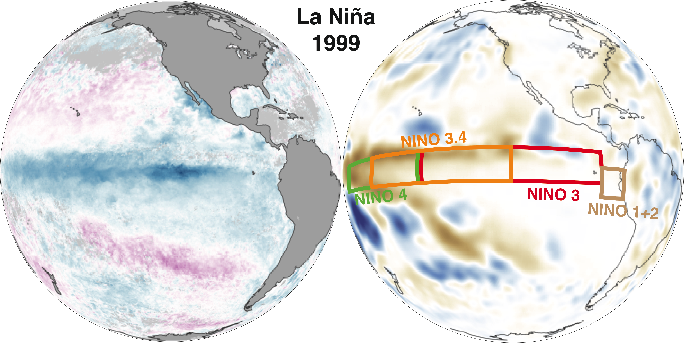
Notes:
Editorial: El Niño-Southern Oscillation - observations and modeling
Pascale Braconnot1, C. Brierley2 and S.P. Harrison3,4
1Laboratoire des Sciences du Climat et de l’Environnement, unité mixte CEA-CNRS-UVSQ, Saclay, France; pascale.braconnot@lsce.ipsl.fr
2Department of Geography, University College London, UK; 3Department of Biological Sciences, Macquarie University, North Ryde, Australia;
4Centre for Past Climate Change and School of Archaeology, Geography and Environmental Sciences, University of Reading, UK
Figure 1: La Nina event of 1999. Left: Positive (purple) and negative (blue) sea surface temperature anomalies. Right: Positive (blue) and negative (brown) rainfall anomalies
(mm). The four El Nino regions referred to in the following articles are depicted in the right panel. Images from NASA.

Slide 3
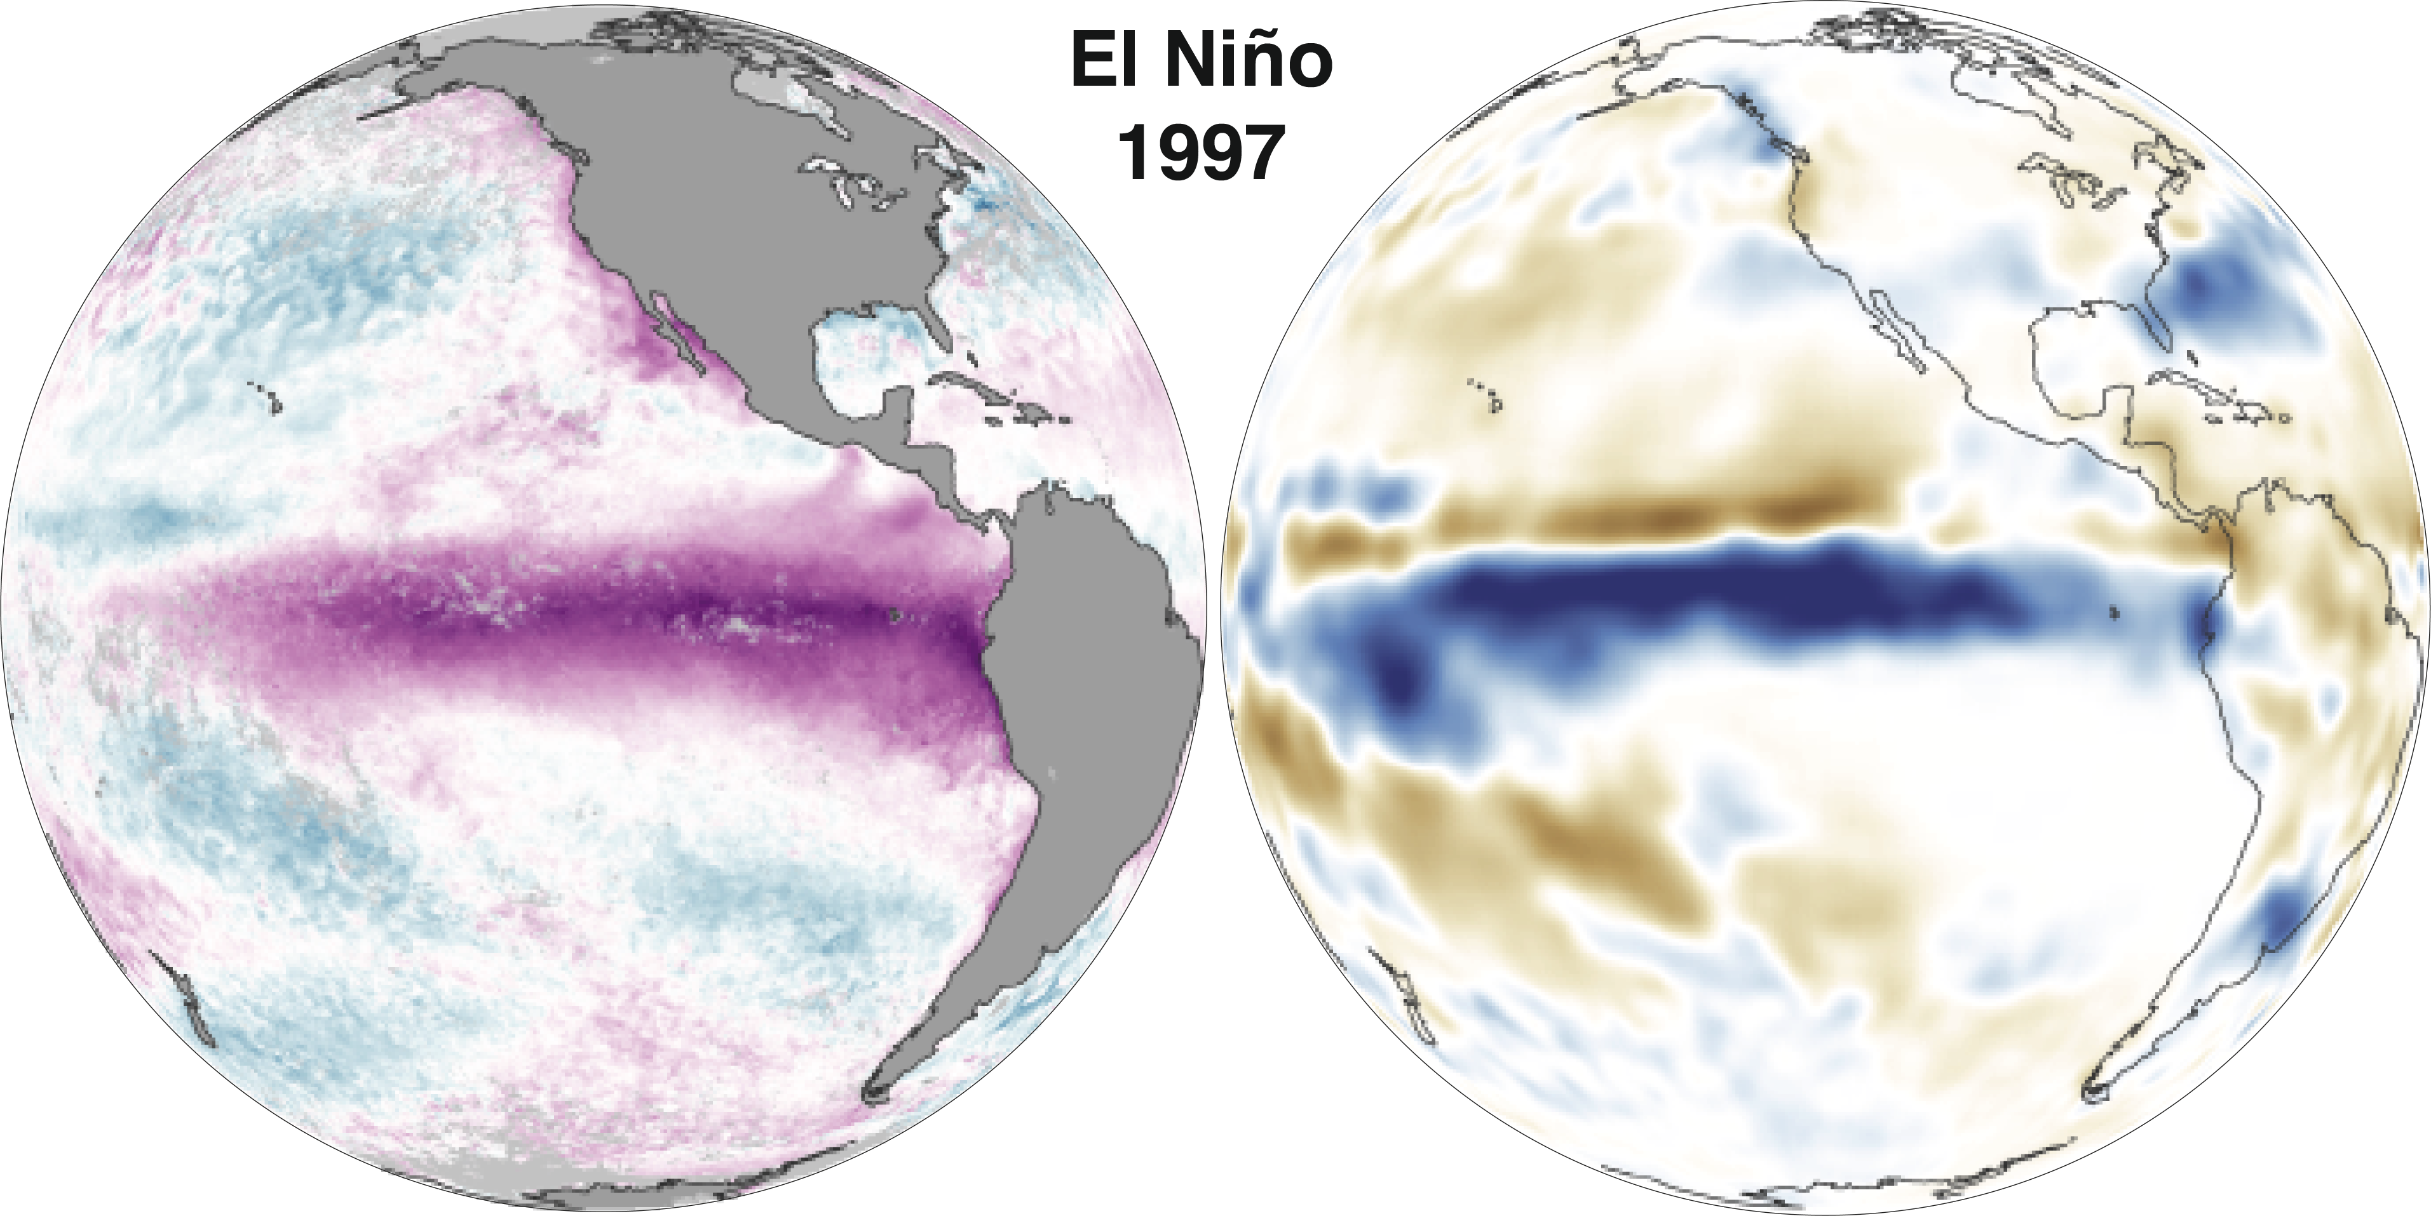
Notes:
Editorial: El Niño-Southern Oscillation - observations and modeling
Pascale Braconnot1, C. Brierley2 and S.P. Harrison3,4
1Laboratoire des Sciences du Climat et de l’Environnement, unité mixte CEA-CNRS-UVSQ, Saclay, France; pascale.braconnot@lsce.ipsl.fr
2Department of Geography, University College London, UK; 3Department of Biological Sciences, Macquarie University, North Ryde, Australia;
4Centre for Past Climate Change and School of Archaeology, Geography and Environmental Sciences, University of Reading, UK
Figure 2: El Ni.o event of 1997. Left: sea surface temperature anomalies. Blue: negative, purple: positive. Right: Rainfall anomalies (mm). Brown: negative, blue: positive. Images from NASA.

Slide 4
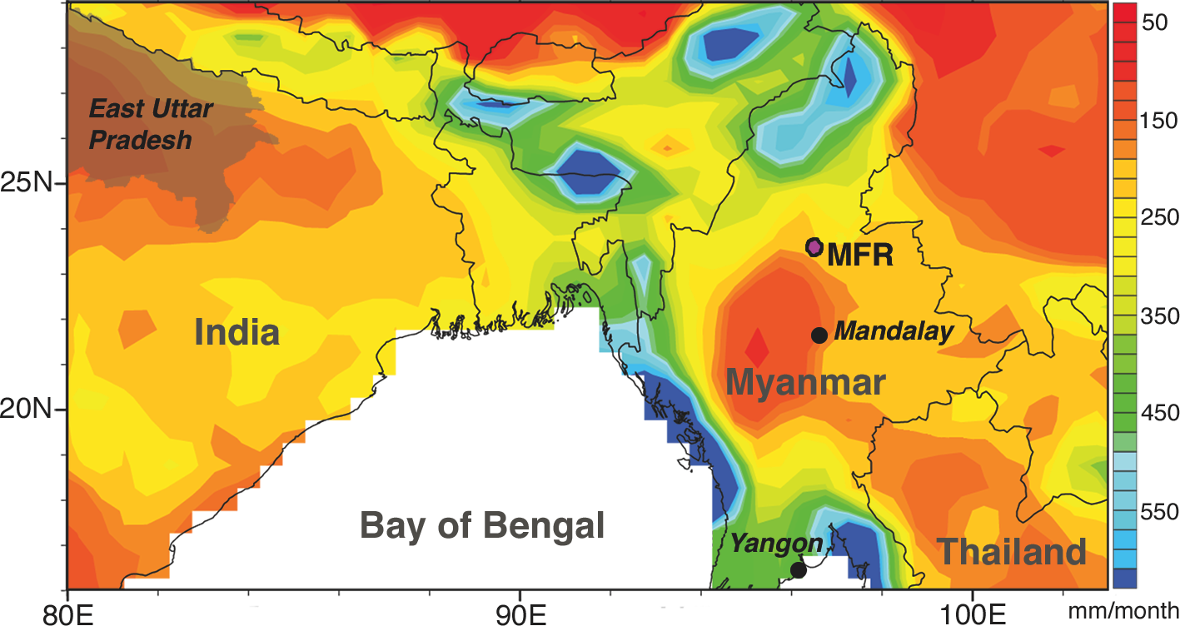
Notes:
Myanmar monsoon drought variability inferred by tree rings over the past 300 years: linkages to ENSO
Rosanne D’Arrigo1, J. Palmer2, C. Ummenhofer3, N.N. Kyaw4 and P. Krusic5
1Lamont-Doherty Earth Observatory (LDEO), Palisades, USA; rdd@ldeo.columbia.edu
2Gondwana Tree-Ring Laboratory, Canterbury, New Zealand; 3Woods Hole Oceanographic Institution, Woods Hole, USA; 4Forest Department,
Naypyidaw, Myanmar; 5Bert Bolin Centre for Climate Research, Sweden University, Stockholm, Sweden
Figure 1: Map of Myanmar and adjacent southern monsoon Asia. Pink dot is Maingtha Forest Reserve (MFR) teak tree-ring site north of Mandalay. Background shows monthly Global Precipitation Climatology Centre rainfall data for the period 1951-2007, averaged for May–October when the majority of Myanmar annual rainfall occurs. The figure shows the lower mean rainfall in central Myanmar (modified from D’Arrigo et al. 2011).

Slide 5
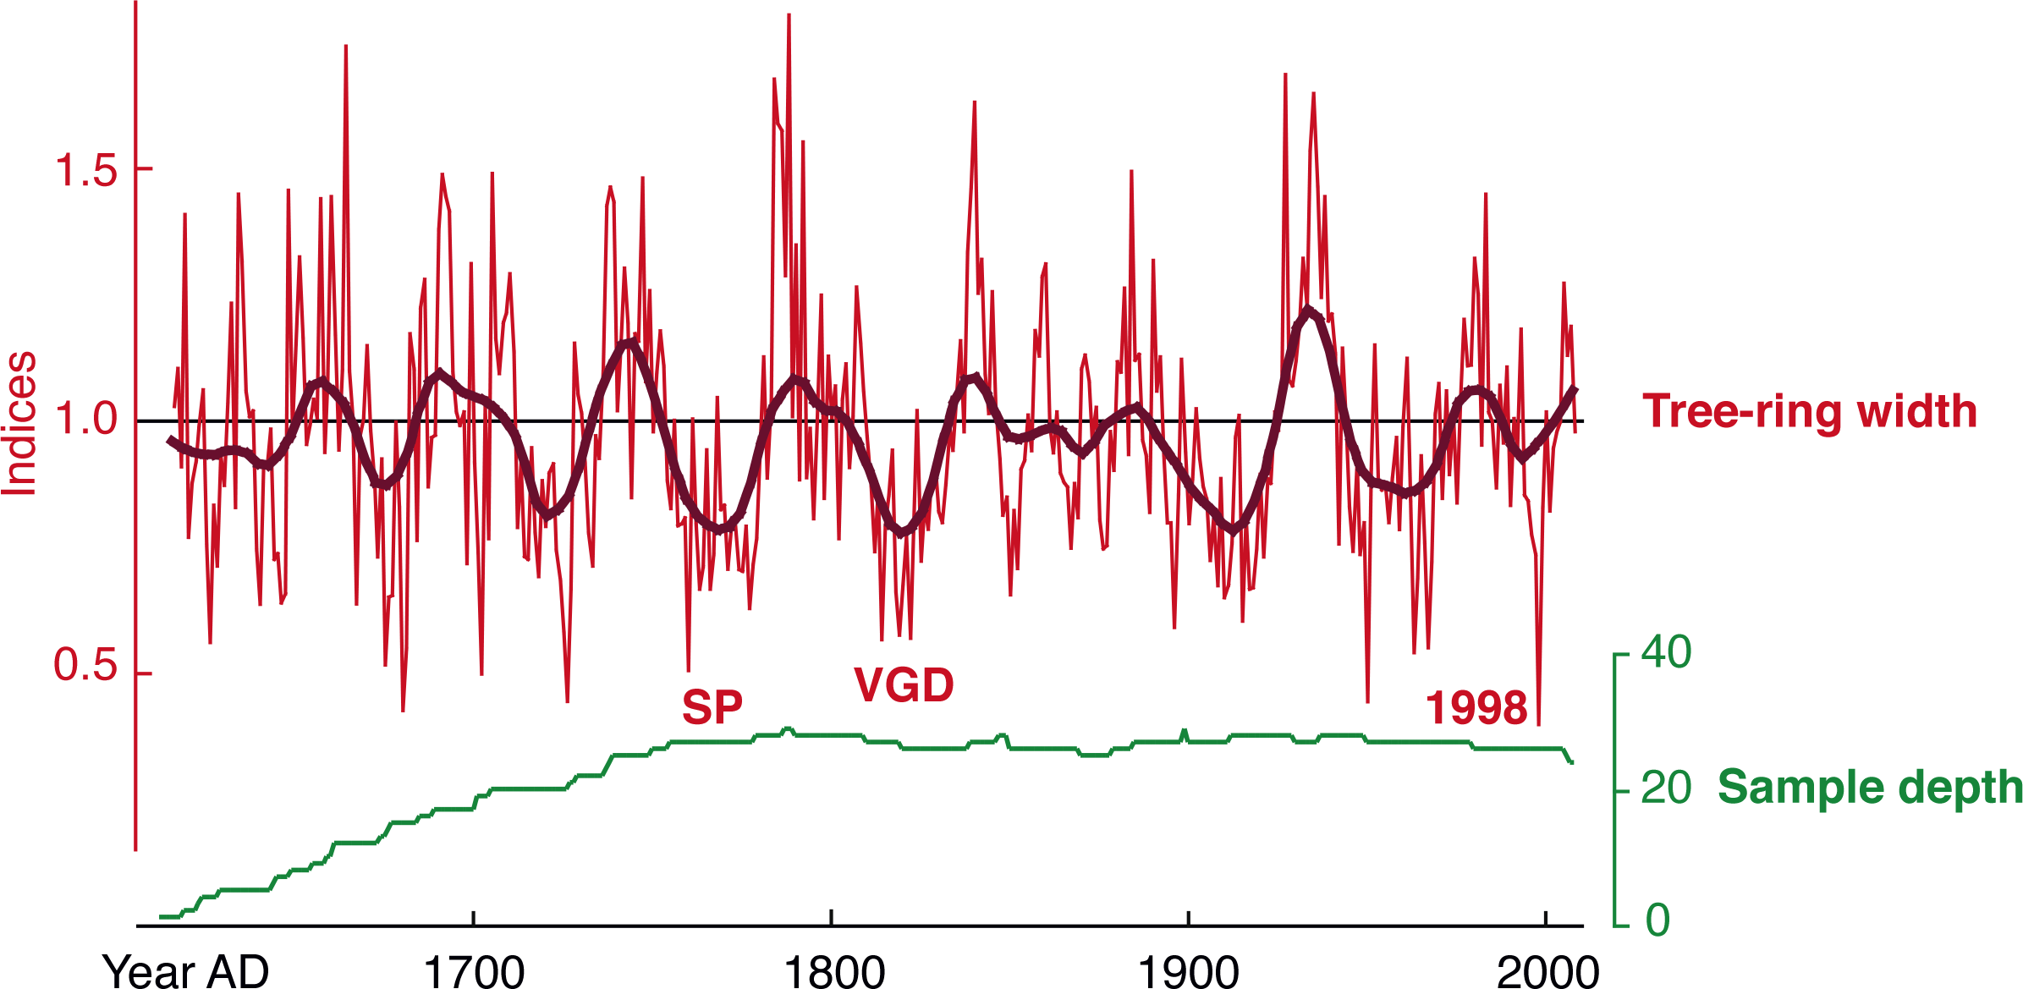
Notes:
Myanmar monsoon drought variability inferred by tree rings over the past 300 years: linkages to ENSO
Rosanne D’Arrigo1, J. Palmer2, C. Ummenhofer3, N.N. Kyaw4 and P. Krusic5
1Lamont-Doherty Earth Observatory (LDEO), Palisades, USA; rdd@ldeo.columbia.edu
2Gondwana Tree-Ring Laboratory, Canterbury, New Zealand; 3Woods Hole Oceanographic Institution, Woods Hole, USA; 4Forest Department,
Naypyidaw, Myanmar; 5Bert Bolin Centre for Climate Research, Sweden University, Stockholm, Sweden
Figure 2: Tree-ring width chronology of teak (in dimensionless indices or values) for central Myanmar, spanning 1613-2009 AD, with sample depth (number of individual tree samples). Sample depth is near its peak over much of the chronology, gradually declining prior to the middle 1700s. Plot labels time of Strange Parallels (SP) drought in the 1700s (Buckley et al. 2007, 2010), the late Victorian Great Drought (VGD), and narrow ring at time of 1997-98 “El Ni.o of the Century” (modified from D’Arrigo et al. 2011).

Slide 6
Notes:
Coral microatoll reconstructions of El Niño-Southern Oscillation: New windows on seasonal and interannual processes
Helen V. McGregor1, C.D. Woodroffe1, M. Fischer2, M.K. Gagan3 and D. Fink2
1School of Earth and Environmental Sciences, University of Wollongong, Australia; mcgregor@uow.edu.au
2Institute for Environmental Research, Australian Nuclear Science and Technology Organisation, Lucas Heights, Australia; 3Research School of Earth Sciences, The Australian National University, Canberra, Australia
Figure 1: Porites coral microatoll image and X-radiograph. A) Porites coral microatolls on a reef flat at low tide. B) Positive X-radiograph cross- section through a Porites microatoll. Dark and light bands are the high and low-density bands, respectively, that form as the coral grows. Starting from the center, the coral grows upwards until further upward growth is constrained by exposure during the minimum low water level (in this case, 1997/1998). Lateral growth then ensues resulting in a discoid microatoll structure. The location of the living surface in 2007 when the coral was collected is indicated. Dashed lines indicate the outline of coral pieces not X-rayed.

Slide 7
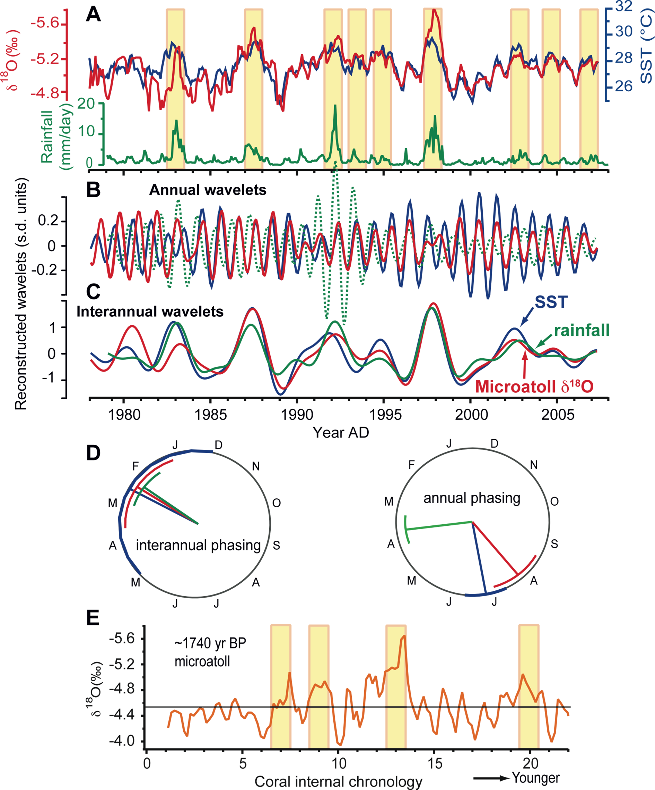
Notes:
Coral microatoll reconstructions of El Niño-Southern Oscillation: New windows on seasonal and interannual processes
Helen V. McGregor1, C.D. Woodroffe1, M. Fischer2, M.K. Gagan3 and D. Fink2
1School of Earth and Environmental Sciences, University of Wollongong, Australia; mcgregor@uow.edu.au
2Institute for Environmental Research, Australian Nuclear Science and Technology Organisation, Lucas Heights, Australia; 3Research School of Earth Sciences, The Australian National University, Canberra, Australia
Figure 2: Variability of Kiritimati Island records. A) Comparison of the stacked microatoll δ18O record (red line) with Kiritimati SST (blue line) and monthly rainfall (green line). The stacked δ18O is a composite of three microatoll records from Kiritimati. The microatoll δ18O record is strongly anti-correlated with Kiritimati SSTs (r = -0.71) and is sensitive to El Ni.o events (yellow bars). B) Annual-scale and (C) interannual-scale wavelets for the stacked microatoll δ18O (red, y-axis inverted), SST (blue), rainfall (green). D) The circular phase plots show the calendar month (and 95% confidence intervals) when, on average, the wavelets in B) and C) reach their maximum value. In general the microatoll δ18O record tracks SST variations. The rainfall is in phase with the SST and coral δ18O data at the interannual scale, but is out of phase at the annual scale. E) Profile of a δ18O microatoll from Kiritimati dated at ~1740 ka BP, placed on a new floating age scale (unpublished data) that shows El Ni.o events (yellow bars) similar to those of the past few decades. Black horizontal line is the mean δ18O. Figure modified after McGregor et al. (2011b), and Woodroffe and Gagan (2000). SST and rainfall data from ERSSTv3b (Smith et al. 2008) and GPCPv2 (Adler et al. 2003), respectively.

Slide 8
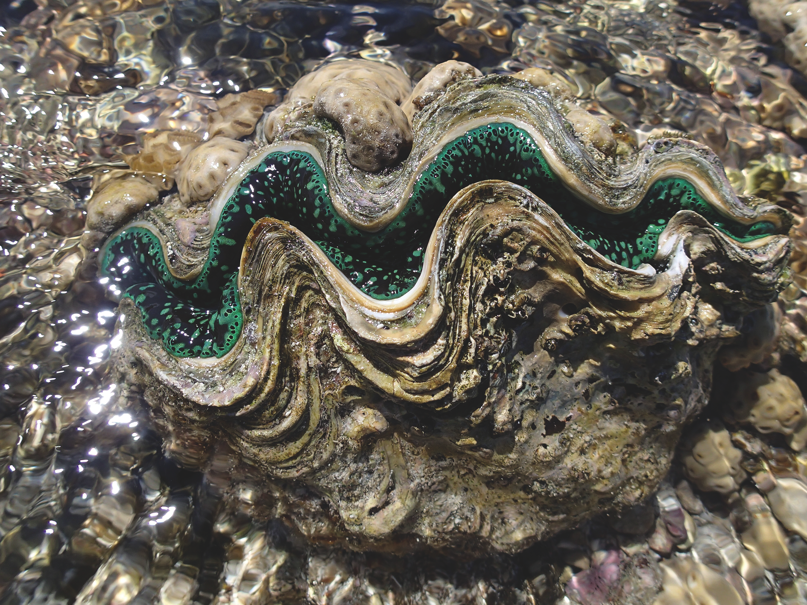
Notes:
Giant clam recorders of ENSO variability
Mary Elliot1, K. Welsh2 and R. Driscoll3
1Laboratoire de Planetologie et Geodynamique, Université de Nantes, France; mary.elliot@univ-nantes.fr
2School of Earth Science, University of Queensland, St. Lucia, Australia; 3School of GeoSciences, University of Edinburgh, UK
Figure 1: Photo of a live Tridacna gigas from Heron Island. T. gigas are reef dwelling mollusks which have symbiotic algae living within their mantle. Valves are 50 cm from end to end. Photo K. Welsh.

Slide 9
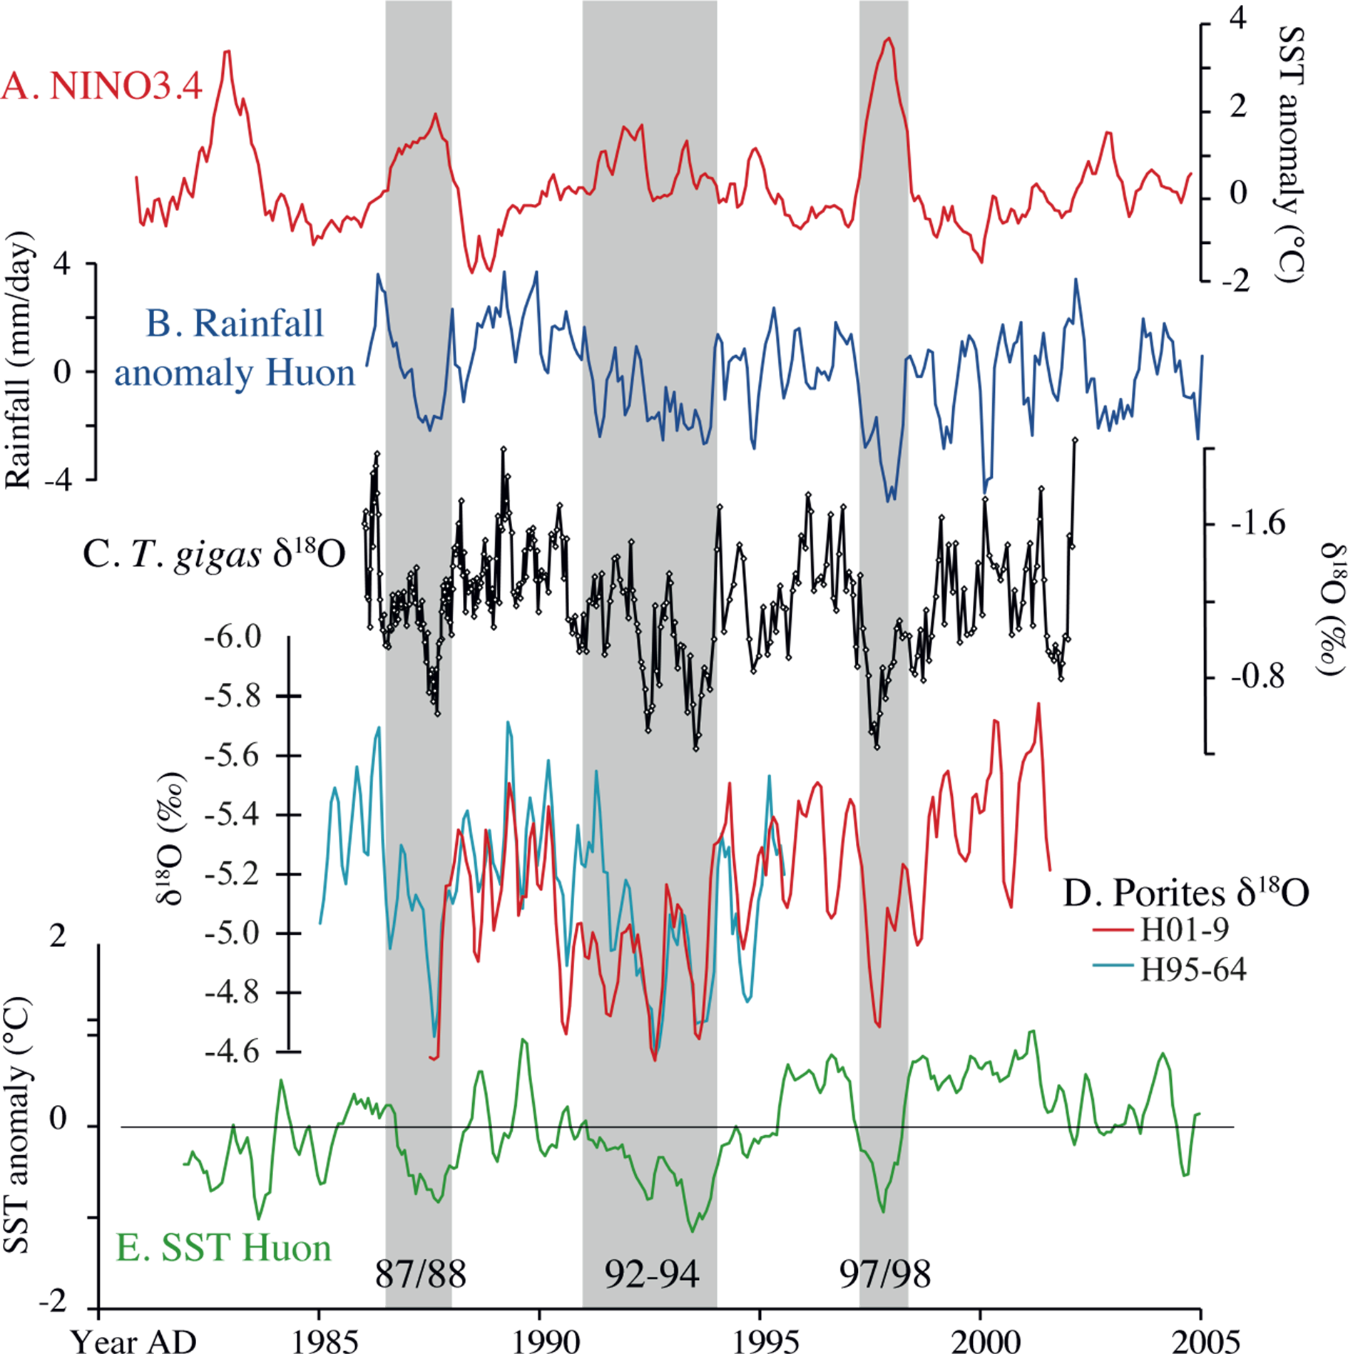
Notes:
Giant clam recorders of ENSO variability
Mary Elliot1, K. Welsh2 and R. Driscoll3
1Laboratoire de Planetologie et Geodynamique, Université de Nantes, France; mary.elliot@univ-nantes.fr
2School of Earth Science, University of Queensland, St. Lucia, Australia; 3School of GeoSciences, University of Edinburgh, UK
Figure 2: Comparison of T. gigas δ18O profile with ENSO index, local temperature and rainfall data. A) NINO3.4 index, (B) 3pt smoothed monthly rainfall anomaly (mm day-1, NASA/GPCPV2) for 146.25ÅãE, 6.25ÅãS, (C) T. gigas δ18O record, (D) Porites δ18O profiles and (E) 3pt smoothed monthly SST anomaly (from IGOSS) for the same grid box as the rainfall data. Y-axes of the δ18O are inverted. The shaded bands indicate El Nino events.

Slide 10
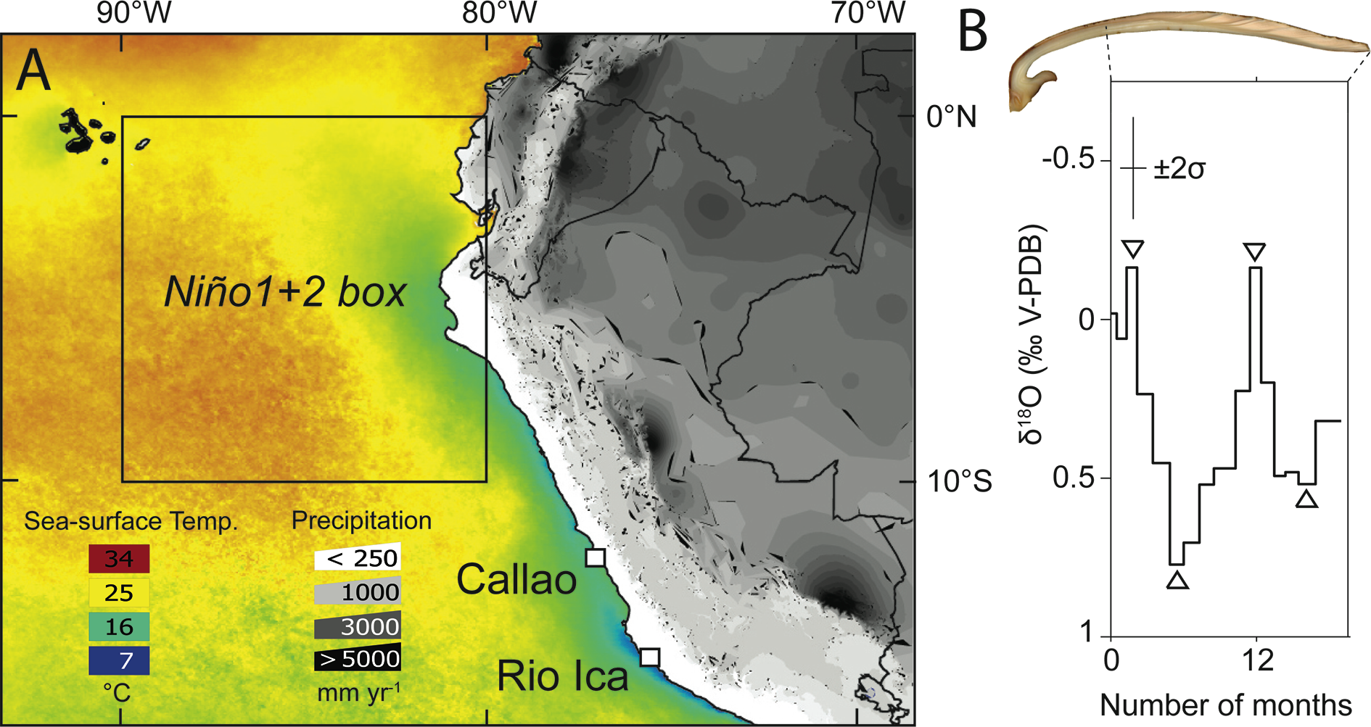
Notes:
Reconstructing ENSO in the Eastern Tropical Pacific from short-lived marine mollusks
Matthieu Carré1, S. Purca2 and J.P. Sachs3
1UM2-CNRS-IRD, Institut des Sciences de l'Evolution de Montpellier, France; matthieu.carre@univ-montp2.fr
2Instituto del Mar del Peru, Callao, Peru; 3School of Oceanography, University of Washington, Seattle, USA
Figure 1: A) Annual mean SST and precipitation for the 1950-2010 period. Location of the Ni.o1+2 region in the Eastern Tropical Pacific and the Peruvian localities mentioned. B) Polished section of a M. donacium shell, and the associated δ18O plotted on a time scale. The shell was continuously sampled so that every data point integrates about one month. The chronology was determined using shell growth lines. Triangles indicate seasonal extrema used for the calculation of seasonal amplitudes ΔT.

Slide 11
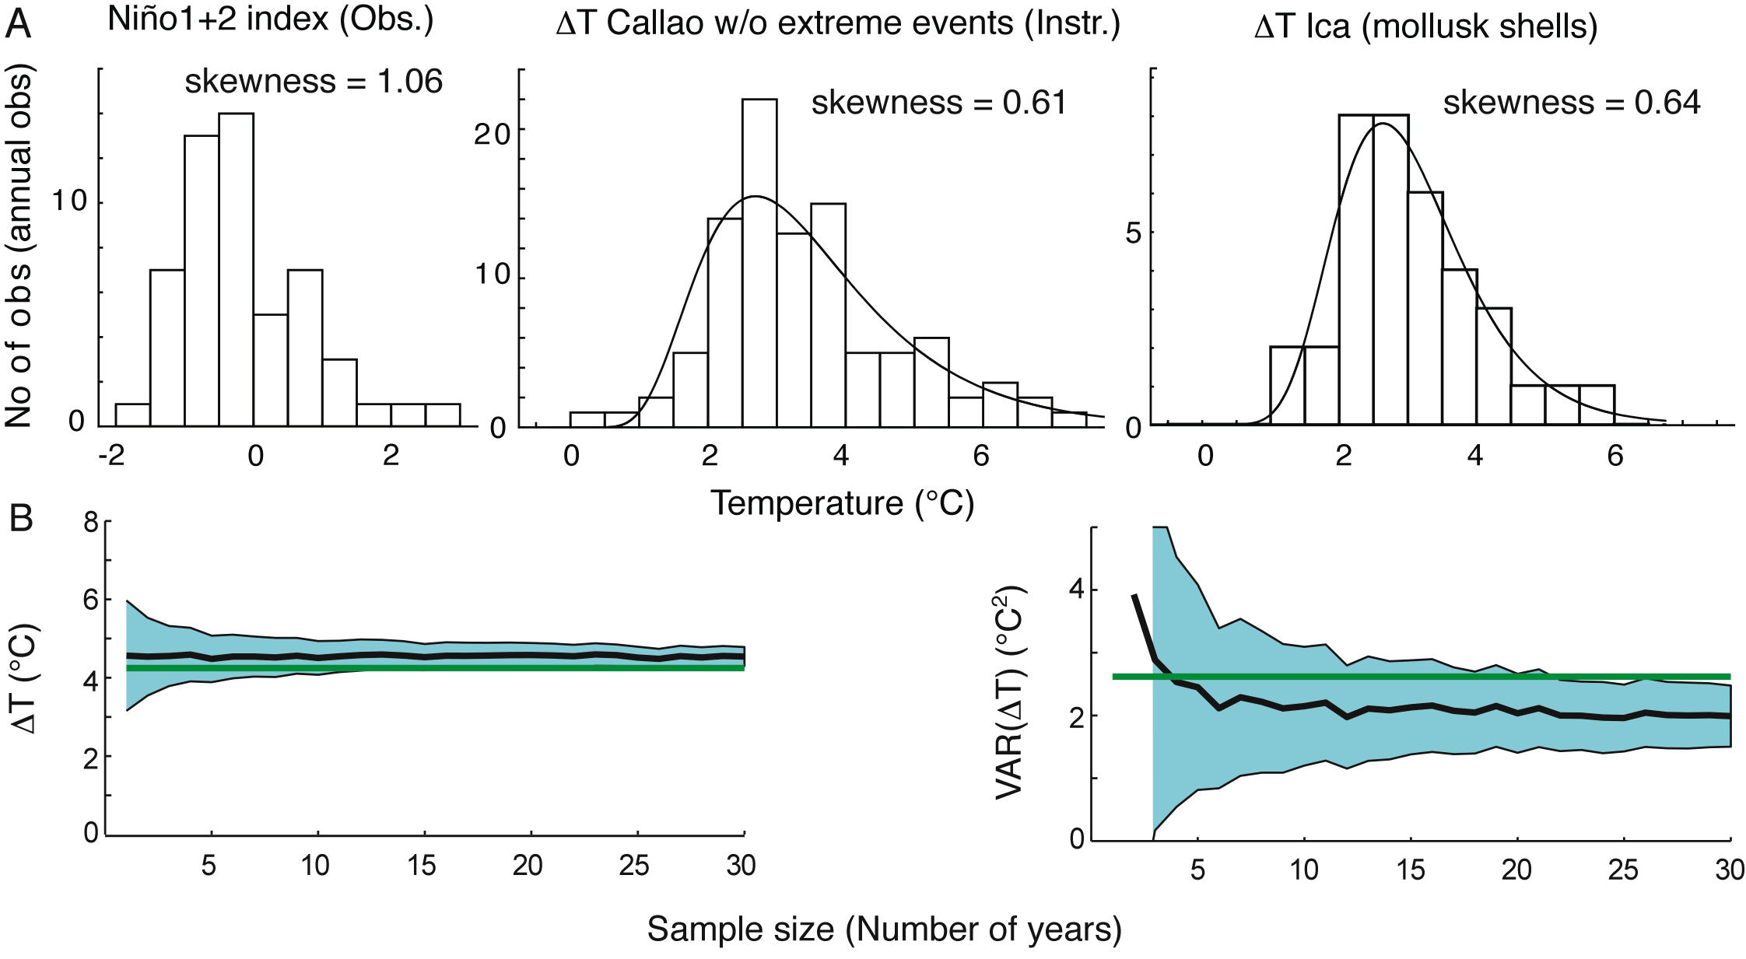
Notes:
Reconstructing ENSO in the Eastern Tropical Pacific from short-lived marine mollusks
Matthieu Carré1, S. Purca2 and J.P. Sachs3
1UM2-CNRS-IRD, Institut des Sciences de l'Evolution de Montpellier, France; matthieu.carre@univ-montp2.fr
2Instituto del Mar del Peru, Callao, Peru; 3School of Oceanography, University of Washington, Seattle, USA
Figure 2: A) Distributions of annual Ni.o1+2 index from 1950 to 2002, seasonal ΔT values in Callao, Peru from 1950 to 2002 excluding extreme El Nino events in 1982-83 and 1997-98, and ΔT values calculated from a modern sample of M. donacium shells from Ica, Peru. B) Results of Monte Carlo simulations undertaken to estimate the uncertainties of mollusk-derived paleoclimate reconstructions. Plots show the true value (green), the ensemble average value (black line), and the standard error (blue area) vs. the sample size, for the reconstruction of the mean and variance of ΔT.

Slide 12
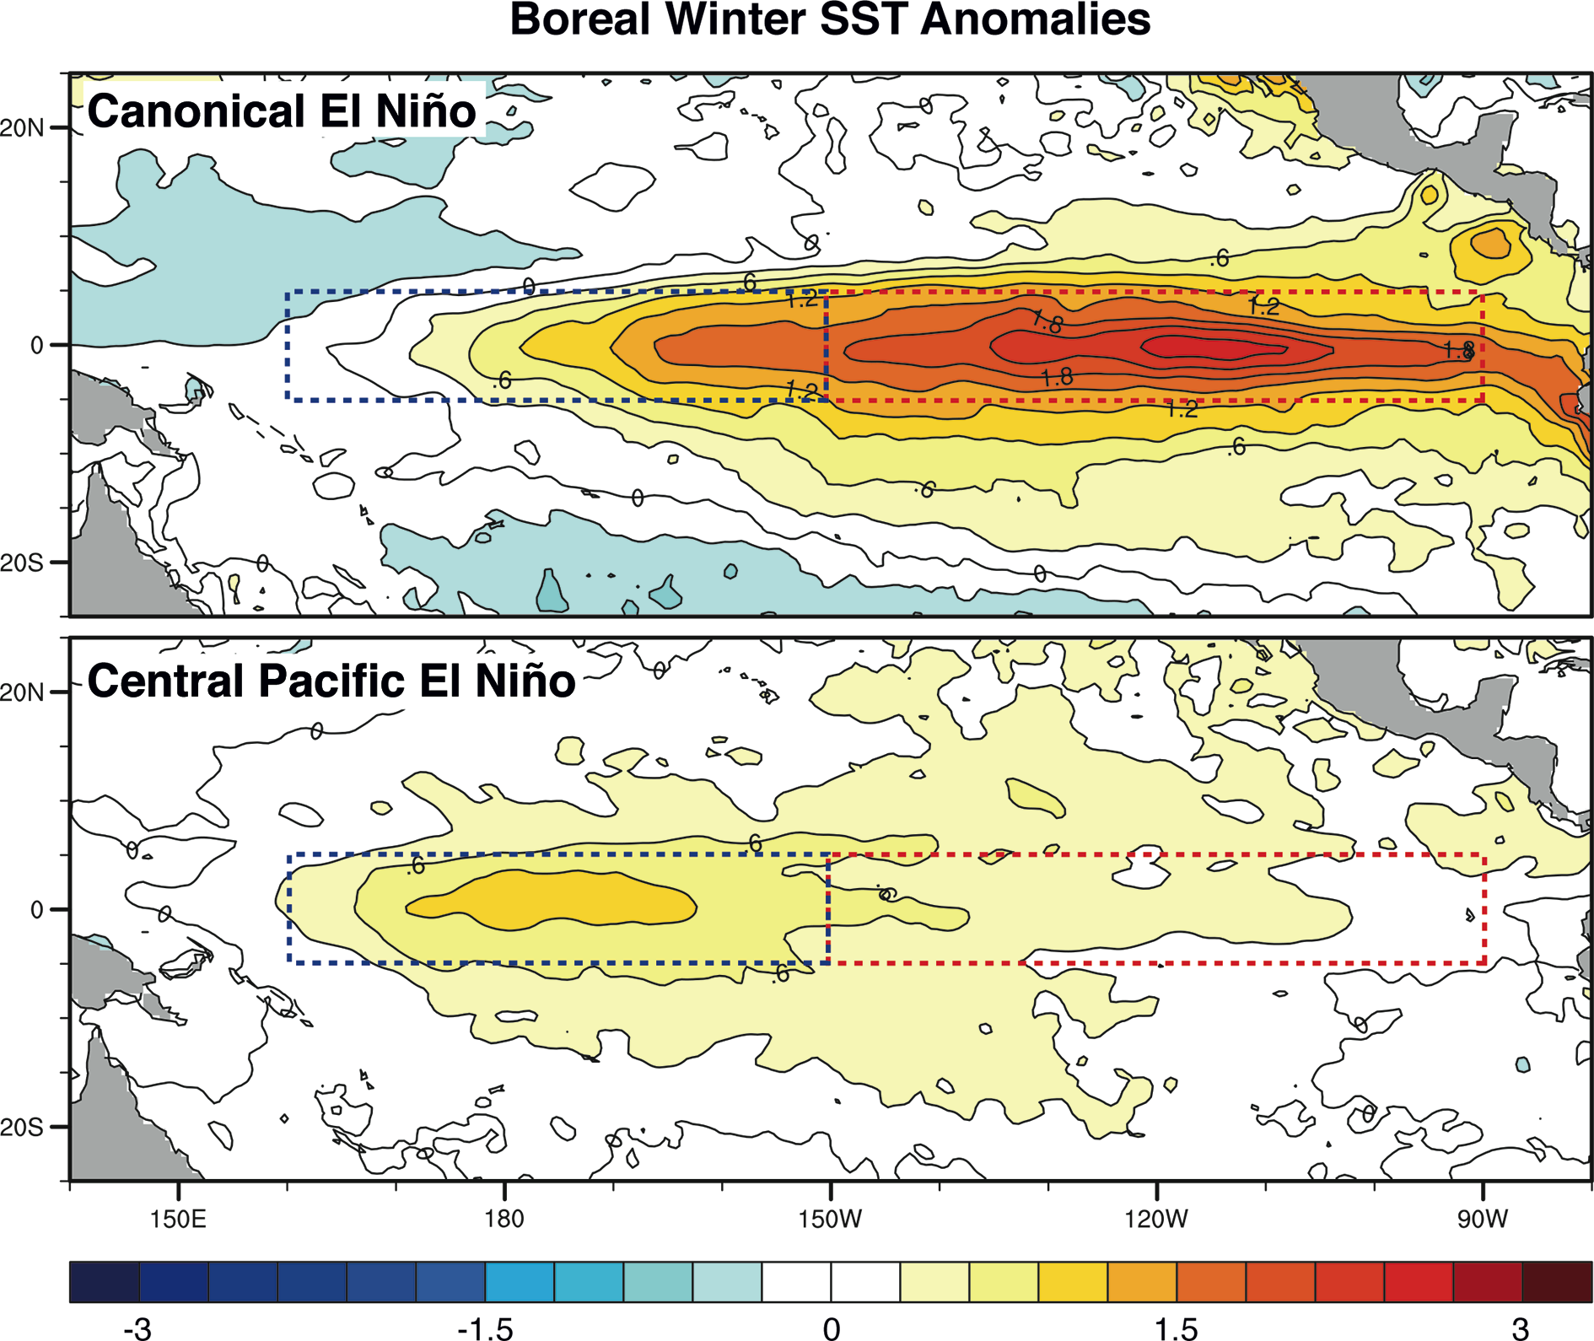
Notes:
Challenges in understanding and modeling ENSO
Antonietta Capotondi1, E. Guilyardi2 and B. Kirtman3
1CIRES, University of Colorado, Boulder, USA; antonietta.capotondi@noaa.gov
2LOCEAN, Institut Pierre Simon Laplace, Paris, France; 3RSMAS/MPO, University of Miami, USA
Figure 1: Composite spatial pattern of SST anomalies for the “canonical” (top) and “Central Pacific” (bottom) El Nino types (SODA 2.0.2/3) from 1958 to 2007 computed with the approach of Kug et al. (2009). Canonical El Ninos are characterized by a boreal winter (DJF) Nino3 index larger than 0.5°C and larger than the Nino4 index (red and blue dashed boxes, respectively), and vice versa for the Central Pacific El Nino (from Capotondi, in press). Observed El Nino events can be described as blends of these two end-member types.

Slide 13
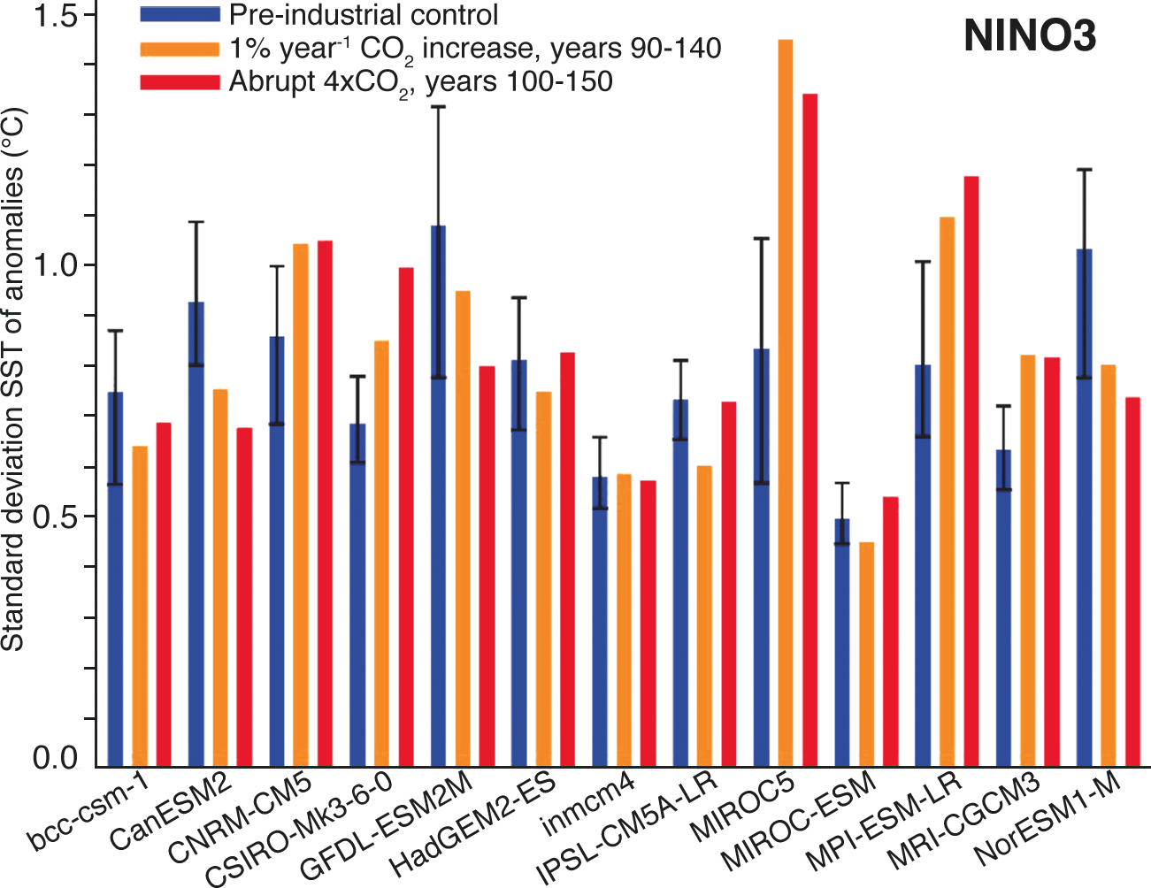
Notes:
Challenges in understanding and modeling ENSO
Antonietta Capotondi1, E. Guilyardi2 and B. Kirtman3
1CIRES, University of Colorado, Boulder, USA; antonietta.capotondi@noaa.gov
2LOCEAN, Institut Pierre Simon Laplace, Paris, France; 3RSMAS/MPO, University of Miami, USA
Figure 2: Standard deviation of Nino3 SST anomalies for thirteen CMIP5 model experiments. Blue bars, pre-industrial control experiments; orange bars, years 90-140 from the 1% year-1 CO2 increase experiments; red bars, years 50-150 after an abrupt four-fold CO2 increase. Model names are given on the x-axis. Error bars indicate the standard deviations over 50-year windows of Nino3 anomalies in the multi-century control experiments. Thus, when the Ni.o3 standard deviation in one of the CO2 runs falls outside the error bar, the changes are deemed significant (modified from Guilyardi et al. 2012b). As in CMIP3, this new set of model simulations does not provide a clear trend for ENSO strength in a warming climate.

Slide 14
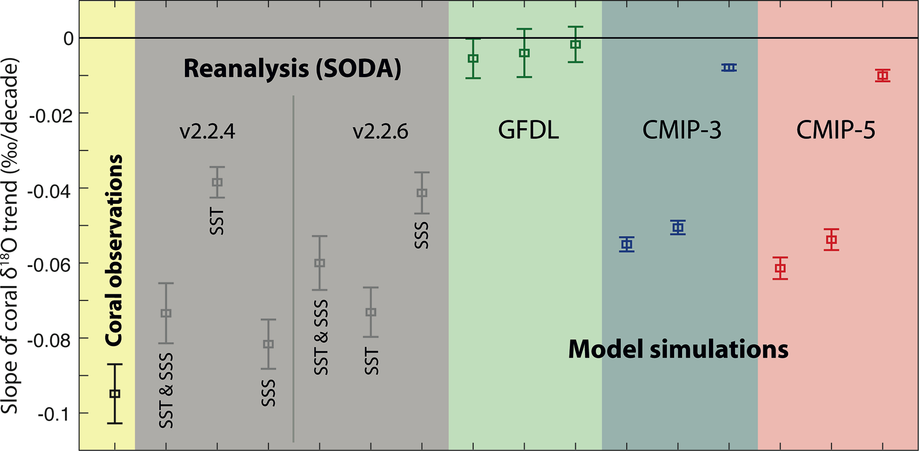
Notes:
Coral-model comparison highlighting the role of salinity in long-term trends
Diane M. Thompson1, T.R. Ault1, M.N. Evans2,1, J.E. Cole1,3, J. Emile-Geay4, A.N. LeGrande5
1Department of Geosciences, University of Arizona, Tucson, USA; thompsod@email.arizona.edu
2Department of Geology and Earth System Science Interdisciplinary Center, University of Maryland, College Park, USA; 3Department of Atmospheric Sciences, University of Arizona, Tucson; USA; 4Department of Earth Sciences, University of Southern California, Los Angeles, USA; 5NASA Goddard Institute for Space Studies and Center for Climate Systems Research, Columbia University, New York, USA
Figure 1: Magnitude of the trend slope (‰ per decade), computed by linear regression through the trend principal component (PC) in corals (far left) and pseudocorals modeled from Simple Ocean Data Assimilation (SODA) 20th century reanalysis (Carton and Giese 2008; Compo et al. 2011), a 500-year control run from the CGCM version CM2.1 of the Geophysical Fluid Dynamics Laboratory (GFDL cm2.1) (Wittenberg et al. 2009), and all CMIP-3 and CMIP-5 model ensembles (average of all models from each modeling group). In each case, δ18Ocoral was modeled from SST and SSS (1), SST only (2), and SSS only (3). Error bars depict +/-1 standard deviation of the regression estimate.

Slide 15
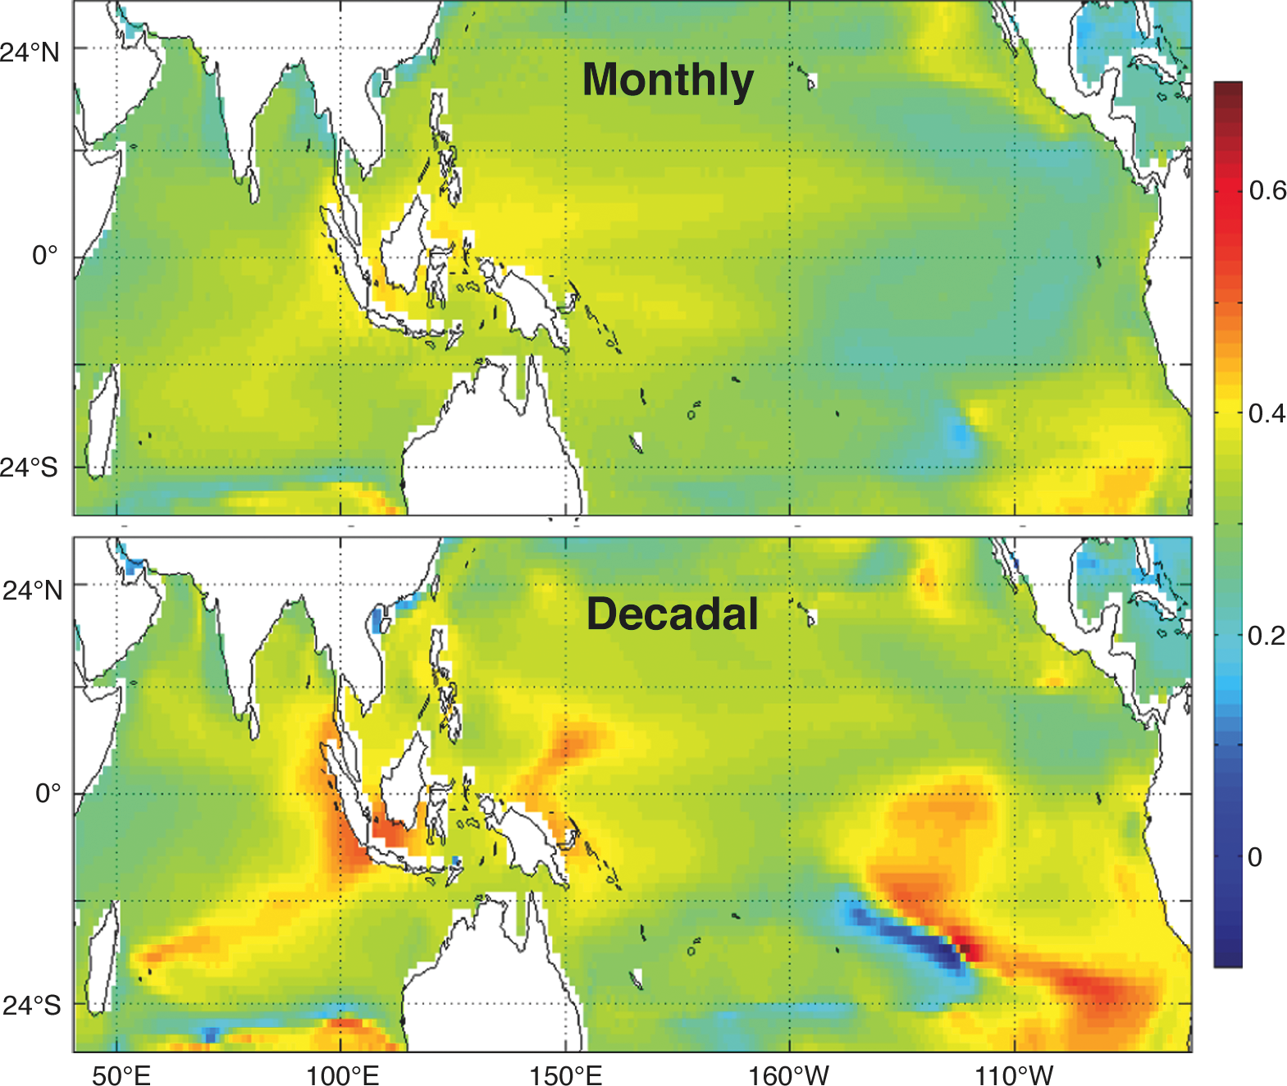
Notes:
Coral-model comparison highlighting the role of salinity in long-term trends
Diane M. Thompson1, T.R. Ault1, M.N. Evans2,1, J.E. Cole1,3, J. Emile-Geay4, A.N. LeGrande5
1Department of Geosciences, University of Arizona, Tucson, USA; thompsod@email.arizona.edu
2Department of Geology and Earth System Science Interdisciplinary Center, University of Maryland, College Park, USA; 3Department of Atmospheric Sciences, University of Arizona, Tucson; USA; 4Department of Earth Sciences, University of Southern California, Los Angeles, USA; 5NASA Goddard Institute for Space Studies and Center for Climate Systems Research, Columbia University, New York, USA
Figure 2: Slope of the GISS ModelE2 simulated δ18Osw vs. salinity relationship at each gridbox on monthly (top) and decadal (bottom) timescales. Decadal series were calculated by averaging the monthly data at 10-year intervals.

Slide 16
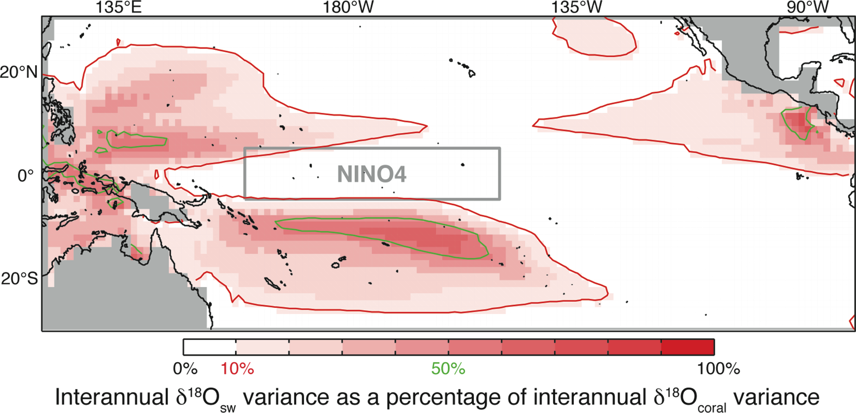
Notes:
The response of pseudo-corals to ENSO in an isotope enabled climate model
Tom Russon1, A.W. Tudhope1, G.C. Hegerl1, M. Collins2 and J. Tindall3
1School of GeoSciences, University of Edinburgh, UK; tom.russon@ed.ac.uk
2College of Engineering, Mathematics and Physical Sciences, University of Exeter, UK; 3School of Earth and Environment, University of Leeds, UK
Figure 1: The percentage of modeled interannual δ18Ocoral variance accounted for by δ18Osw, assuming a SST - δ18Ocoral slope of -0.2‰ K-1. The 10% and 50% levels are contoured in red and green respectively and the location of the NINO4 region is highlighted in gray.

Slide 17
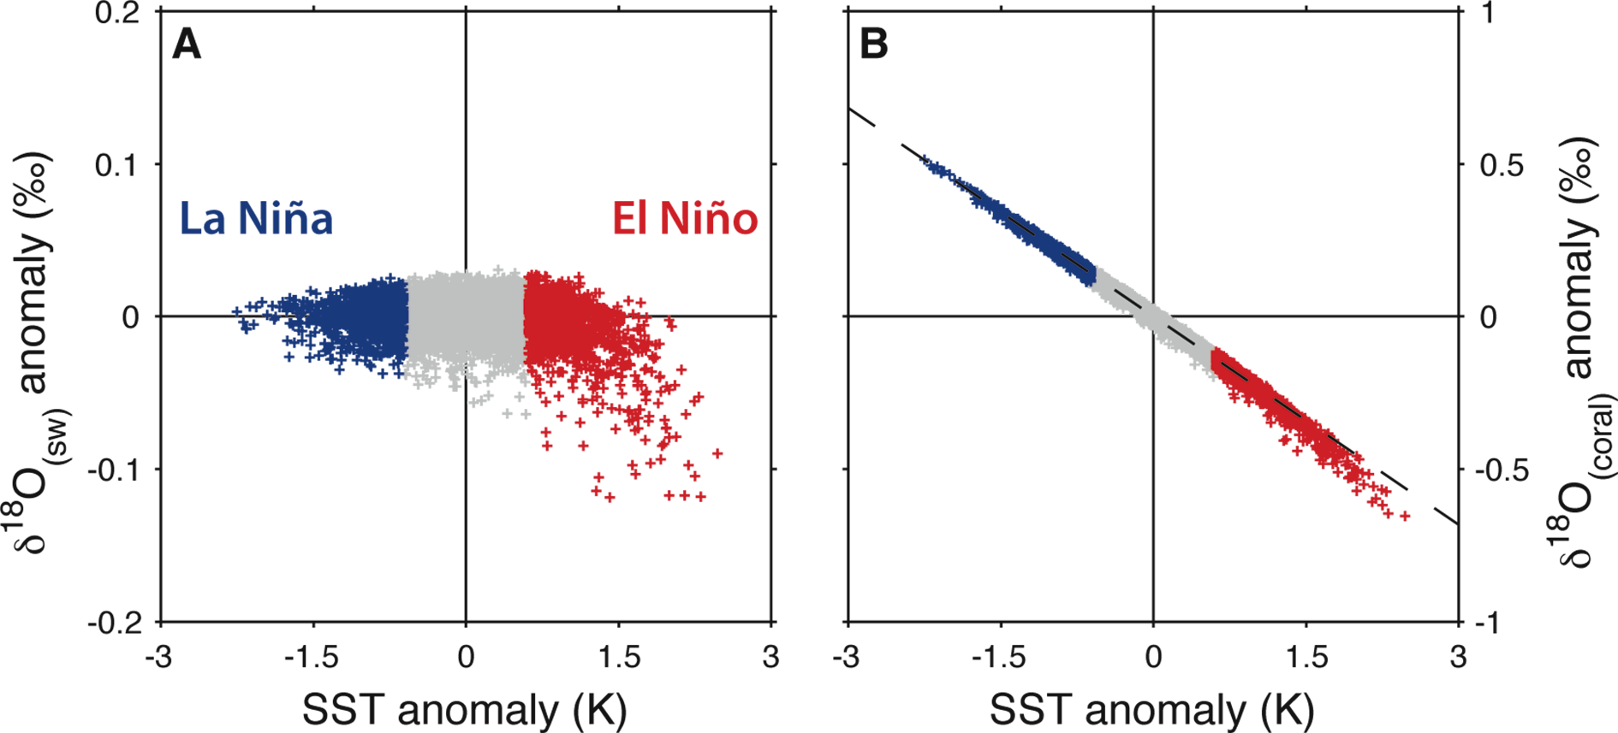
Notes:
The response of pseudo-corals to ENSO in an isotope enabled climate model
Tom Russon1, A.W. Tudhope1, G.C. Hegerl1, M. Collins2 and J. Tindall3
1School of GeoSciences, University of Edinburgh, UK; tom.russon@ed.ac.uk
2College of Engineering, Mathematics and Physical Sciences, University of Exeter, UK; 3School of Earth and Environment, University of Leeds, UK
Figure 2: Scatter plots of modeled monthly inter-annual anomaly data within the NINO4 box. A) shows δ18Osw plotted against SST. B) shows δ18Ocoral plotted against SST, with the assumed slope of -0.2‰ K-1 used to calculate δ18Ocoral shown as a dashed line. Points are color coded according to their SST anomaly values, such that those lying in the upper and lower standard deviations of the SST data are highlighted red and blue, and are associated with El-Nino and La-Nina events respectively.

Slide 18
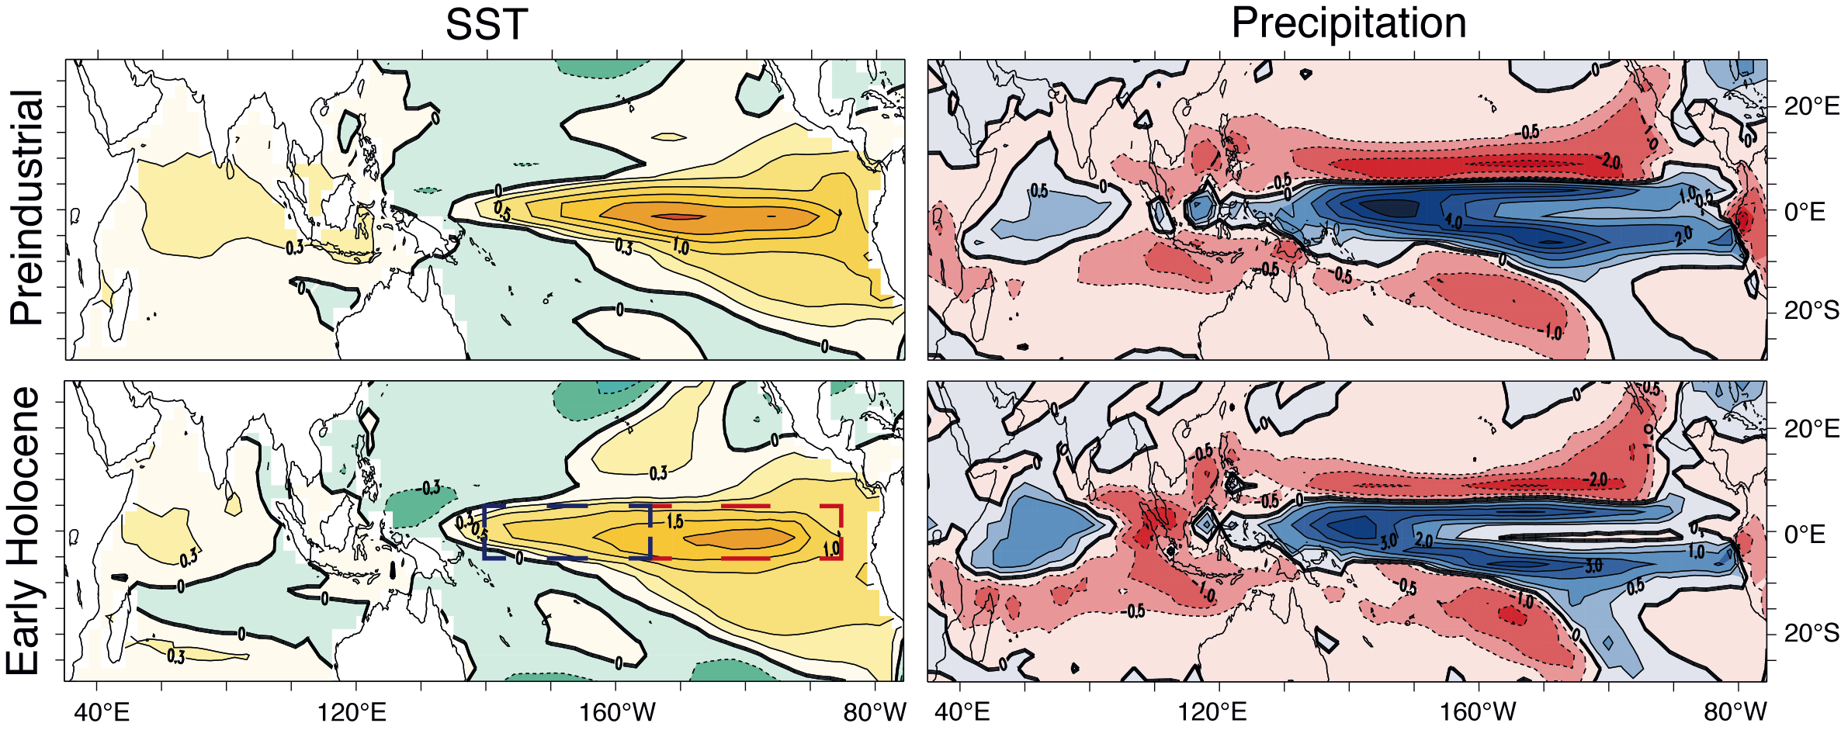
Notes:
ENSO and changes in the mean state in Holocene Simulations
P. Braconnot1 and Y. Luan1,2
1Laboratoire des Sciences du Climat et de l’Environnement, Gif-sur-Yvette, France; pascale.braconnot@lsce.ipsl.fr
2State Key Laboratory of Numerical Modeling for Atmospheric Sciences and Geophysical Fluid Dynamics, Institute of Atmospheric Physics, Beijing, China
Figure 1: Composite sea surface temperature (SST) anomaly and precipitation anomaly maps during El Ni.o events as simulated by the IPSL-CM4 climate model for preindustrial and Early Holocene (9.5 ka BP) climates. The anomalies describe the departures from normal years in each simulation at the peak of the event in December-January. Isolines are plotted every 0.5ÅãC for SST with a refinement of 0.25ÅãC around the 0 line, and every 1 mm d-1 for precipitation with a refinement of 0.5 mm d-1 around the 0 line. The red and blue dashed boxes in the lower left panel show the Ni.o3 and Ni.o4 regions, respectively.

Slide 19
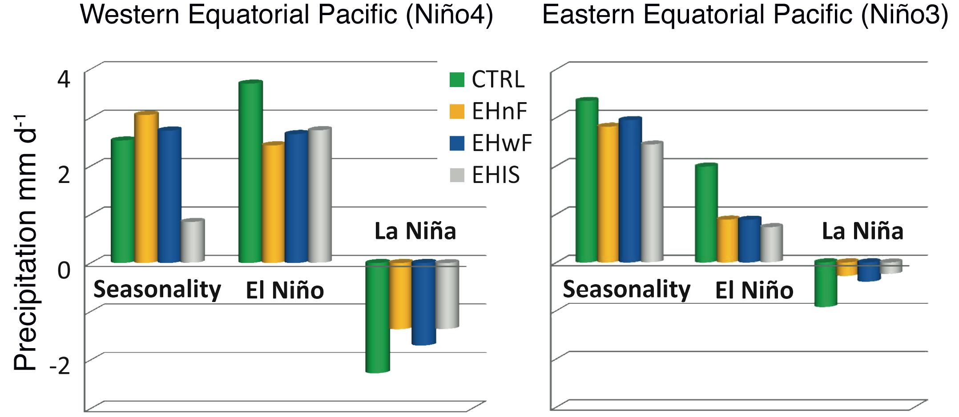
Notes:
ENSO and changes in the mean state in Holocene Simulations
P. Braconnot1 and Y. Luan1,2
1Laboratoire des Sciences du Climat et de l’Environnement, Gif-sur-Yvette, France; pascale.braconnot@lsce.ipsl.fr
2State Key Laboratory of Numerical Modeling for Atmospheric Sciences and Geophysical Fluid Dynamics, Institute of Atmospheric Physics, Beijing, China
Figure 2: Sensitivity experiments: Diagrams of precipitation (mm d-1) averaged over the Ni.o3 and Ni.o4 regions in the Pacific Ocean. Groups of columns show the magnitude of the seasonal cycle and the peak (December) magnitude of El Nino and La Nina events for each of the simulations discussed in the text: pre-industrial (CTRL), Early Holocene (9.5 ka BP, EHnF), Early Holocene with a fresh water flux mimicking ice sheet melting in the North Atlantic (EHwF) and Early Holocene with the presence of remnant Laurentide and Fennoscandian ice sheets (EHIS). See Braconnot et al. (2012) for details on the methodology and statistical significance. The magnitude of the seasonal cycle is computed as the difference between maximum and minimum monthly values at the annual time scale. El Nino and La Nina anomalies correspond to the value at the peak of the event in December.

Slide 20
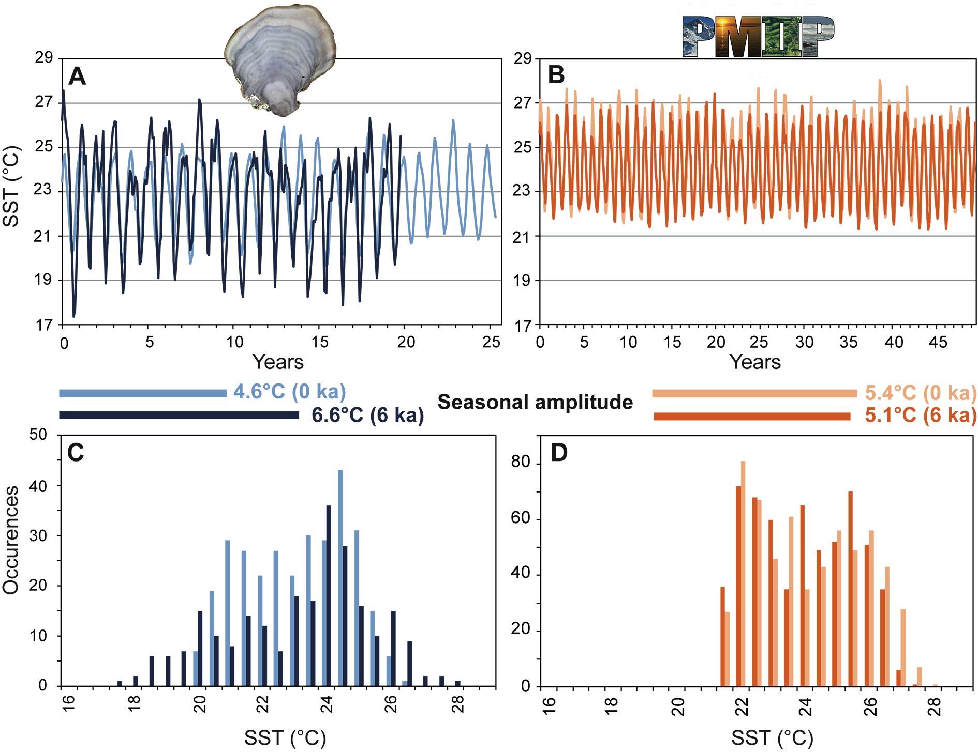
Notes:
A controversial insight into Southwest Pacific mid-Holocene seasonality: from corals to models
Claire E. Lazareth1, M.G. Bustamante Rosell1, N. Duprey1, N. Pujol2, G. Cabioch1,§, S. Caquineau1, T. Corrège2, F. Le Cornec1, C. Maes3,
M. Mandeng-Yogo1 and B. Turcq1
1IPSL/LOCEAN, UPMC/CNRS/IRD/MNHN, Institut de recherche pour le développement France Nord, Bondy, France;
claire.lazareth@locean-ipsl.upmc.fr
2University of Bordeaux, Environnements et Paléoenvironnements Océaniques et Continentaux, Talence, France; 3Laboratoire d’Etudes en Géophysique
et Océanographie Spatiales, Institut de Recherche pour le Développement, Toulouse, France;
§To Guy, in memoriam
Figure 1: Comparison between coral (blue) and model run (orange) results in terms of sea surface temperature (SST; °C) characteristics in the New Caledonia region for the present (light colors) and the mid-Holocene (dark colors) situations. A) Monthly coral time series from New Caledonia, at present (light blue, Stephans et al. 2004; Stephans et al. 2005) and from a coral fossil from the mid-Holocene (5.5 ka BP, dark blue; Lazareth et al. 2013). B) Monthly time series from the CCSM PMIP2-models for the New Caledonia region (160-164°E 20-24°S), at present (light orange) and at the mid-Holocene (6 ka BP; dark orange; Otto-Bliesner et al. 2006). C, D) Monthly SST histograms and calculated seasonal amplitude.

Slide 21
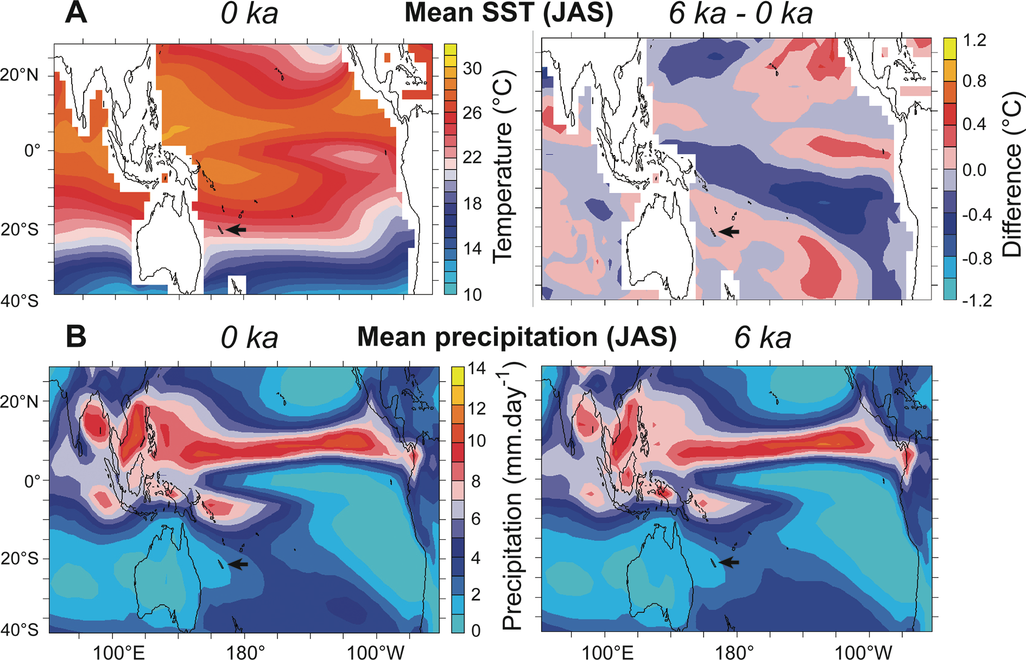
Notes:
A controversial insight into Southwest Pacific mid-Holocene seasonality: from corals to models
Claire E. Lazareth1, M.G. Bustamante Rosell1, N. Duprey1, N. Pujol2, G. Cabioch1,§, S. Caquineau1, T. Corrège2, F. Le Cornec1, C. Maes3,
M. Mandeng-Yogo1 and B. Turcq1
1IPSL/LOCEAN, UPMC/CNRS/IRD/MNHN, Institut de recherche pour le développement France Nord, Bondy, France;
claire.lazareth@locean-ipsl.upmc.fr
2University of Bordeaux, Environnements et Paléoenvironnements Océaniques et Continentaux, Talence, France; 3Laboratoire d’Etudes en Géophysique
et Océanographie Spatiales, Institut de Recherche pour le Développement, Toulouse, France;
§To Guy, in memoriam
Figure 2: Multi-model mean maps for the winter season (July-August-September, JAS). Six PMIP2 simulations having similar resolution and reproducing correctly the mean seasonal cycle in the New Caledonia region have been used. The arrow points to New Caledonia. A) SST multi-model maps at 0 ka (left) and difference (6 ka – 0 ka; right). B) Multi-model mean precipitation field at 0 ka (left) and 6 ka (right). Modified from Lazareth et al. (2013).

Slide 22
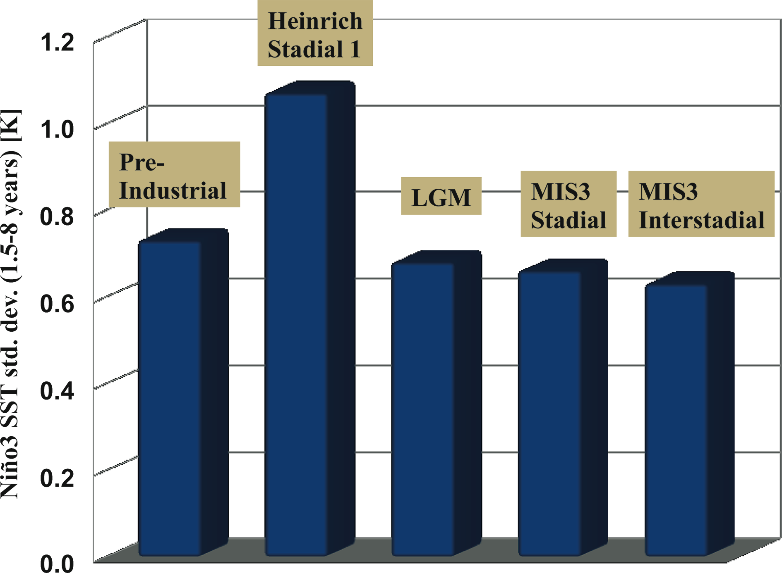
Notes:
Interannual variability in the tropical Pacific and associated atmospheric teleconnections during the last glacial period
Ute Merkel, M. Prange and M. Schulz
MARUM - Center for Marine Environmental Sciences, University of Bremen, Germany; umerkel@marum.de
Figure 1: ENSO variability of sea surface temperature in the eastern tropical Pacific (Ni.o3 region: 150°W-90°W, 5°S-5°N) for different simulated climatic states.

Slide 23
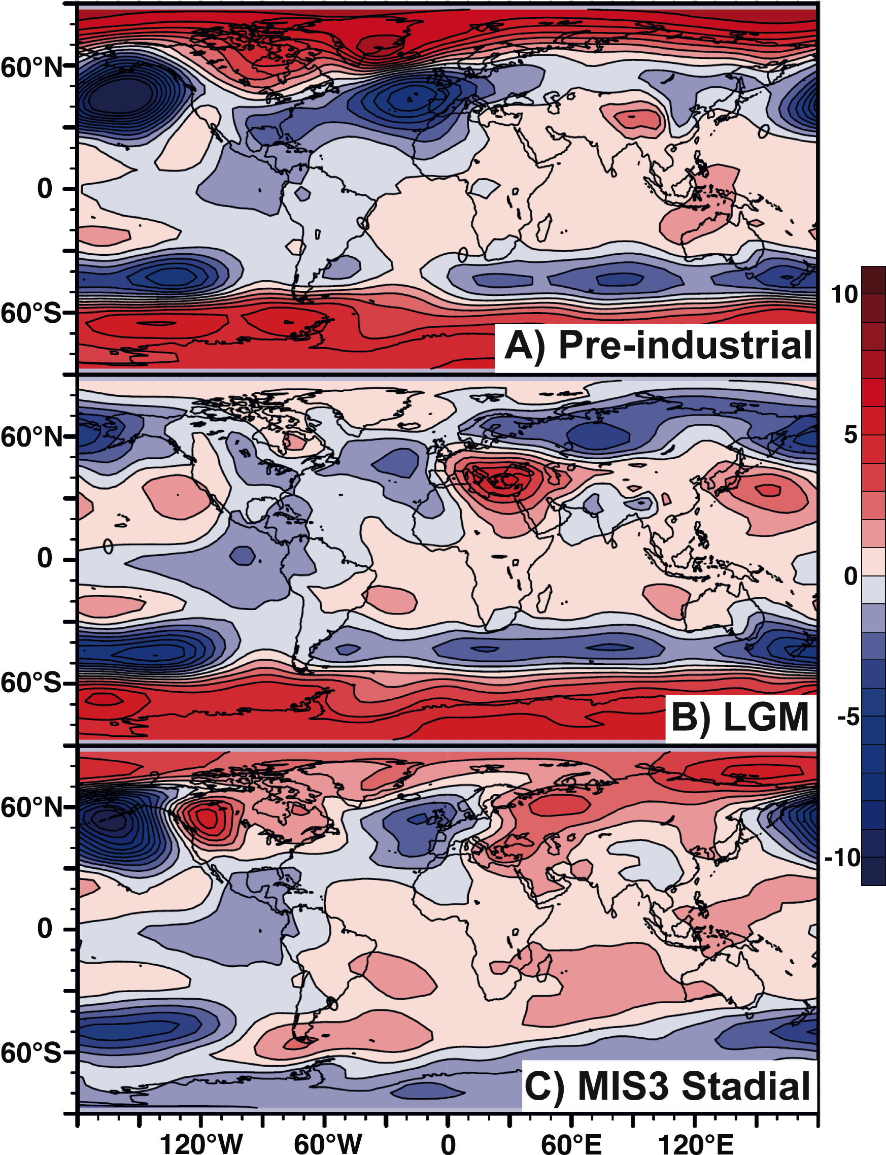
Notes:
Interannual variability in the tropical Pacific and associated atmospheric teleconnections during the last glacial period
Ute Merkel, M. Prange and M. Schulz
MARUM - Center for Marine Environmental Sciences, University of Bremen, Germany; umerkel@marum.de
Figure 2: ENSO teleconnections during boreal winter (Dec.-Feb.): El Nino minus La Nina composites of sea level pressure [hPa] for (A) pre-industrial control climate, (B) LGM, and (C) MIS3 stadial climate. Figure modified from Merkel et al. 2010.

Slide 24
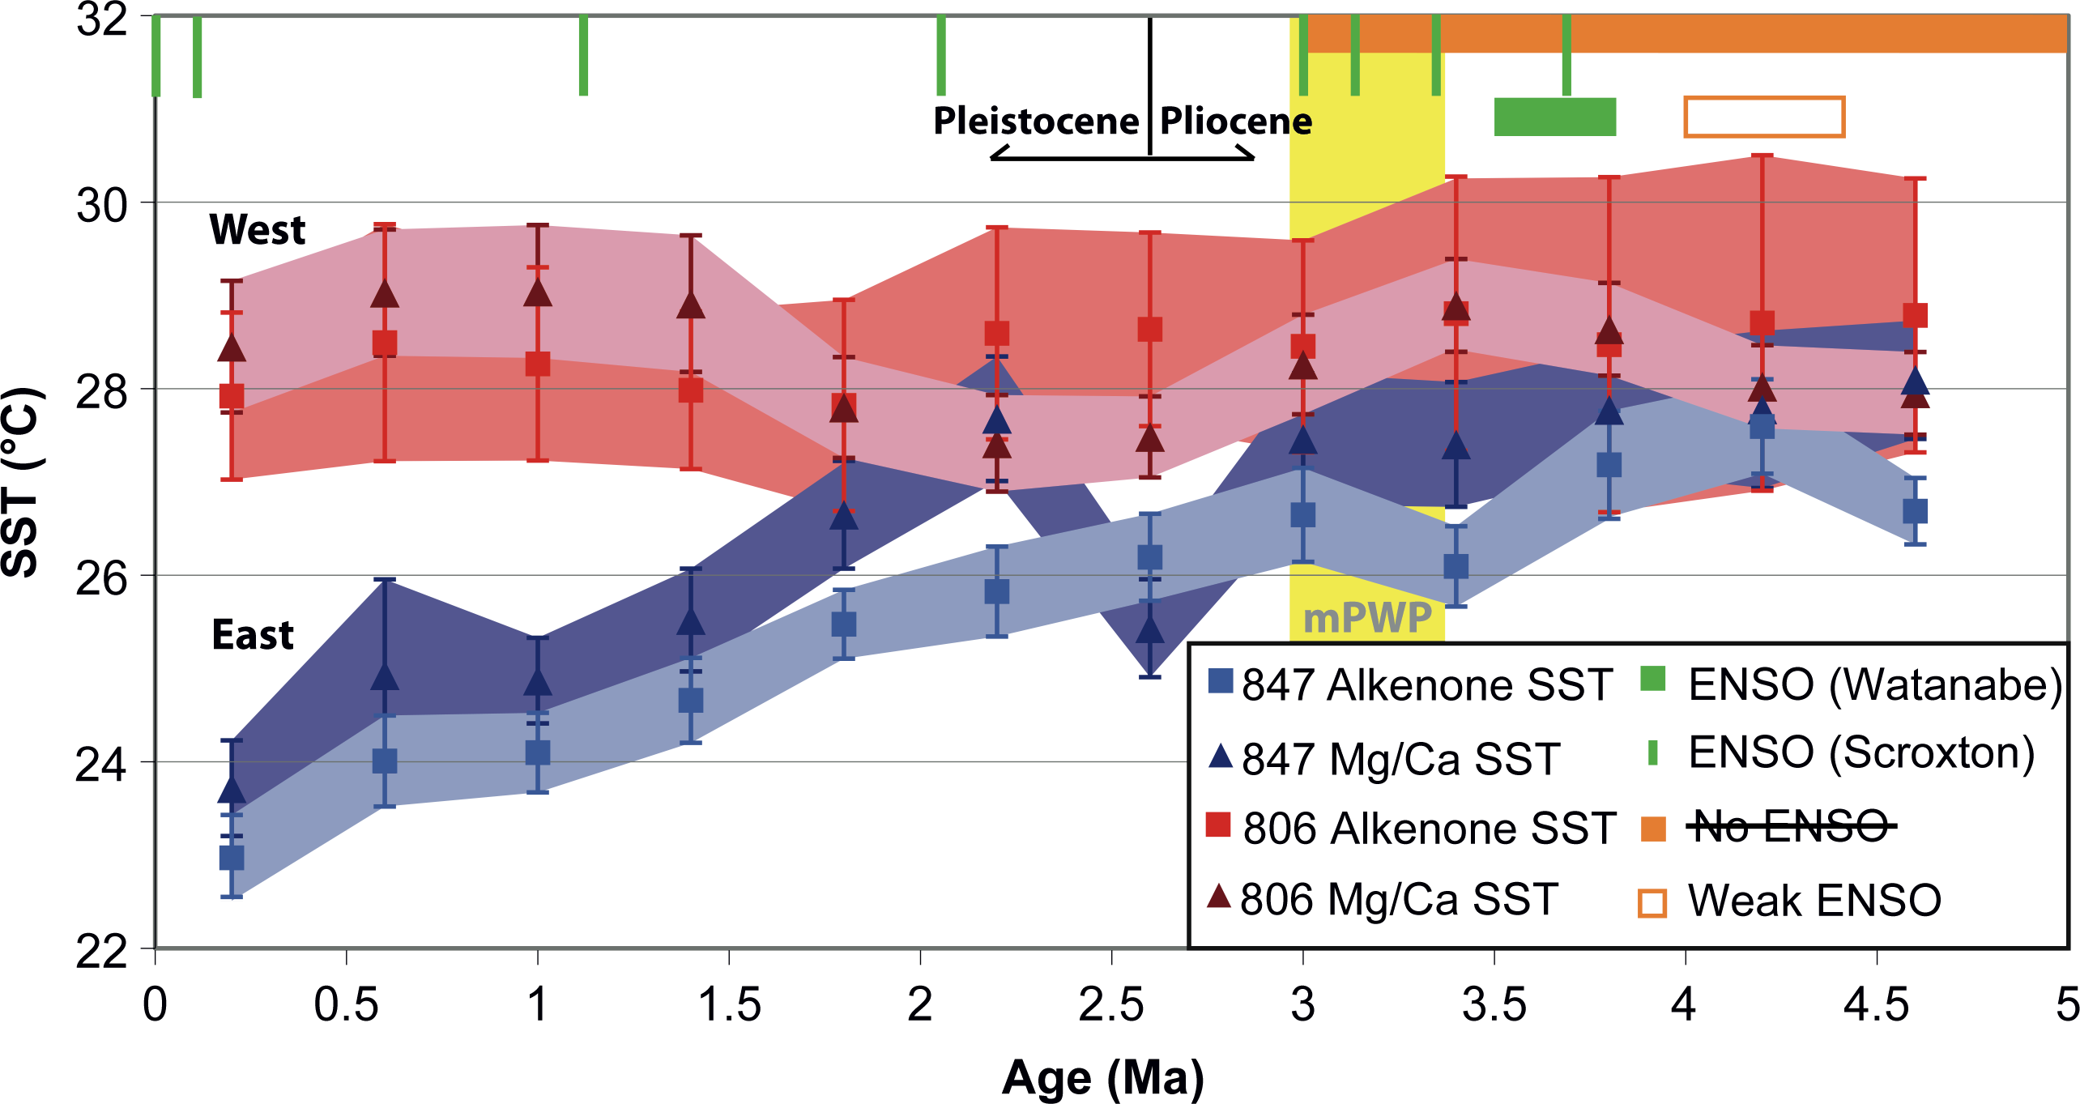
Notes:
ENSO behavior before the Pleistocene
Chris Brierley
Department of Geography, University College London, UK; c.brierley@ucl.ac.uk
Figure 1: Variation in the Sea Surface Temperature in the Equatorial Pacific over the past five million years. The estimates come from two ocean cores in the West (ODP 806 at 150ÅãE) and the East (ODP 847 at 95ÅãW). Two different types of record are used to reconstruct the temperatures: Mg/Ca (Wara et al. 2005) and alkenones (Dekens et al. 2007; Pagani et al. 2010). The period described as lacking ENSO variability (i.e. the period of the “permanent El Ni.o”) from a mistaken interpretation of Fedorov et al. (2006) is shown in orange. Times with observed ENSO variability, as found by Scroxton et al. (2011) and Watanabe et al. (2011), are marked in green. The time-slab used by PlioMIP and its precursors is marked as “mPWP”. Figure modified after Fedorov et al. (2013).

Slide 25
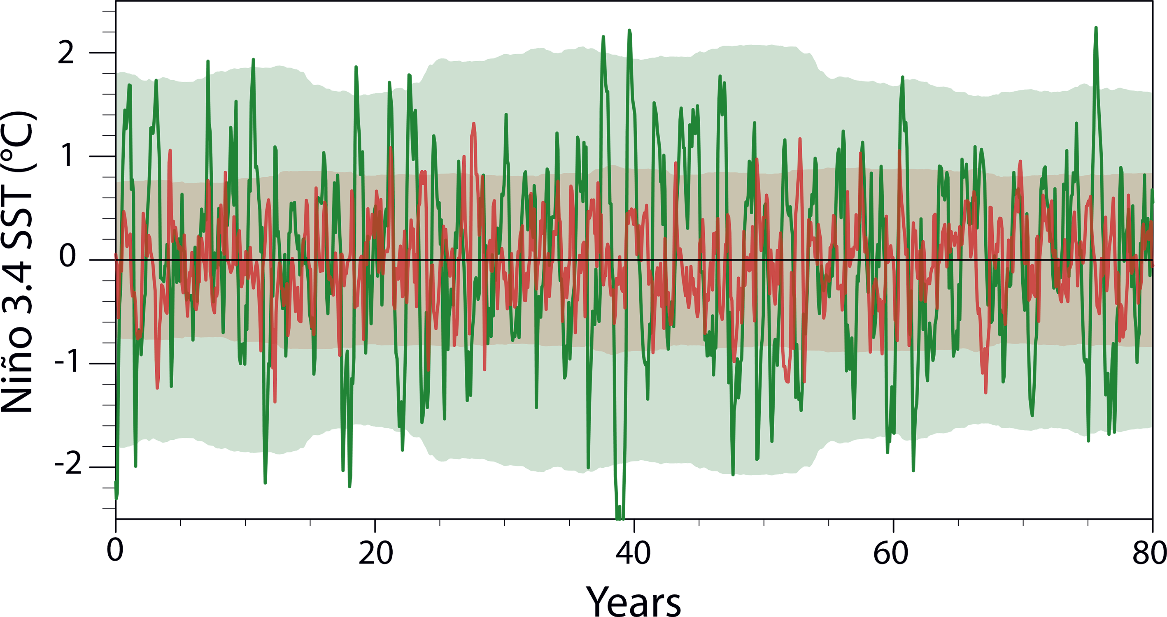
Notes:
ENSO behavior before the Pleistocene
Chris Brierley
Department of Geography, University College London, UK; c.brierley@ucl.ac.uk
Figure 2: Nino 3.4 SST anomalies in two model simulations; a control (green) and one with an equatorial SST gradient that is approximately halved (red). The shaded area represents four standard deviations from a 30-year running window (Fedorov et al. 2010).

Slide 26
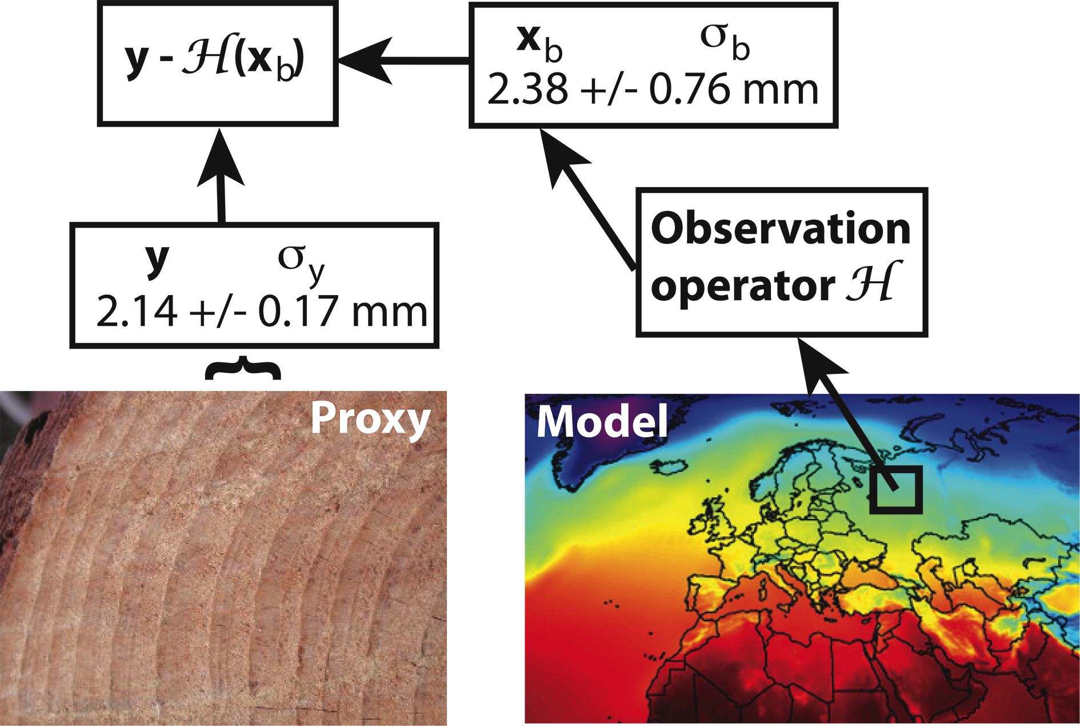
Notes:
Overview of data assimilation methods
Gregory J. Hakim1, J. Annan2, S. Brönniman3, M. Crucifix4, T. Edwards5, H. Goosse4, A. Paul6, G. van der Schrier7and M. Widmann8
1Department of Atmospheric Sciences, University of Washington, Seattle, USA; ghakim@uw.edu
2Research Institute for Global Change, JAMSTEC, Yokohama Institute for Earth Sciences, Japan; 3Institute of Geography and Oeschger Centre for Climate Change Research, University of Bern, Switzerland; 4Earth and Life Institute and Georges Lemaître Centre for Earth and Climate Research, Université catholique de Louvain, Belgium; 5Department of Geographical Sciences, University of Bristol, UK; 6MARUM and Department of Geosciences, University of Bremen, Germany; 7KNMI, De Bilt, The Netherlands; 8School of Geography, Earth and Environmental Sciences, University of
Birmingham, UK
Figure 1: Schematic illustration of how the innovation is determined in data assimilation for a tree-ring example. Proxy measurements are illustrated on the left, and model estimates of the proxy on the right. The observation operator provides the map from gridded model data, such as temperature, to tree-ring width, which is used to compute the innovation. Images credit: Wikipedia.

Slide 27
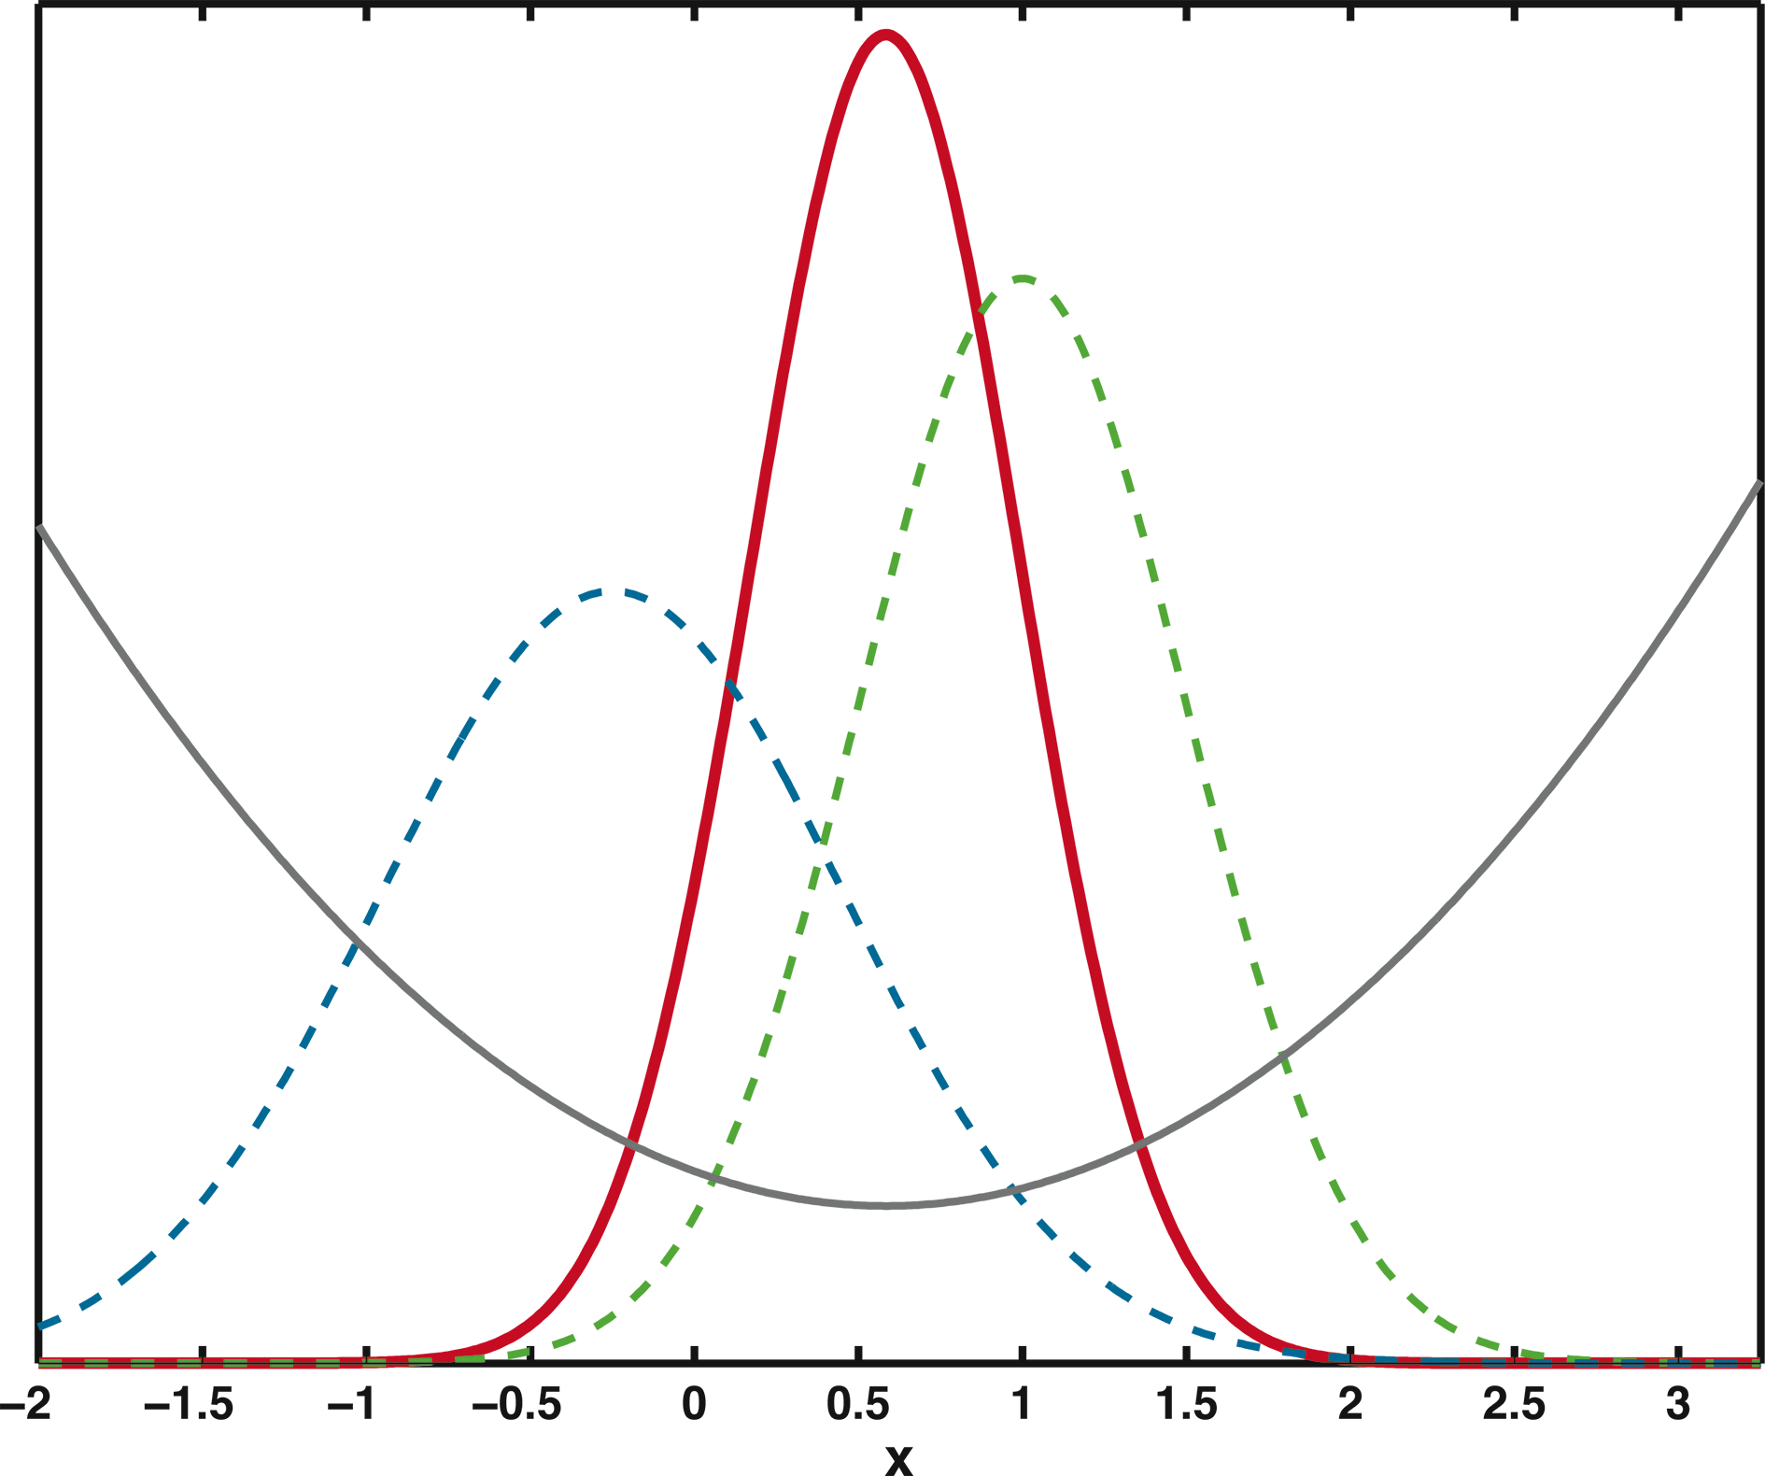
Notes:
Overview of data assimilation methods
Gregory J. Hakim1, J. Annan2, S. Brönniman3, M. Crucifix4, T. Edwards5, H. Goosse4, A. Paul6, G. van der Schrier7and M. Widmann8
1Department of Atmospheric Sciences, University of Washington, Seattle, USA; ghakim@uw.edu
2Research Institute for Global Change, JAMSTEC, Yokohama Institute for Earth Sciences, Japan; 3Institute of Geography and Oeschger Centre for Climate Change Research, University of Bern, Switzerland; 4Earth and Life Institute and Georges Lemaître Centre for Earth and Climate Research, Université catholique de Louvain, Belgium; 5Department of Geographical Sciences, University of Bristol, UK; 6MARUM and Department of Geosciences, University of Bremen, Germany; 7KNMI, De Bilt, The Netherlands; 8School of Geography, Earth and Environmental Sciences, University of
Birmingham, UK
Figure 2: Data assimilation for scalar variable x assuming Gaussian error statistics. Prior estimate, given by the dashed blue line, has mean -0.25 and variance 0.5. Observation y, given by the dashed green line, has mean 1.0 and variance 0.25. The analysis, given by the thick red line, has mean 0.58 and variance 0.17. The parabolic gray curve denotes a cost function, J, which measures the misfit to both the observation and prior; it takes a minimum at the mean value of xa. From Holton and Hakim 2012.

Slide 28
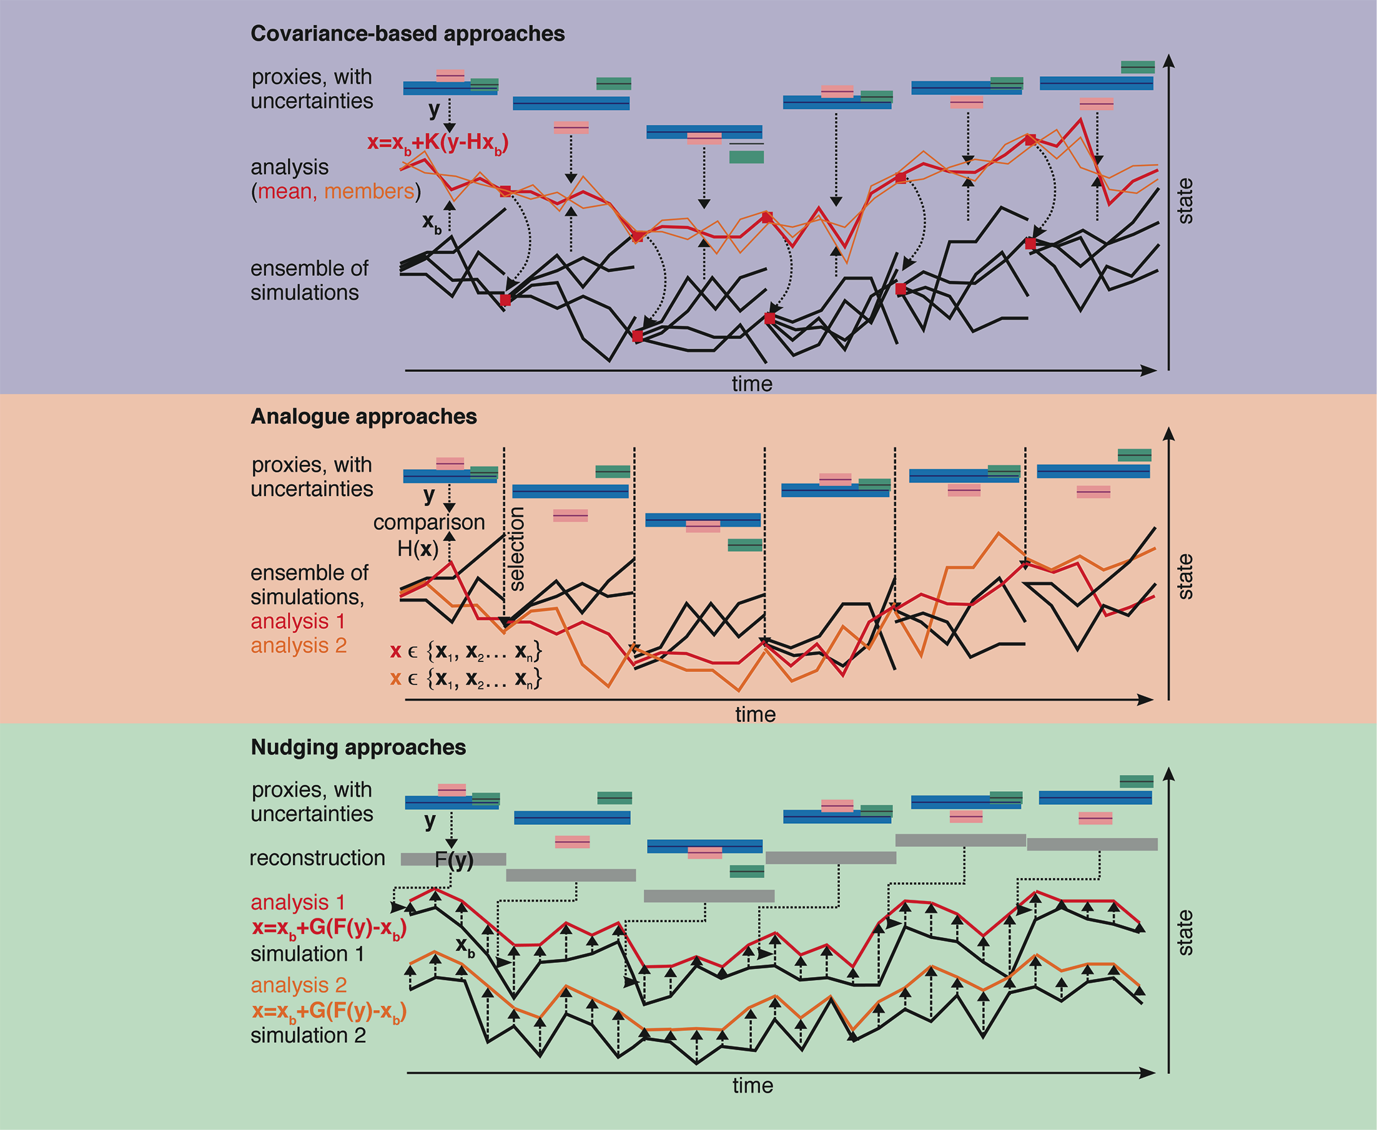
Notes:
Transient state estimation in paleoclimatology using data assimilation
Stefan Brönimann1, J. Franke1, P. Breitenmoser1, G. Hakim2, H. Goosse3, M. Widmann4, M. Crucifix3, G. Gebbie5, J. Annans and G. van der Schrier7
1Institute of Geography and Oeschger Centre for Climate Change Research, University of Bern, Switzerland; stefan.broennimann@giub.unibe.ch
2Department of Atmospheric Sciences, University of Washington, Seattle, USA; 3Earth and Life Institute and Georges Lemaître Centre for Earth and Climate Research, Université catholique de Louvain, Belgium; 4School of Geography, Earth and Environmental Sciences, University of Birmingham, UK; 5Department of Physical Oceanography, Woods Hole Oceanographic Institution, USA; 6Research Institute for Global Change, JAMSTEC, Yokohama Institute for Earth Sciences, Japan; 7KNMI, De Bilt, The Netherlands
Figure 1: Schematic overview of assimilation approaches. Arrows denote steps in the procedure.

Slide 29
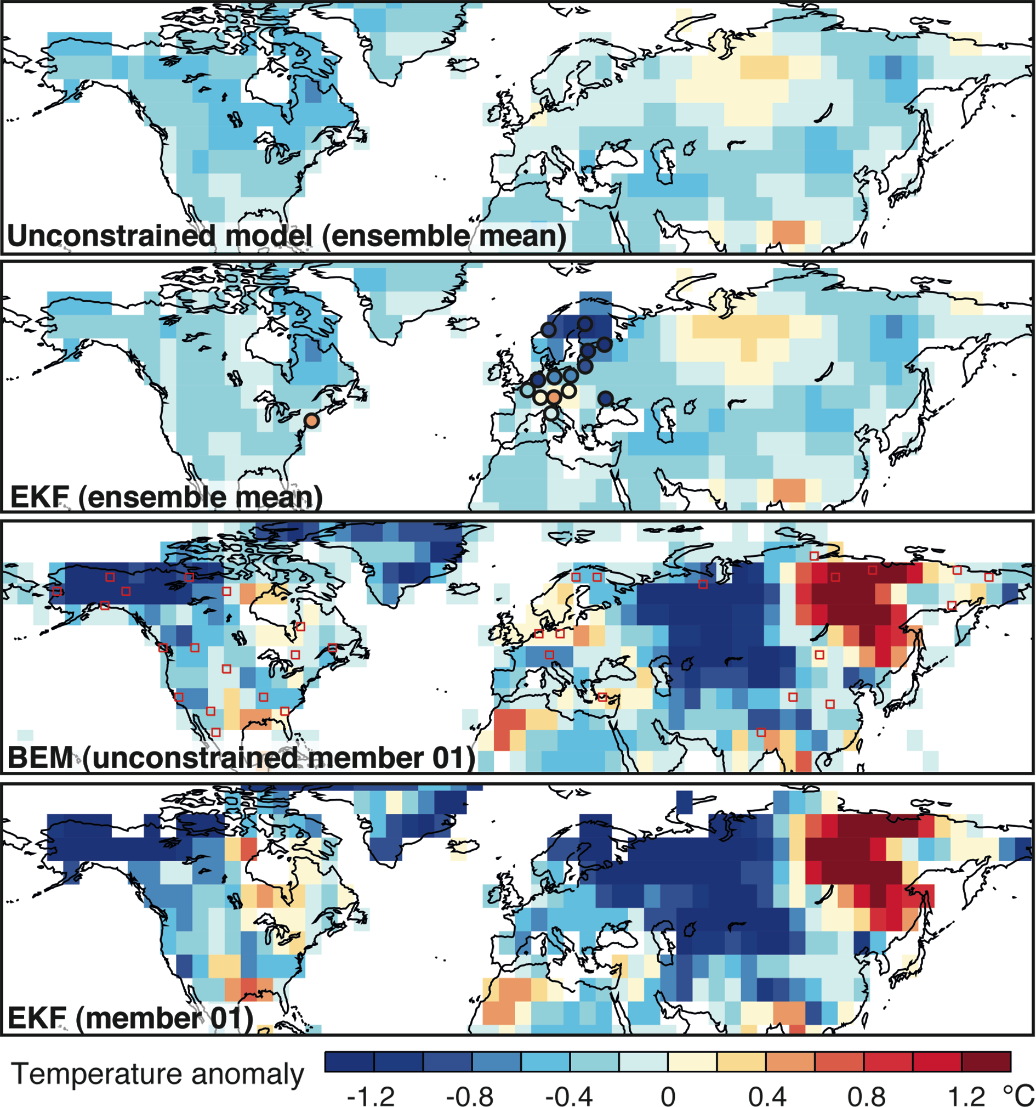
Notes:
Transient state estimation in paleoclimatology using data assimilation
Stefan Brönimann1, J. Franke1, P. Breitenmoser1, G. Hakim2, H. Goosse3, M. Widmann4, M. Crucifix3, G. Gebbie5, J. Annans and G. van der Schrier7
1Institute of Geography and Oeschger Centre for Climate Change Research, University of Bern, Switzerland; stefan.broennimann@giub.unibe.ch
2Department of Atmospheric Sciences, University of Washington, Seattle, USA; 3Earth and Life Institute and Georges Lemaître Centre for Earth and Climate Research, Université catholique de Louvain, Belgium; 4School of Geography, Earth and Environmental Sciences, University of Birmingham, UK; 5Department of Physical Oceanography, Woods Hole Oceanographic Institution, USA; 6Research Institute for Global Change, JAMSTEC, Yokohama Institute for Earth Sciences, Japan; 7KNMI, De Bilt, The Netherlands
Figure 2: Northern hemisphere temperature anomalies for April to September 1810 (relative to 1801-1830) from the unconstrained ensemble mean, the EKF ensemble mean, BEM (member 01), and the EKF analysis for the BEM member. Circles indicate locations and anomalies of the assimilated instrumental measurements; red squares the locations of tree-ring proxies.

Slide 30
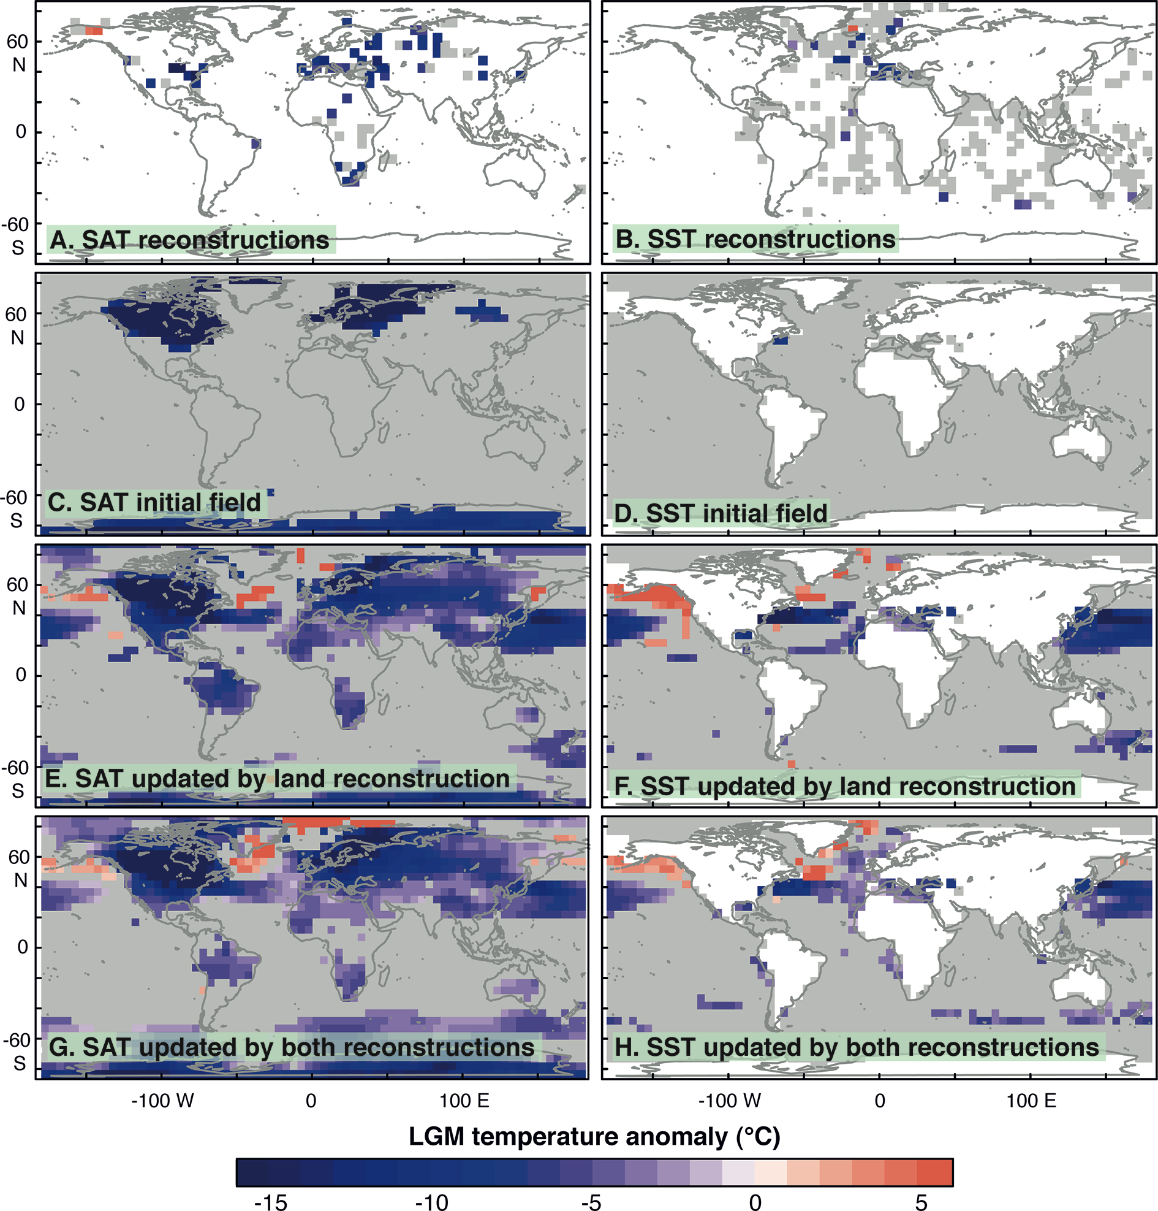
Notes:
Best-of-both-worlds estimates for time slices in the past
Tamsin L. Edwards1, J. Annan2, M. Crucifix3, G. Gebbie4 and A. Paul5
1Department of Geographical Sciences, University of Bristol, UK; tamsin.edwards@bristol.ac.uk
2Research Institute for Global Change, JAMSTEC, Yokohama Institute for Earth Sciences, Japan; 3Earth and Life Institute and Georges Lemaître Centre for Earth and Climate Research, Université catholique de Louvain, Belgium; 4Department of Physical Oceanography, Woods Hole Oceanographic Institution, USA; 5MARUM - Center for Marine Environmental Sciences and Department of Geosciences, University of Bremen, Germany
Figure 1: LGM annual mean temperature anomalies from: A) surface air temperature (SAT) reconstructions based on pollen and plant macrofossils (Bartlein et al. 2010); B) sea surface temperature (SST) reconstructions based on multiple ocean proxies (MARGO et al. 2009); C, D) simulations from the HadCM3 general circulation model (mean of 17 member perturbed parameter ensemble; Edwards, unpublished data). Data assimilation estimates generated by updating with SAT reconstructions (E, F), and both SAT and SST reconstructions (G, H). Gray areas indicate regions with low signal-to-noise: magnitude of temperature anomaly is less than 3σ of uncertainty estimates.

Slide 31
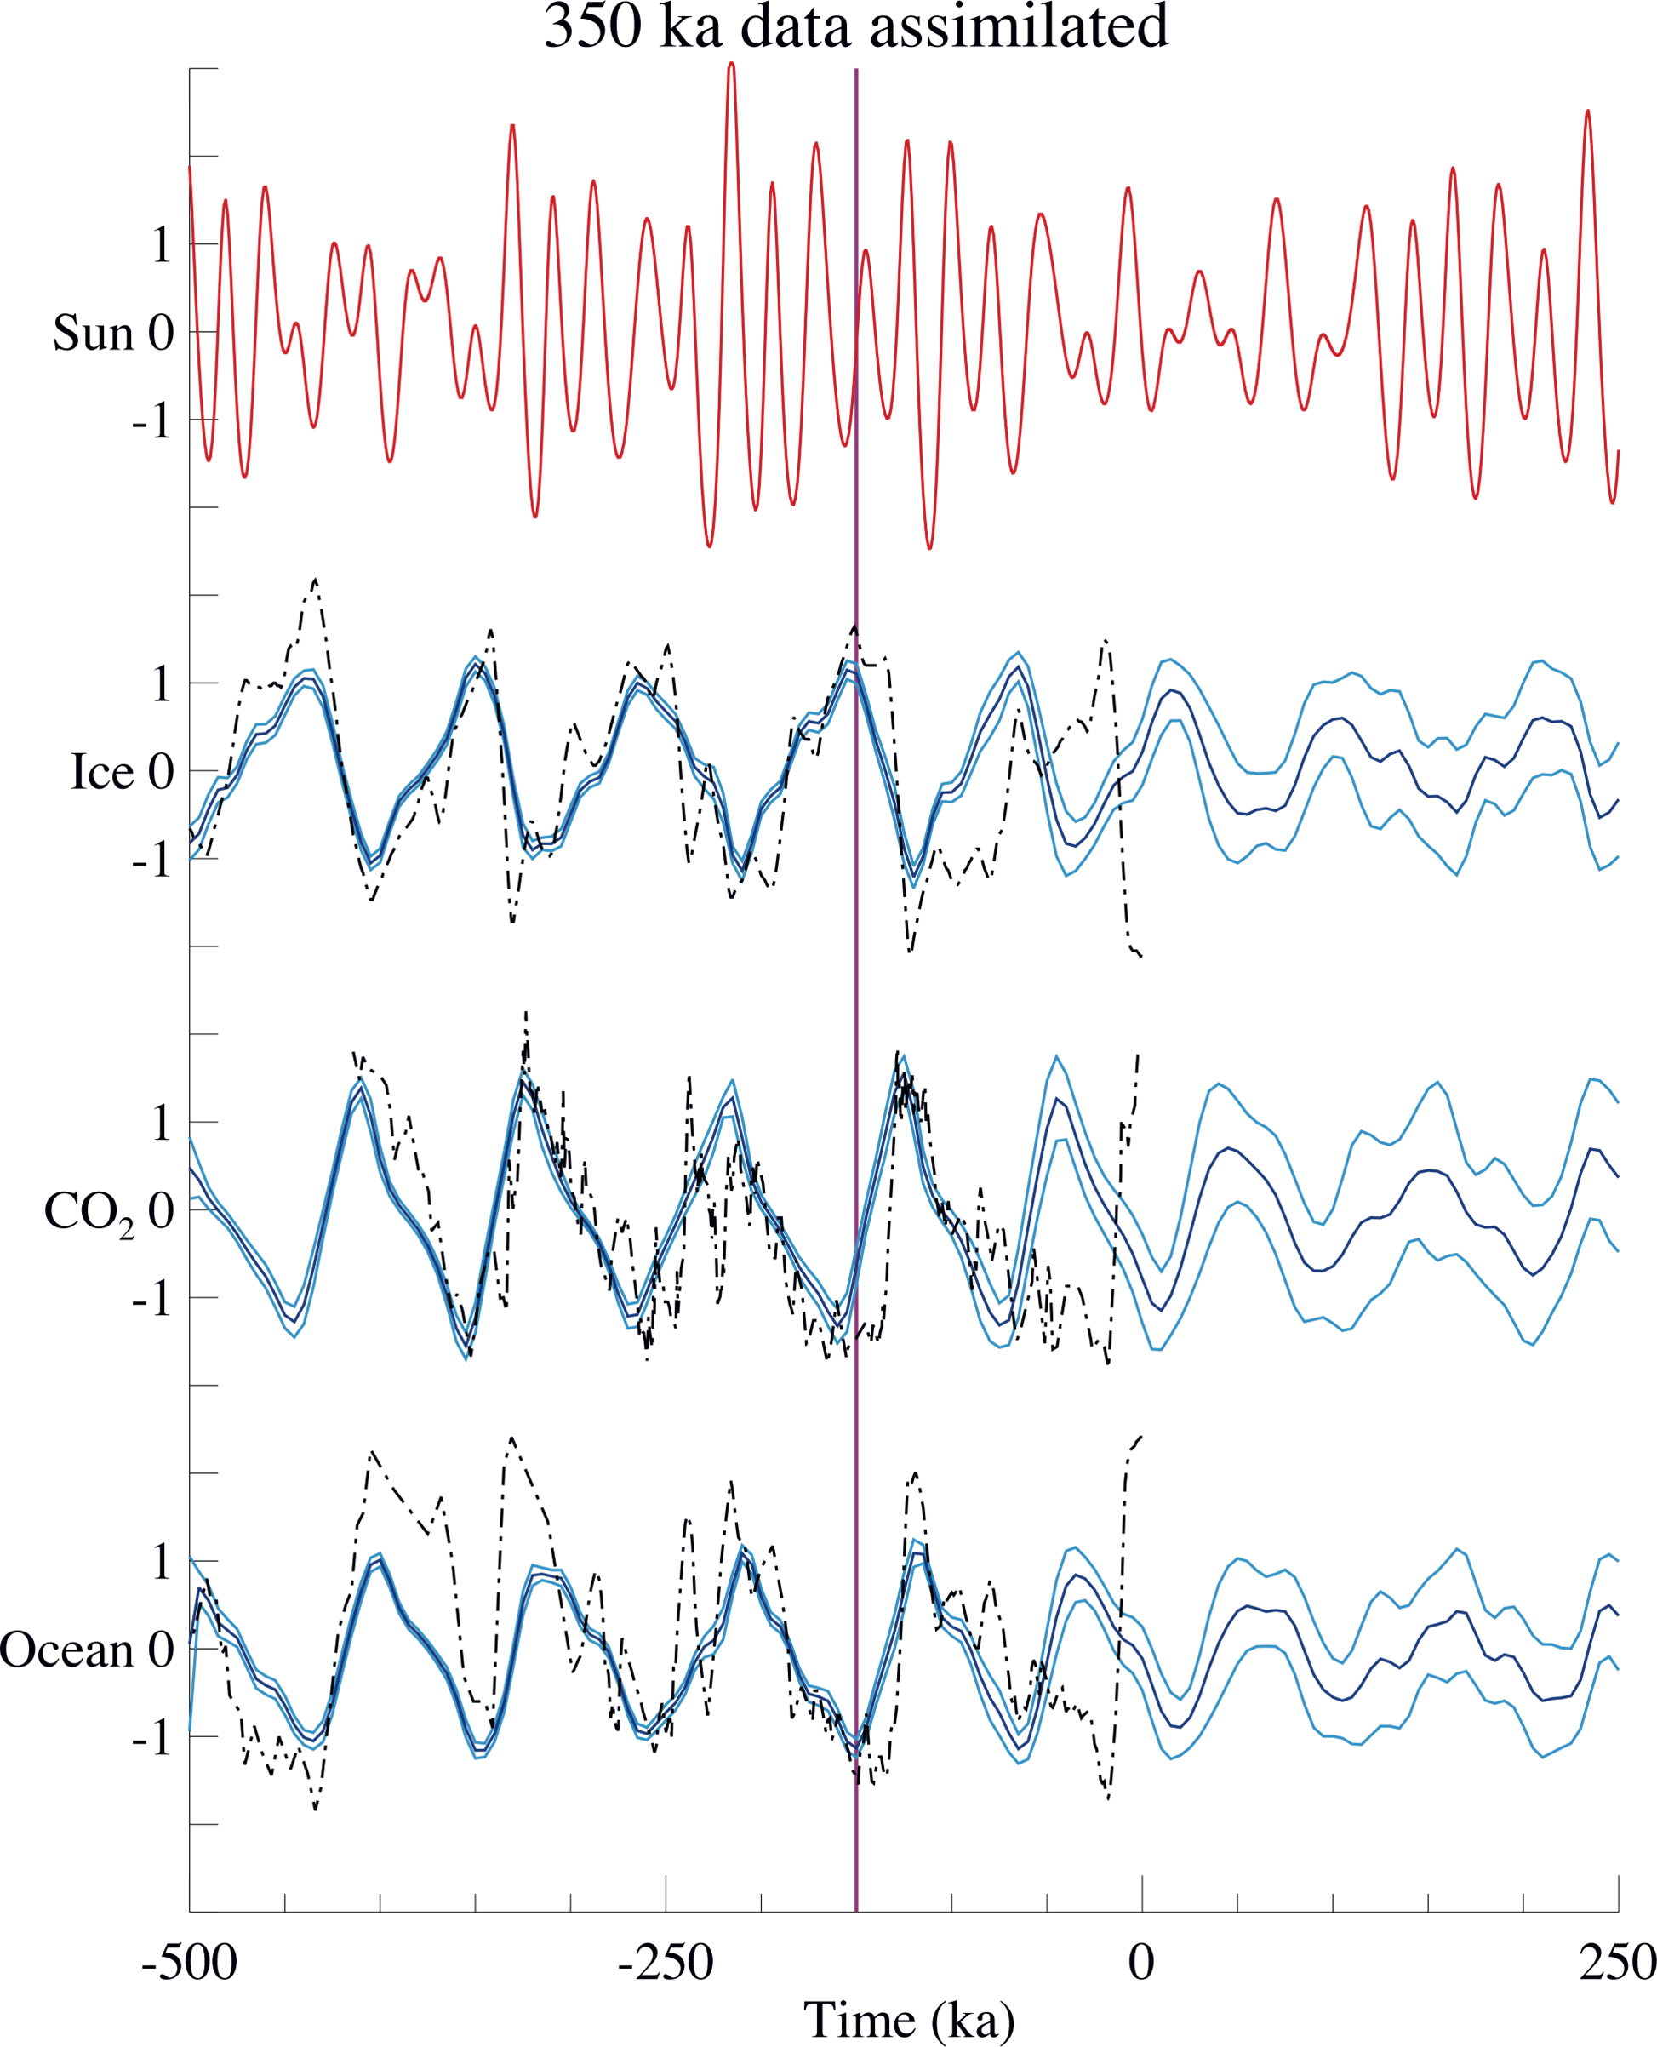
Notes:
Parameter estimation using paleodata assimilation
James D. Annan1, M. Crucifix2, T.L. Edwards3 and A. Paul4
1RIGC/JAMSTEC, Yokohama, Japan; jdannan@jamstec.go.jp
2Georges Lemaitre Centre for Earth and Climate Science, Université Catholique de Louvain, Belgium; 3School of Geographical Sciences, Bristol University, UK; 4MARUM, University of Bremen, Germany
Figure 1: Experiment with 350 ka of data assimilated. The red line at the top is the normalized summer solar insolation forcing at 65Åã N. The black dot-dashed lines are normalized proxy data from Vostok (ice volume and atmospheric CO2 concentration) and SPECMAP (deep ocean temperature) cores. Data to the left of the vertical magenta line were used to tune parameters, with the right hand side used as validation of the model forecast, which (over a range of experiments) shows substantial skill for a duration of around 50-100 ka. The dark blue lines show the mean of the ensemble and the light blue lines show one standard deviation of the ensemble. Modified from Hargreaves and Annan (2002).

Slide 32
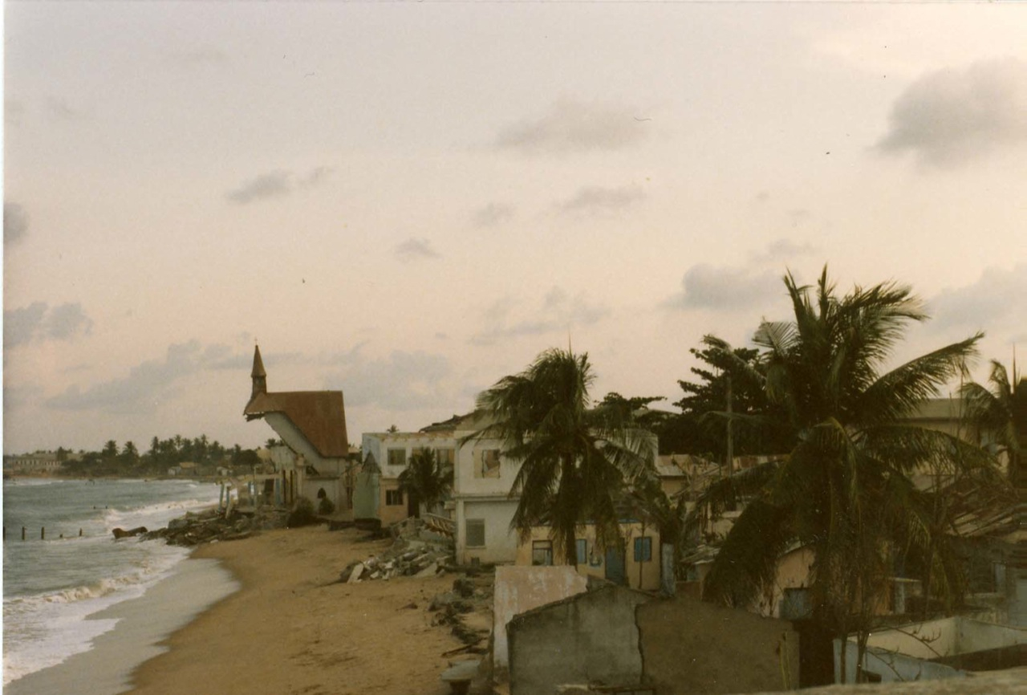
Notes:
Impact of climate and sea level change on coastal evolution
Accra, Ghana, 8-12 October 2012
Kwasi Appeaning-Addo, S.W. Laryea, B.A. Foli and C.L. Allotey
Department of Marine and Fisheries Sciences, University of Ghana; kappeaning-addo@ug.edu.gh
Figure 1: This photo from 1985 shows a section of the Keta town destroyed by sea erosion. Photo by Beth Knittle. (http://www.flickr.com/photos/38318523@N00/293700514/)

Slide 33
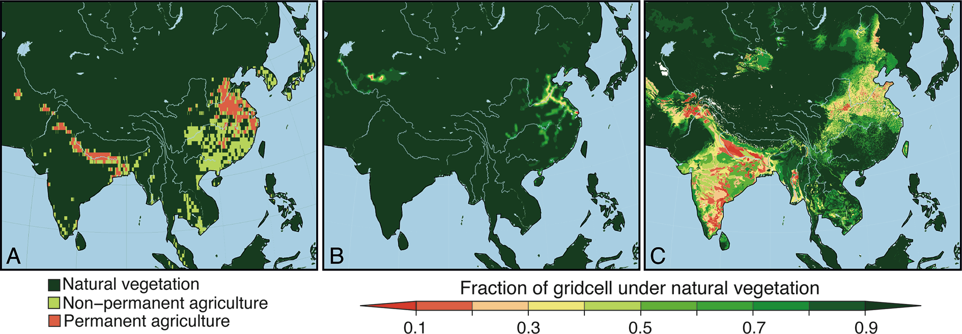
Notes:
Holocene land-cover change in Eastern Asia for climate modeling
Shijazhuang, China, October 9-11 2012
Marie-José Gaillard1 and Qinghai Xu2
1Department of Biology and Environmental Science, Linnaeus University, Kalmar, Sweden; marie-jose.gaillard-lemdahl@lnu.se
2Key Laboratory of Environmental Change and Ecological Construction, Hebei Normal University, Shijiazhuang, China
Figure 1: Global anthropogenic land use at AD 1 simulated by three different approaches: A) Olofsson and Hickler (2008); (B) HYDE (History Database of the Global Environment) version 3.1 (Klein Goldewijk et al. 2010); and (C) Kaplan et al. (2009). Note the large differences in land-cover between the different methodologies.

Slide 34
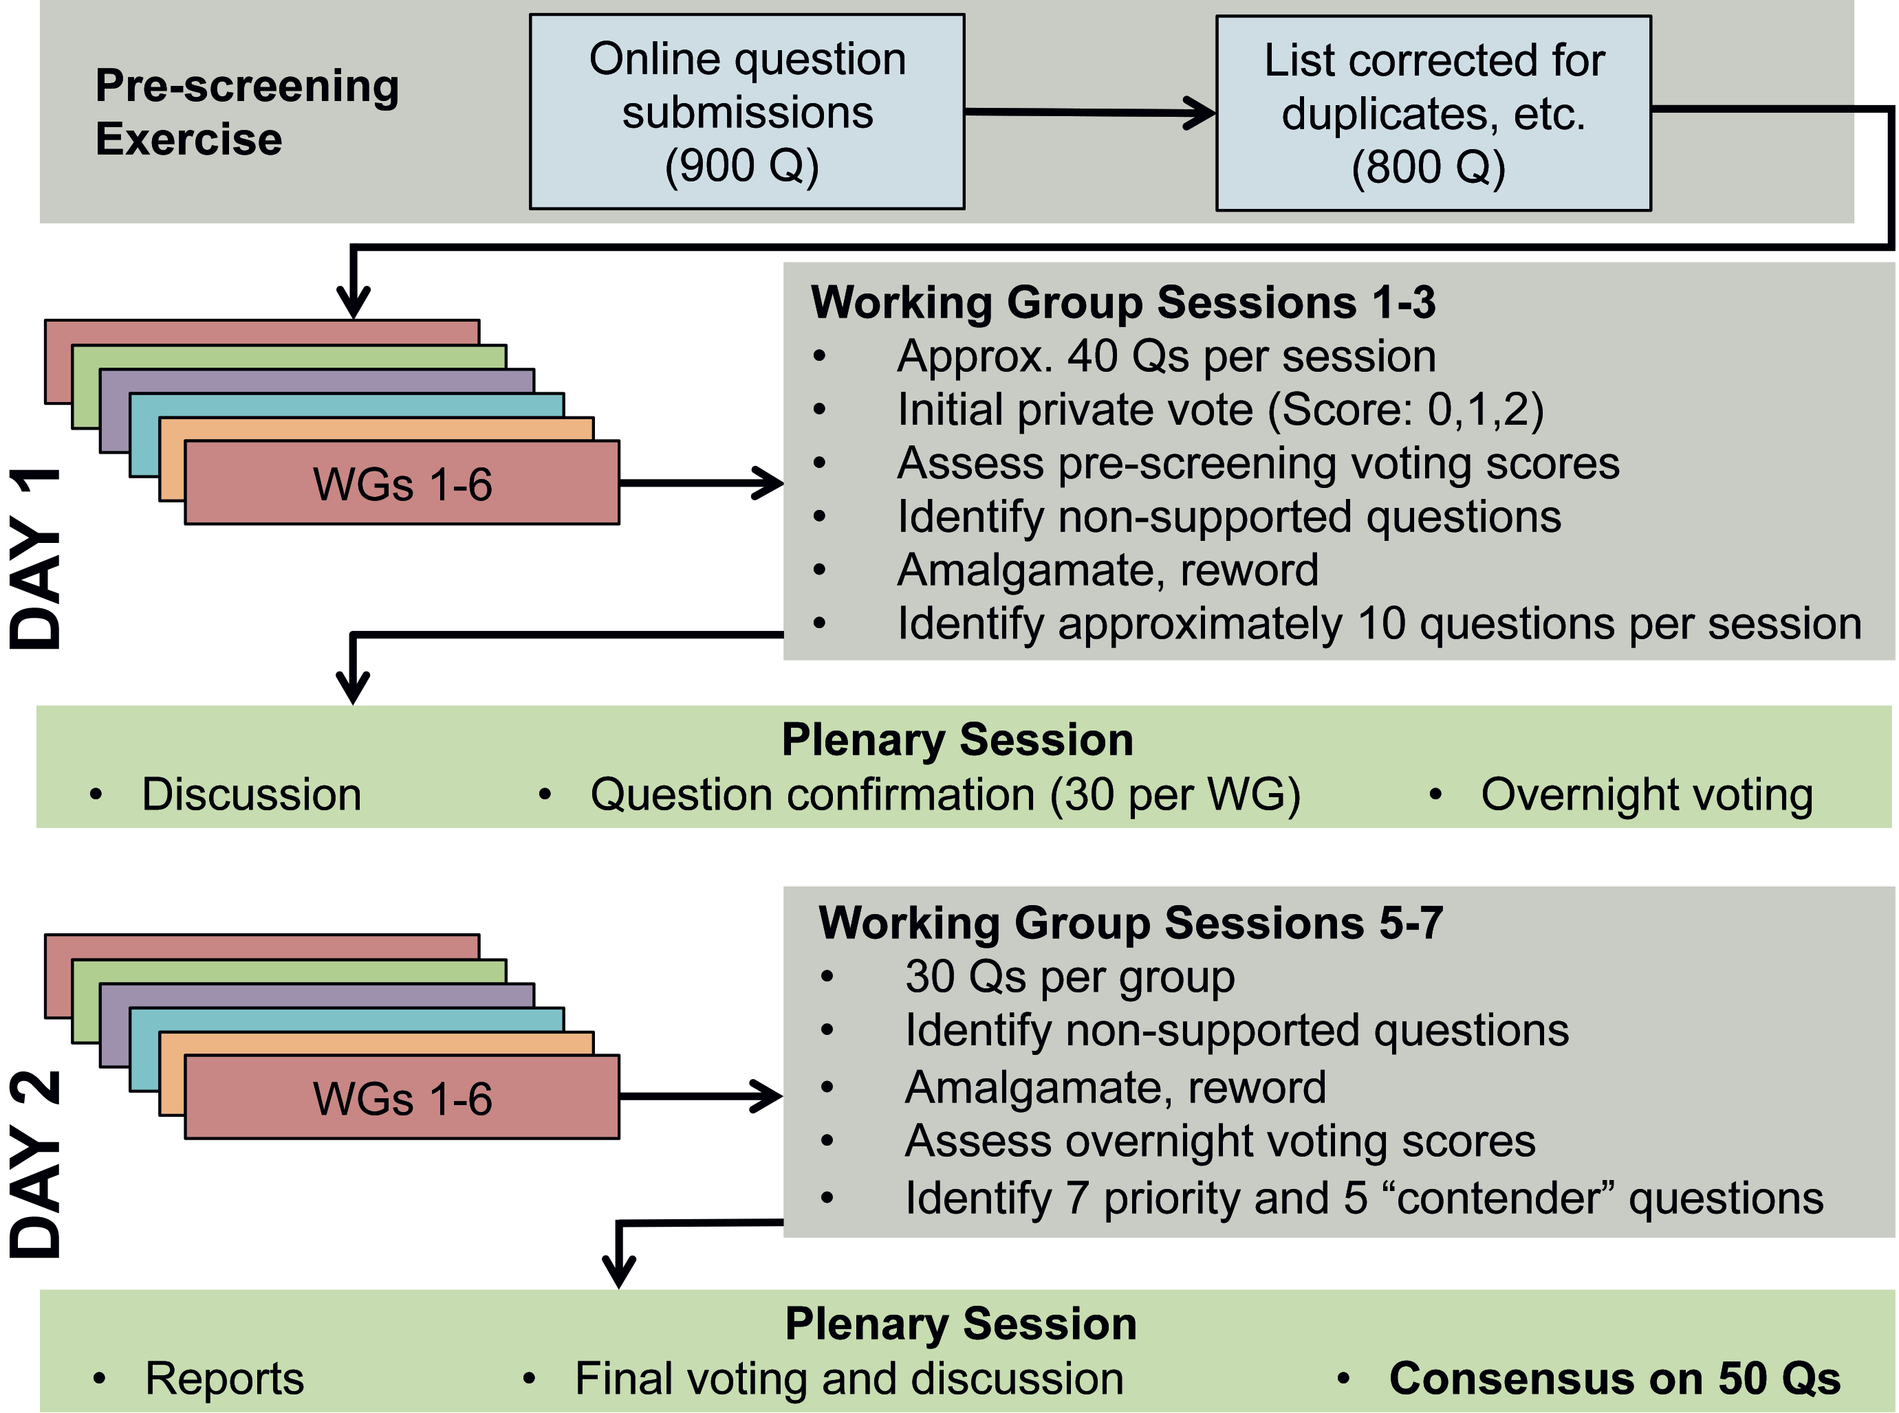
Notes:
Palaeo50: The priority research questions in paleoecology
Oxford, UK, 13-14 December 2012
Anson W. Mackay1, A.W.R. Seddon2,3 and A.G. Baker2
1Environmental Change Research Centre, University College London, UK; a.mackay@ucl.ac.uk
2Oxford Long-Term Ecology Laboratory, University of Oxford, UK; 3Department of Biology, University of Bergen, Norway
Figure 1: Flowchart of the selection process for the 50 priority research questions.

Slide 35
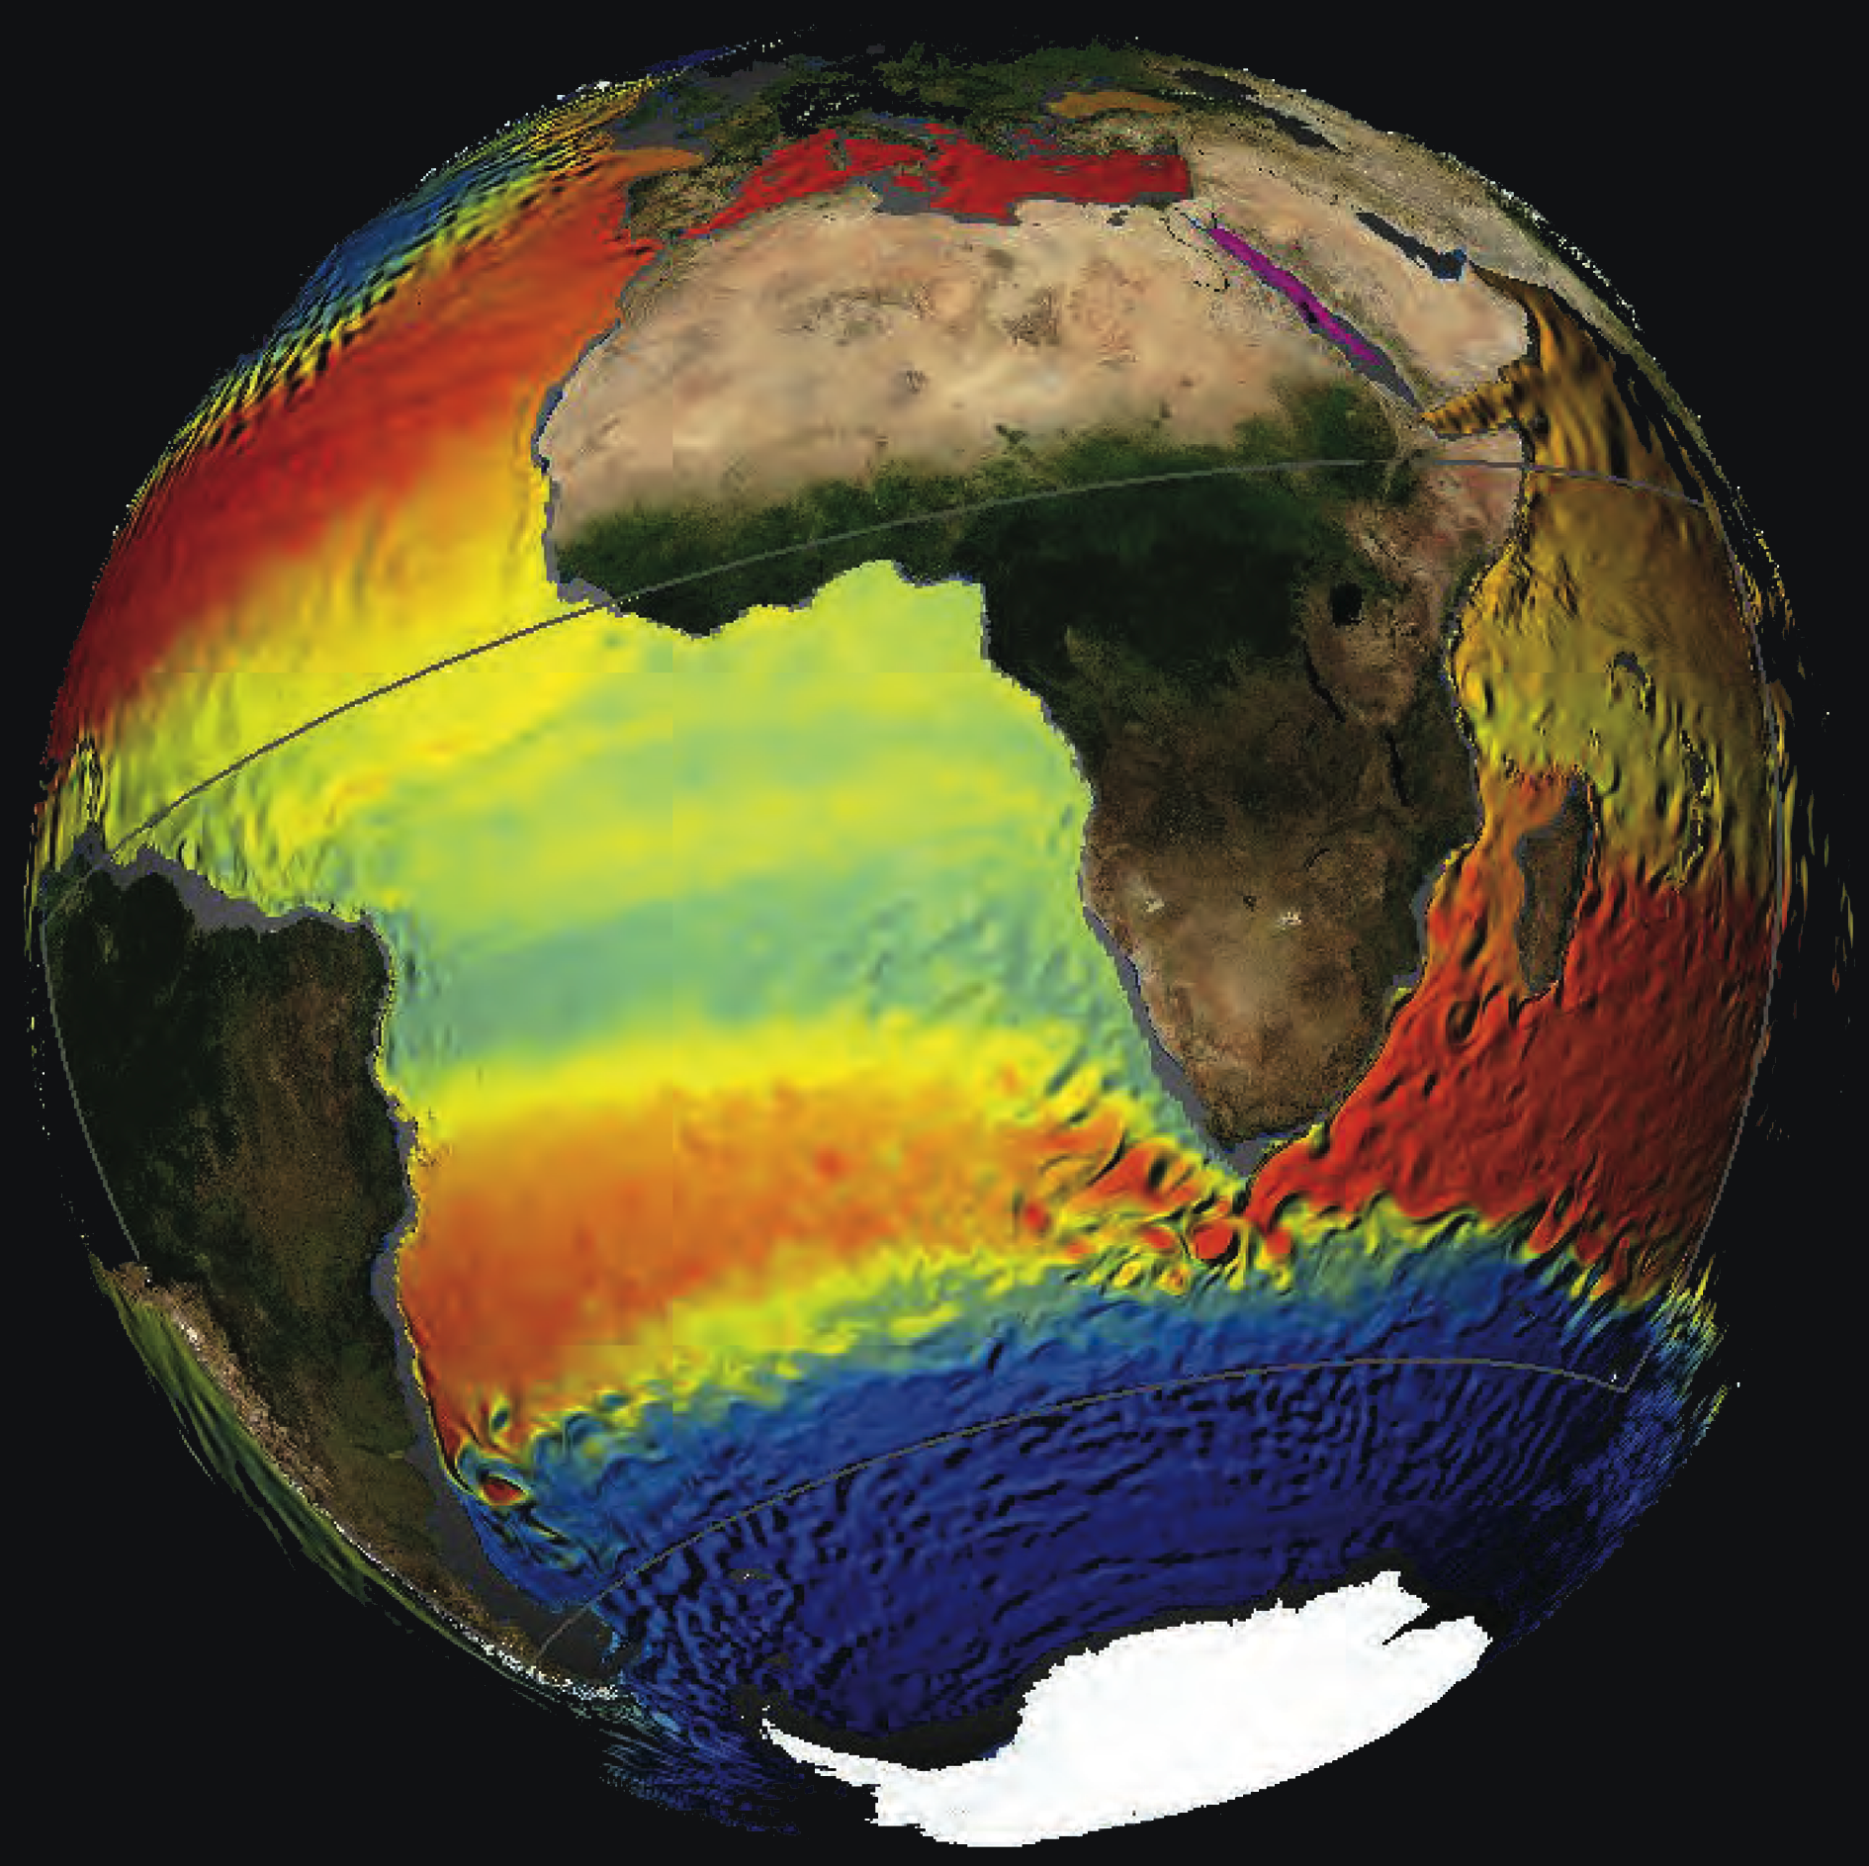
Notes:
The Agulhas System and its role in changing ocean circulation, climate, and marine ecosystems
Stellenbosch, Republic of South Africa, 8-12 October 2012
Rainer Zahn1, W.P.M. de Ruijter2, L. Beal3, A. Biastoch4 and SCOR /WCR P/IAPSO Working Group 1365
1Institut de Ciència i Tecnologia Ambientals, Universitat Autònoma de Barcelona, Bellaterra, Spain; rainer.zahn@uab.cat
2Institute for Marine and Atmospheric Research, Utrecht University, The Netherlands; 3Rosenstiel School of Marine and Atmospheric Science,
University of Miami, USA; 4GEOMAR Helmholtz Centre for Ocean Research, Kiel, Germany; 5www.scor-int.org/Working_Groups/wg136.htm
Figure 1: A model perspective of Agulhas leakage and the interbasin water transports between the Indian Ocean and Atlantic. A high-resolution Agulhas model (1/10°, gray box), is nested in a (1/2°) global ocean/sea ice model to simulate temperature and magnitude of currents (see Biastoch et al. 2009).

Slide 36
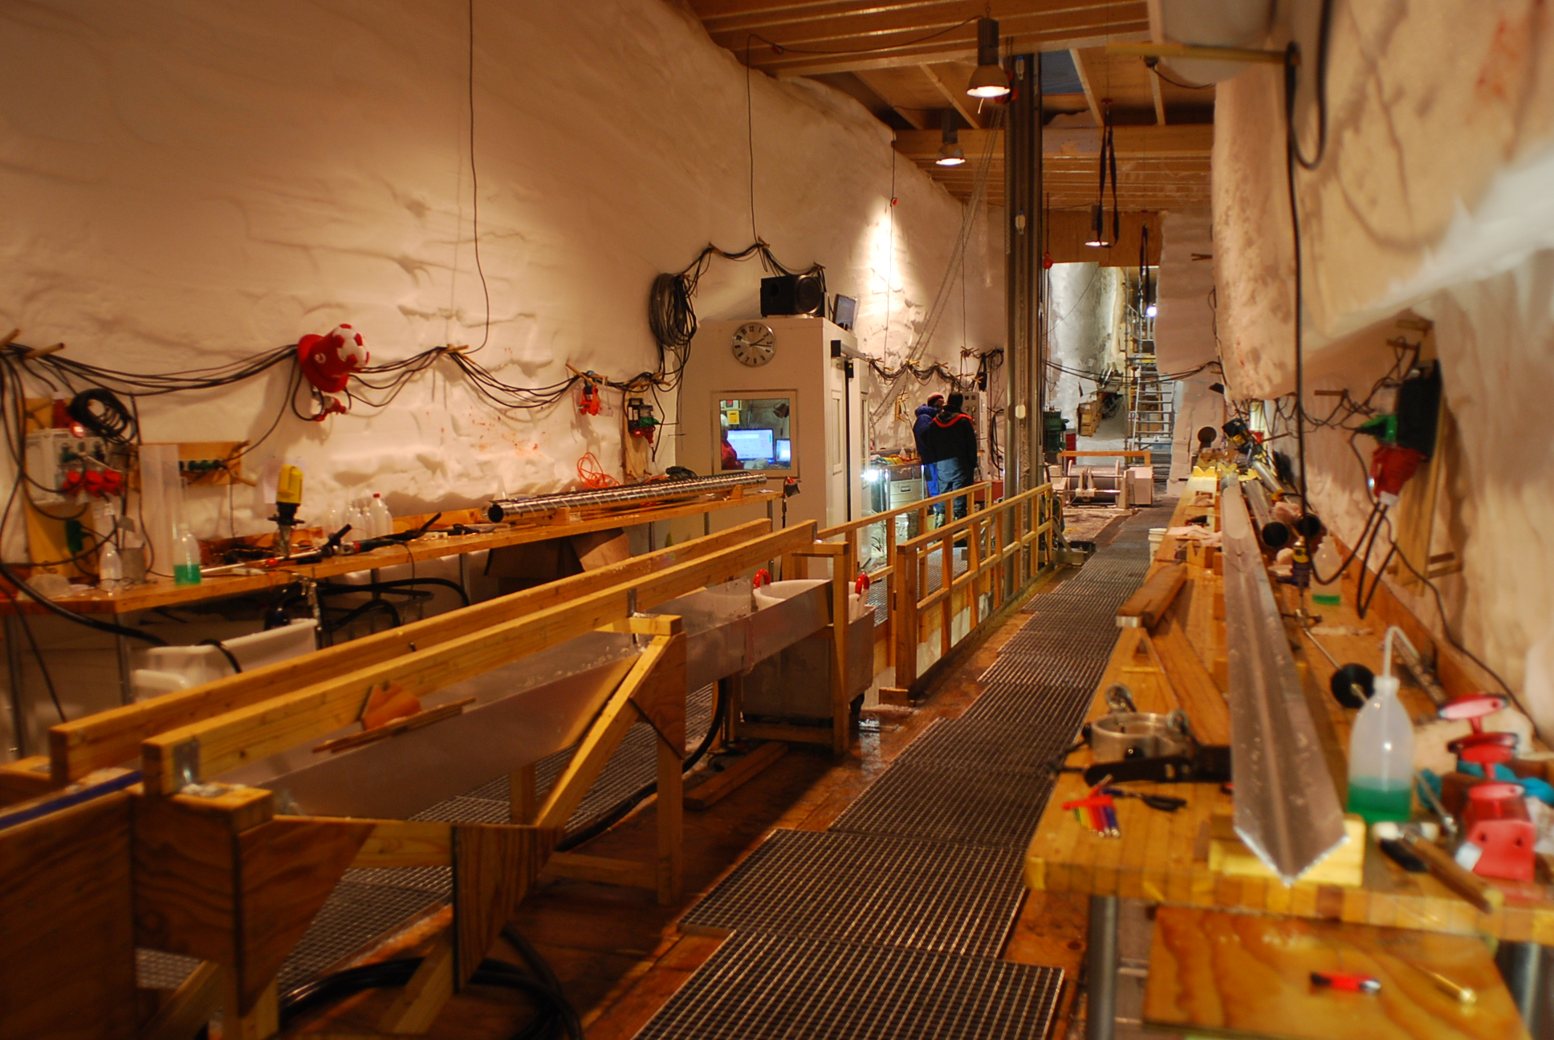
Notes:
IPICS First Open Science conference
Presqu’île de Giens, France, 1-5 October 2012
Jérôme Chappellaz1, Eric Wolff2 and Ed Brook3
1Laboratoire de Glaciologie et Géophysique de l’Environnement, Université Joseph Fourier Grenoble, St Martin d’Hères, France; jerome@lgge.obs.ujf-grenoble.fr
2British Antarctic Survey, Cambridge, UK; 3College of Earth, Ocean, and Atmospheric Sciences, Oregon State University, Corvallis, USA
Figure 1: Inside the drilling trench at NEEM, Greenland. The North Greenland Eemian (NEEM) ice drilling is an international project managed by the Centre for Ice and Climate, Denmark, involving 14 nations. In Summer 2010, it recovered ice from the Eemian dating back from 130 ka BP, helping to describe the warming and ice sheet shrinking at a time of unusually high Arctic summer insolation (NEEM community members 2013). Photo: Jérôme Chappellaz.

Slide 37
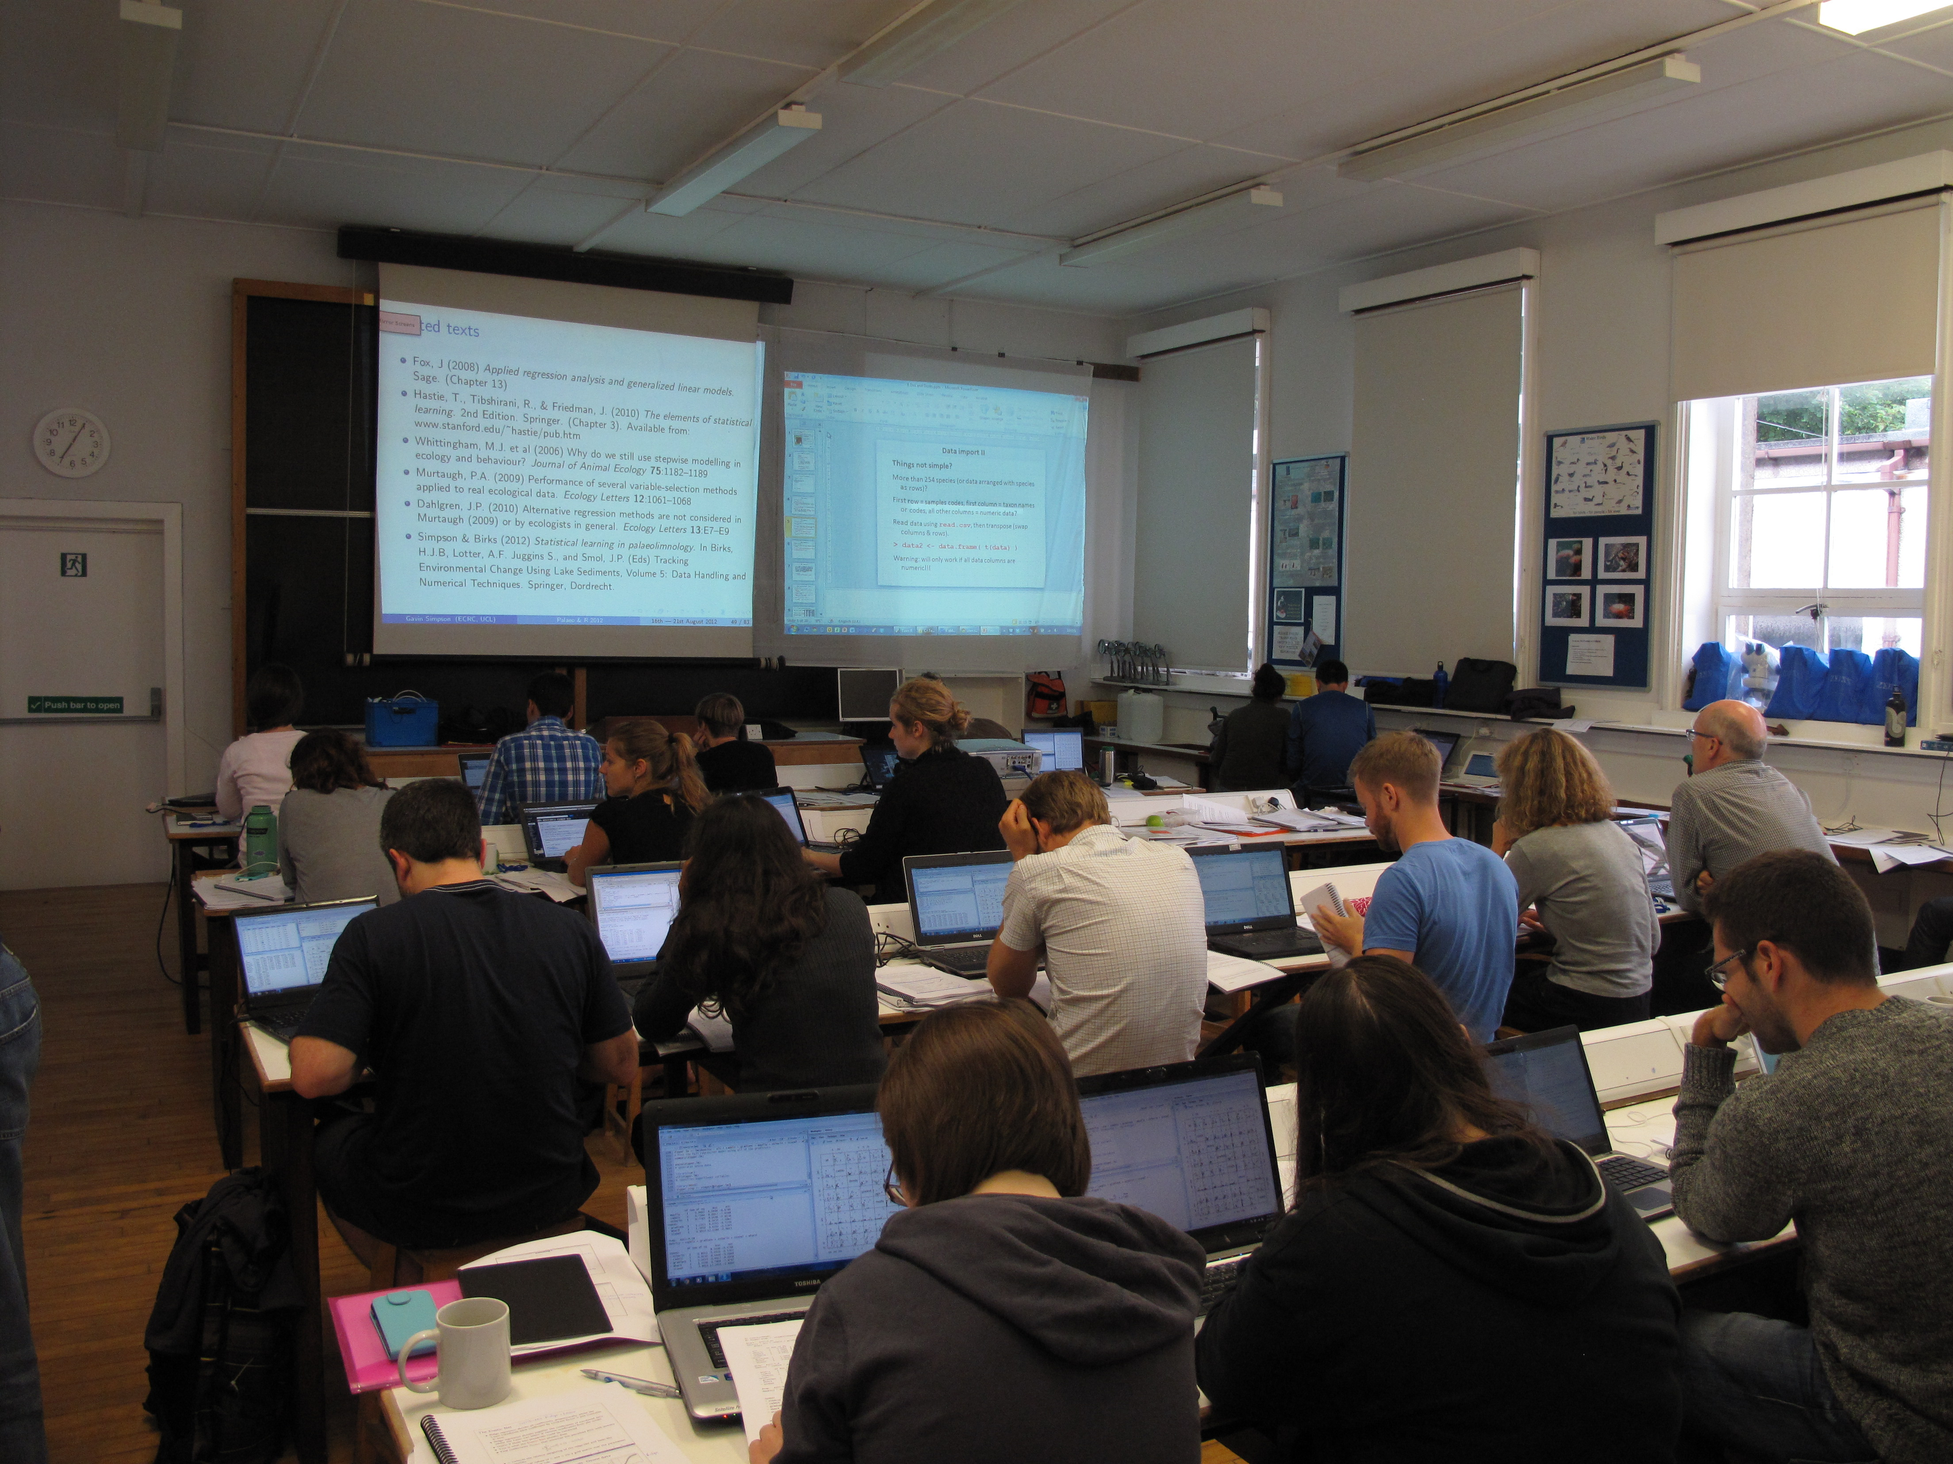
Notes:
Analyzing paleolimnological data with R
Isle of Cumbrae, Scotland, 16-20 August 2012
Diego Navarro1 and Steve Juggins2
1Instituto de Investigaciones Marinas y Costeras, CONICET, Universidad Nacional de Mar del Plata, Argentina; dnavarro@conicet.gov.ar
2School of Geography, Politics and Sociology, Newcastle University, Newcastle upon Tyne, UK
Figure 1: Participants during the R workshop. Photo by S. Juggins.

Slide 38
Notes:
The Sun and its role in climate change
Workshop of the PAGES Solar Working Group – Davos, Switzerland, 5-7 September 2012
Juerg Beer
Swiss Federal Institute of Aquatic Science and Technology (Eawag), Dübendorf, Switzerland; beer@eawag.ch
Figure 1: Image of a solar magnetic filament burst. Image by NASA.

Slide 39
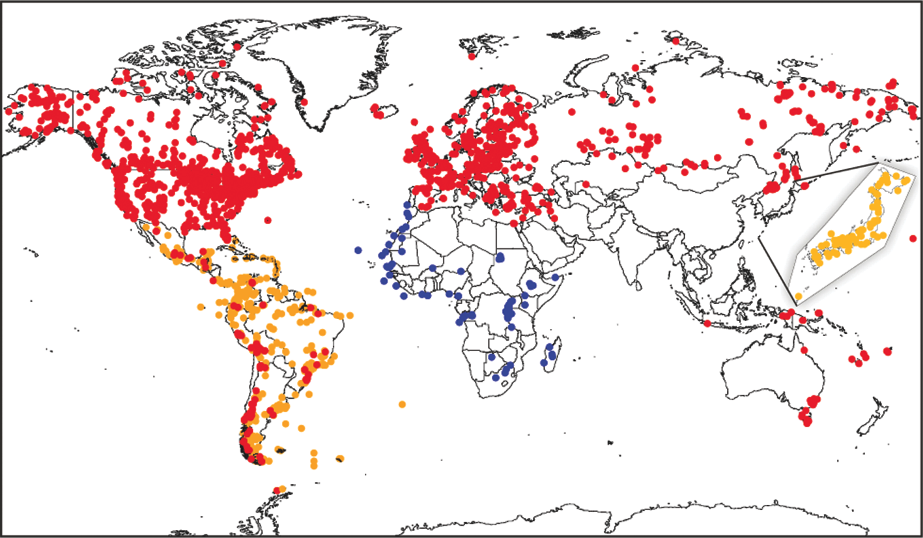
Notes:
Updated Latin American Pollen Database: Version 2013 in preparation for NEOTOMA
Suzette G.A. Flantua1,2, H. Hooghiemstra1, E. Grimm3 and V. Markgraf4
1Institute of Biodiversity Ecosystem Dynamics, University of Amsterdam, Netherlands; s.g.a.flantua@uva.nl
2Palinología y Paleoecología, Universidad Los Andes, Bogotá, Colombia; 3Illinois State Museum, Springfield, USA; 4Institute of Arctic and Alpine Research, University of Colorado, Boulder, USA
Figure 1: NEOTOMA and LAPD pollen sites. Red dots: existing NEOTOMA database; blue dots: African Pollen Database; yellow dots: inventoried sites for inclusion from Latin America and Japan. (Figure from Grimm et al. 2013).

Slide 40
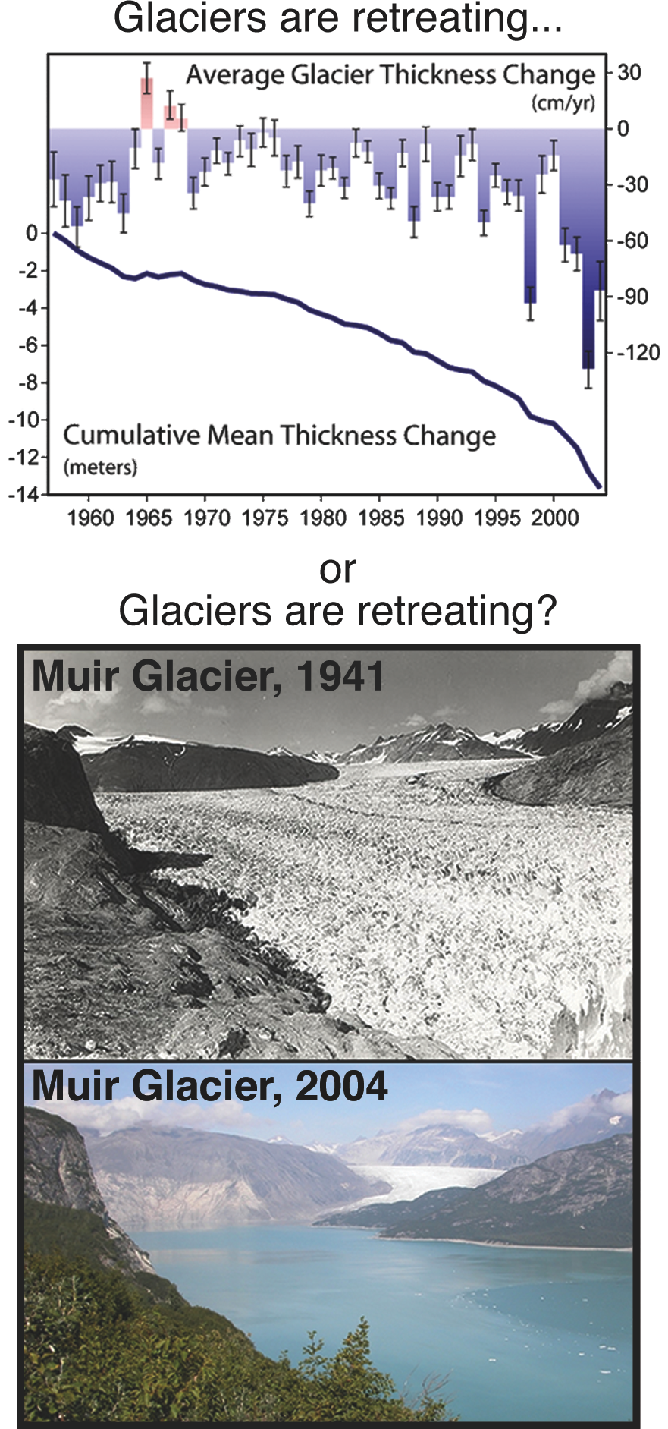
Notes:
The Art of Communicating Science: traps, tips and tasks for the modern-day scientist
Heidi Roop1, G. Martínez-Méndez2 and K. Mills3
1Antarctic Research Centre, Victoria University of Wellington, New Zealand; h.roop@gns.cri.nz
2MARUM Center for Marine Environmental Sciences, University of Bremen, Germany; 3Department of Geography, Loughborough University, UK
Figure 1: The use of imagery is an effective way to convey messages to the general public. Which illustration would you choose for a public lecture? Image sources: US National Snow and Ice Data Center.

Slide 41
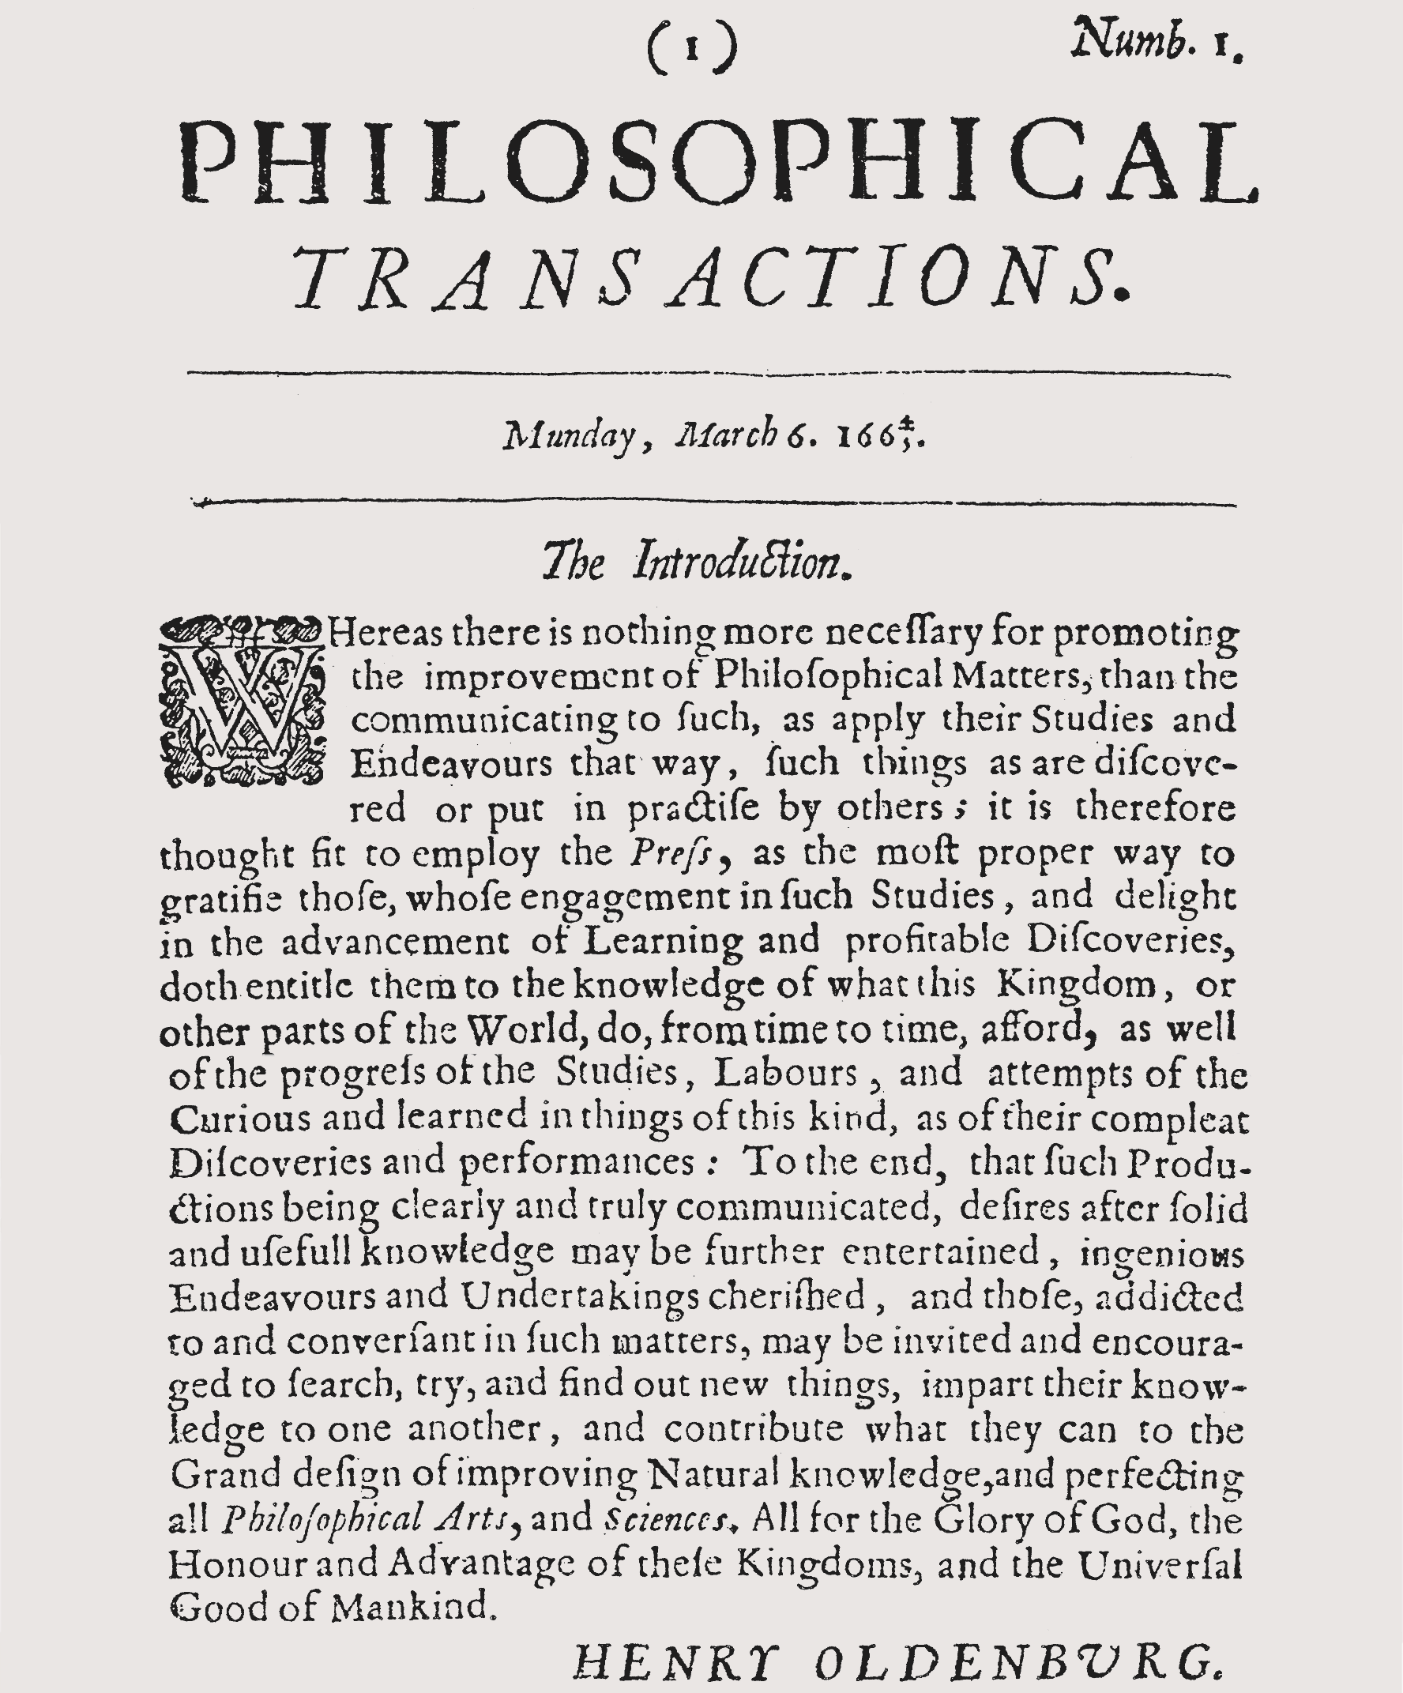
Notes:
The Art of Reviewing: Holding up quality in the scientific quality control system
Rajani Panchang1, A. Govin2 and C. Omuombo3
1Geology & Palaeontology Group, Agharkar Research Institute, Pune, India; rajanipanchang@gmail.com
2MARUM Center for Marine Environmental Sciences, University of Bremen, Germany; 3Department of Geology, University of Nairobi, Kenya
Figure 1: Introduction by Henry Oldenburg to the first issue of the Philosophical Transactions of the Royal Society (Oldenburg 1665).

Slide 42
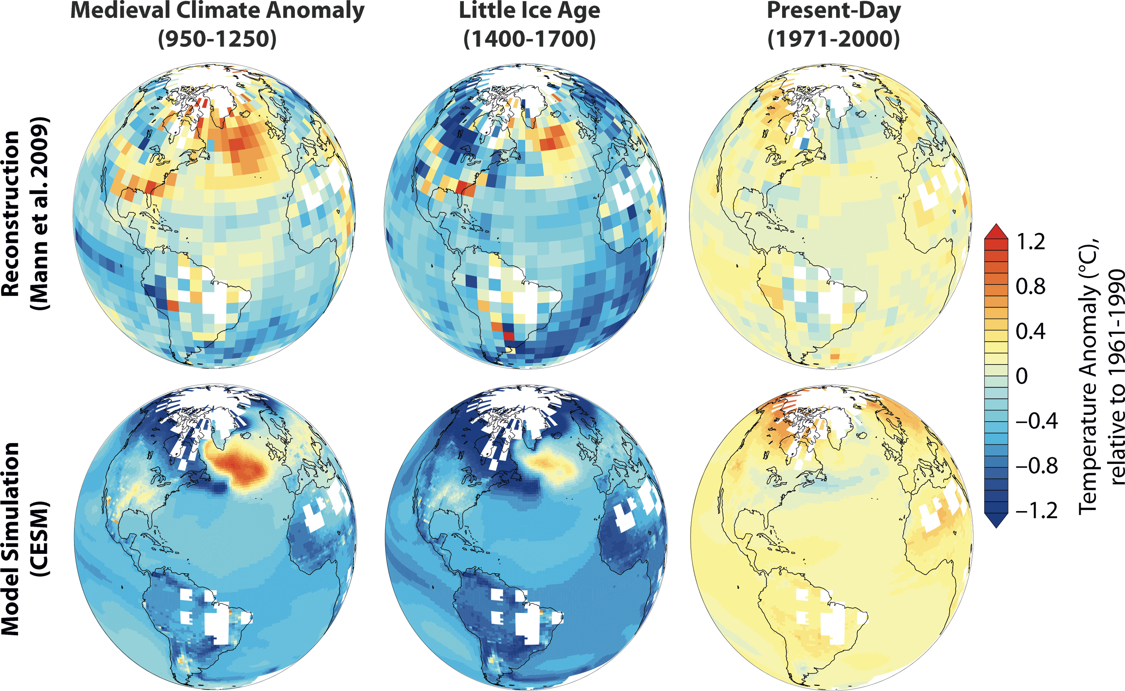
Notes:
The Art of Data Sharing: key in future climate science
Aurora Elmore1, F. Lehner2 and J. Franke2
1Department of Geography, Durham University, UK; aurora.elmore@durham.ac.uk
2Oeschger Centre for Climate Change Research, University of Bern, Switzerland
Figure 1: Sharing and combining data and model simulations allows for a better understanding of past climate variability. Temperature anomalies relative to 1961-1990 in a reconstruction (Mann et al. 2009) and a Last Millennium simulation with a comprehensive coupled model (Community Earth System Model). White areas indicate no reconstruction data; the same areas have been masked in the model output for comparability.

